Slide 1
From Ansible to Nornir: sailing from a network engineer’s comfort zone

Slide 2
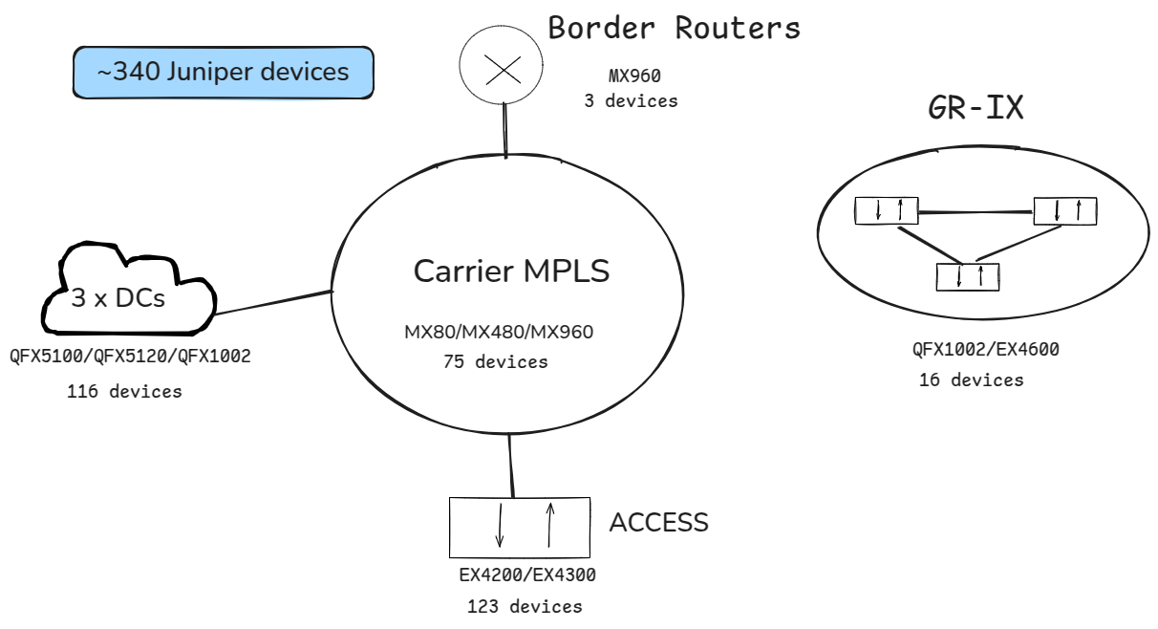
Network architecture
Notes:
Before we start comparing the tools and show our migration journey we should look, what our automation pipelines are used for. We produce full configuration commands for ~340 devices of different
- device_type
- device_role
And deliver services inside each network entity as well as across different network entities

Slide 3
Our Pipeline
Notes:
Our pipeline consists of 3 main parts. First we retrieve data from different APIs, mainly netbox (as we are also trying to make it our only source of truth) plus some other tools like IXP manager and some inhouse dbs. Then we generate the config using a combination of the retrieved information and static information. Finally we check the configuration to the device, compare running config with the candidate one and commit it. All this happens through a single pipeline without having to differentiate depending on device type or device.

Slide 4
Ansible
Ansible is an open source IT automation engine that automates provisioning, configuration management and other IT processes.
It is based on the inventory concept (consisting of hosts), roles (basically grouping for the hosts) and tasks which are the building blocks of every ansible script, called a playbook.
Notes:
I know many of you already know or use Ansible as your automation pipeline tool, but for those who don't we ll just say a few words about it.
Ansible is an open source IT automation engine that automates provisioning, configuration management and other IT processes.
It consists of an inventory aka the hosts ( in our case network devices ), roles and tasks. Tasks are building blocks that do simple operations such as save a variable, parse a json or do an api call. Roles are basically grouping for tasks.

Slide 5
What is Ansible great for
Abstracts teams from the underlying python
Provides multiple built-in functionalities
Is open-source
It is widely-adopted, maintained and updated frequently
Notes:
What is ansible great for
Ansible abstracts teams from the underlying python and gives many builtin functions and utilities such as error handling or sending email reports.
It is developed and maintained by an open-source community and it is also widely adopted in the industry.

Slide 6
Ansible is great … until you want something more
Development speed: simple tasks need dozens lines of code and many intermediate unnecessary steps
Execution speed: jinja rendering, connection to devices are all sequential and take too long to execute. We need a few hours to execute our workflow for the whole network
Pray that something doesn’t go wrong: Finding out what is wrong, with ansible builtin error handling is challenging to say the least, and debugging is even harder
Adding new functionality: You have to write your own python code and import it, say goodbye to abstraction
Notes:
Ansible is great until you want something more...
Development speed:
Even simple things such as parsing a json or writing a for loop, might need many tasks and dosens of lines of code. intermediate tasks are needed to save variables (might include a task that shows how much is needed to save a variable) and all these while constantly having to check the documentation to use the appropriate function calls.
Pray something doesn't go wrong:
Your task didn't do what you thought it should do? good luck finding out why. adding debugging print statements pauses etc is a struggle, and together with the abstraction of task execution is really confusing sometimes. Even finding out where a variable is defined can be a struggle.
Adding new functionality:
You wish to do something that is not builtin in ansible?
you can write it in python and import it using a unique set of python calls and class creations. So the thing that ansible was supposed to abstract you from, can't be abstracted no more.
Actual speed:
Running our pipeline for all the devices in our network could take a few hours. And this without any error to the process (connection issues) or a configuration error in a device.
In our case, this caused many devices to have old configs

Slide 7
Ansible is great … until you want something more
Code integration: other tools or python scripts your team might use can not be so easily integrated
Has its own syntax you must learn and get comfortable, thus knowledge is not transferable to other tools or even field
Notes:
It is also very hard to integrate it with existing python scripts or use it to retrieve data from many devices to use it lets say for a database migration or a bulk upload. Its unique syntax is also another thing you have to get comfortable with, a skill that doesn’t really transfer to anything else.

Slide 8
One language to rule them all
Since more engineers are comfortable with python nowadays, why not use it for everything. We already use it for:
Ci-cd pipelines
Database migration scripts
Monitoring-report scripts
Notes:
In the world of IT python is widely use for scripting, database API calls, migrations, ci-cd pipelines etc. While it is really slow for high computational tasks, it is perfect for fast development, it’s easy to use, and has a huge amount of useful libraries and is quite fast when dealing with async operations such as remote command execution(talking to network devices) or api calls

Slide 9
Nornir
Nornir is an automation framework written in python to be used with python.

Slide 10
Nornir design
Also works with the concept of inventory and tasks. It has a few available inventories such as simple inventory (hosts in a static file) or netbox inventory (dynamic from netbox)
Abstracts the multithreading aspect of connections
Abstracts the inventory handling
Supports many plugins, static and dynamic inventories
Notes:
It works similarly to ansible as it also uses the inventory and task concept. It abstracts the multithreading aspect of remote code execution . It supports many plugins from static inventories (hosts in a static file) to dynamic inventories such as netbox(the one we use).

Slide 11
So why Nornir?
Fast speed, due to multithreading
Pure python, can integrate other scripts and pipelines easily
Can take advantage of simple APIs from other tools and services
Ease of adding new functionality
Maintainability
Easy debugging
Verbose custom error handling
Fast development speed
Notes:
As you will see later nornir is a lot faster, due to multithreading. For up to a certain number of hosts which i believe to be in the realm of hundreds and maybe thousands nornir basically has the same execution speed(for a large amount of devices cpu heave tasks such as jinja rendering start to affect the time speed a bit). It is also really good for integrating it with existing python code. For example we used it for a database migration where we wanted to retrieve vlans from all our carrier and access switch devices and post them to netbox. This part would need a lot of time if done in a serial manner or it would need a lot of time to write a multithreading library wrapper for netmiko/napalm connections (basically rewriting the core part of Nornir). Nornir is also very easy to add new functionality,(Just write your normal python libraries and import it like a normal python module), maintain, and add your own verbose error handling. Finally it is much faster to develop than Ansible and much much easier to debug.

Slide 12
Great power comes with great responsibility
What Nornir doesn’t do well? Well it’s up to you…
With nornir, your configuration management pipeline, is now a software engineering project.
You need to establish coding standards
You need to create much of Ansible’s built-in in libraries yourself (vault,email etc)
When libraries update, things will break more often
Notes:
What Nornir doesn’t do well? Well it’s up to you… You need to establish coding standards, it will need a lot more code writing from your team so QOL rules should be established such as commenting, defining variable types and function return types, creating custom errors and error handlers. Some things might break when libraries update, and there won’t be an open-source community solving those. Also a lot of builtin ansible libraries don’t exist in nornir so you either have to find alternatives or create your own replacements

Slide 13
What we had to do to prepare for the migration
We got a nornir course, many of our team members started to experiment for the first time with coding
We setup a ci-cd pipeline to mirror changes done to Ansible, to Nornir while Ansible was still in production
We had to update our pipelines and cronjobs to include Nornir for testing purposes
Notes:
We got a nornir course, and many members of our team started to experiment for the first time with some coding. We also had to setup a ci-cd pipeline between the two repos, because while nornir was in development and testing stages ansible was still being used as our production pipeline. So changes being made to the ansible static files should be mirrored to nornir repo. Thankfully we designed the transition so the static files had a 1 to 1 representation to the new repo. Finally we had to update our pipelines and cronjobs to use nornir.

Slide 14
Problems we faced
General:
Getting the team familiar with contributing to a python project, creates a new barrier between members familiar with coding and not
Technical:
Connection issues: paramiko/netmiko/napalm issues, ssh issues
Handle errors ourselves: needed to do custom text parsing in netmiko replies to identify issues
Wrote our own inventory Plugin, because we needed custom grouping for our hosts
Notes:
Software engineering is something new for the world of network engineering and as teams can benefit more from automation, they also need to adapt to the new challenges. For many of our team members it was the first time having to write code, which of course was challenging. Ansible tasks and the way playbooks are structured are a bit more readable than python for the inexperienced eye.
We faced some issues handling connections to devices. More specifically some older devices didn’t function properly when connecting with napalm, so we had to switch to netmiko. While napalm abstracts some of the device commands netmiko doesn’t and we had issues handling errors. Also netmiko returns everything as text, there is no option for json, thus needing custom text parsing for each different command. We also had to write our one Inventory Plugin to extend NetboxInventory as we needed custom grouping of hosts.

Slide 15
Comparison inventory/tasks
Ansible
Netbox inventory
Jinja2 templates
Ansible tasks
Per device execution
Host_vars, group_vars
YAML files
Nornir
Netbox inventory plugin
Jinja2 templates
Nornir tasks / Python functions
Per device execution
Host_vars, group_vars (we made our own plugin for that)
YAML files / JSON ouput
Notes:
As you can seen, the way Nornir handles inventory is almost identical to Ansible, you basically transition from playbooks to scripts and tasks to Nornir tasks or python functions. We use Jinja templates to render the configuration in both tools.

Slide 16
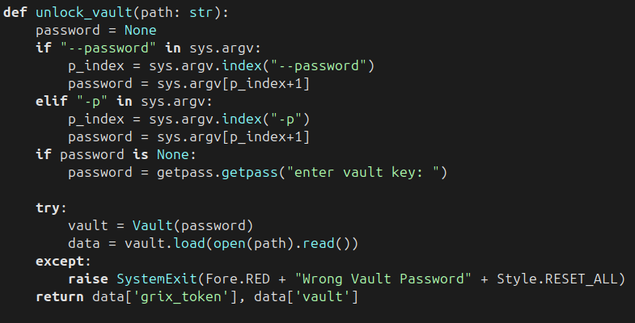
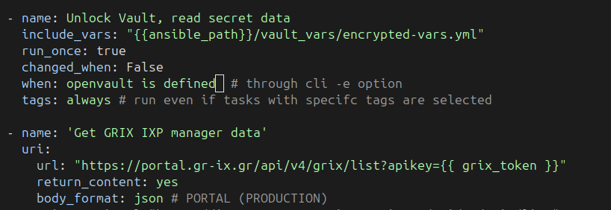
Tasks vs Functions

Slide 17
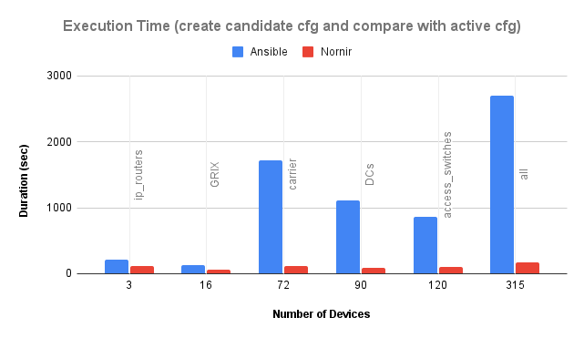
Speed comparison
Notes:
As you can see with Nornir(in red) execution time is mostly identical. This is only for creating the config and compare it with active config, not even committing it to the device. The difference between Nornir and Ansible is huge, what used to take a few hours now takes, a few minutes.

Slide 18
Thank you
Useful links:
https://nornir.readthedocs.io/en/latest/
https://github.com/wvandeun/nornir_netbox
My email:
panoskostopoulos@noc.grnet.gr

