Slide 1
What’s new on PeeringDB?
Livio Morina – Vice President of PeeringDB
livio@peeringdb.com
R1
Notes:
Presentation: who am I?
How many people do not know or do not have a record on PeeringDB?
What is PeeringDB? Its a directory of information related to peering including sites, networks, internet exchanges and other useful information (unique voltage offerings, contact information and other data)

Slide 2
What is PeeringDB?
Mission statement: “PeeringDB, a nonprofit member-based organization, facilitates the exchange of user maintained interconnection related information, primarily for Peering Coordinators and Internet Exchange, Facility, and Network Operators.”
A PeeringDB record makes it easy for people to find you, and helps you establish peering
If you aren’t registered in PeeringDB, you can register at https://www.peeringdb.com/register
We use basic verification for new accounts and require current Whois information, so please
  Update and maintain your Whois information
  Register from an email address associated with your ASN /company
?
…
Livio Morina
Notes:
skip

Slide 3
Governance and Membership
PeeringDB is a United States 501(c)(6) volunteer organization that is 100% funded by sponsorships
Healthy organization, building financial reserves and executing the long term strategic plan
Membership rules
  A corporation, limited liability company, partnership or other legal business entity may be a Member of the Corporation
  Membership is determined by having both an active PeeringDB.com account and an individual representative or role subscription to the PeeringDB Governance mailing list
  344 addresses subscribed to the Governance mailing list (as of April 16, 2019)
  Governance list is at http://lists.peeringdb.com/cgi-bin/mailman/listinfo/pdb-gov
  More information available at http://gov.peeringdb.com/
2025-12-12
GRNOG19 – Athens (Greece)
3
Livio Morina
Notes:
skip

Slide 4



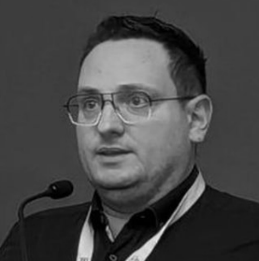

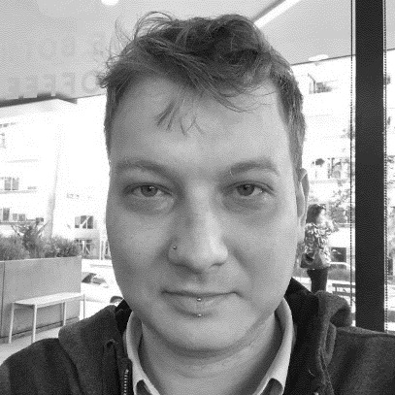
Board of Directors and Officers
Shawna Bong – Secretary and Treasurer | Alexandre Corso – Director (Term Expires 2027) | Aaron Hughes –President (Term Expires 2026)
Livio Morina – Vice President (Term Expires 2027) | Isabel Odida – Director (Term Expires 2027) | Job Snijders – Director (Term Expires 2026)
2025-12-12
GRNOG19 – Athens (Greece)
4
Livio Morina

Slide 5
Committees
Admin Committee | Operations Committee | Outreach Committee | Product Committee
Manage administration of user accounts and PeeringDB records Answer support tickets Cleansing and completion of PeeringDB records Leads: Chriztoffer Hansen (Chair) and Peter Helmenstine (Vice Chair) Contact: admincom@ lists.peeringdb.com | Manage PeeringDB infrastructure Leads: Job Snijders (Chair) and Aaron Hughes (Vice Chair) Contact: pdb-ops@ lists.peeringdb.com | Manage marketing and social media Develop and maintain presentations, workshops and webinars Coordinate presentations and attendance at events Leads: Ben Ryall (Chair) Contact: outreachcom@ lists.peeringdb.com | Manage roadmap and development priorities Ask for input from the community on desired features Write SoWs to solicit bids to complete requested features Leads: Jack Carrozzo (Chair) and Matt Griswold (Vice Chair) Product Manager: Leo Vegoda Contact: productcom@ lists.peeringdb.com
2025-12-12
GRNOG19 – Athens (Greece)
5
Livio Morina

Slide 6

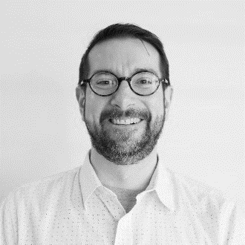
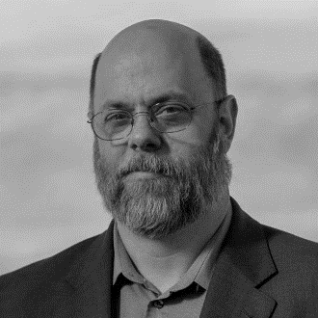


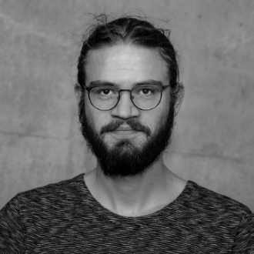

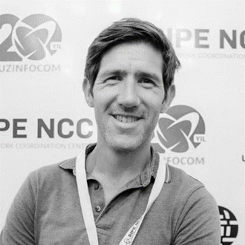


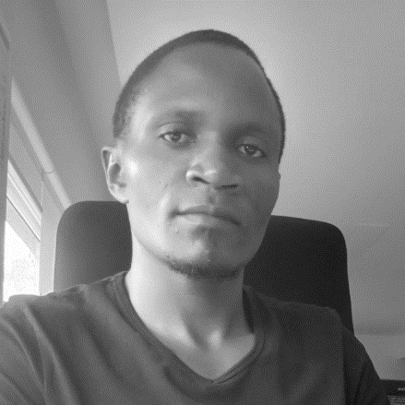
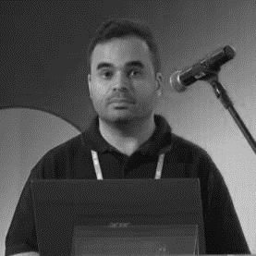
Admin Committee
Ankesh Anand | Austin Brower | John Brown | Budiwijaya | Shaun Coffey | Ron Grant | Chriztoffer Hansen – Chair | Peter Helmenstine – Vice Chair
Gaël Hernandez | Adam Korab | Chris Malayter | Aquinas Masakha | Crisóstomo Mbundu | Julimar Mendes | Laura Yepes
2025-12-12
GRNOG19 – Athens (Greece)
6
Livio Morina

Slide 7

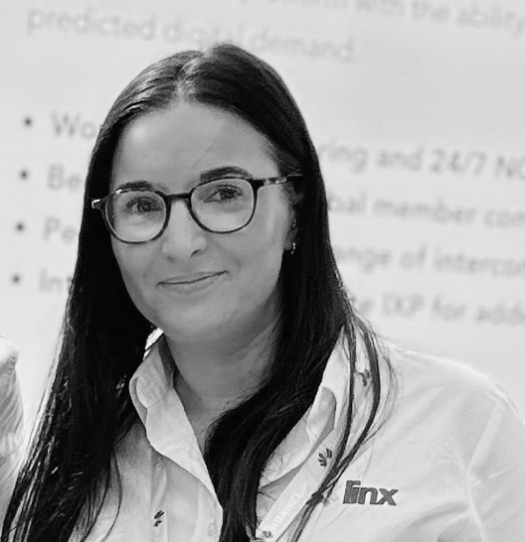



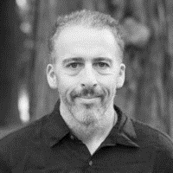
Outreach Committee
Obinna Adumike | Lynsey Buckingham | Greg Hankins | Aaron Hughes – Board Liaison | Tarryn Kidd
Livio Morina | Arnold Nipper | Ben Ryall – Chair | Leo Vegoda – Product Manager
2025-12-12
GRNOG19 – Athens (Greece)
7
Livio Morina

Slide 8





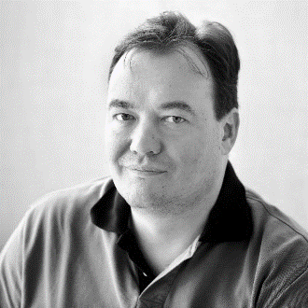
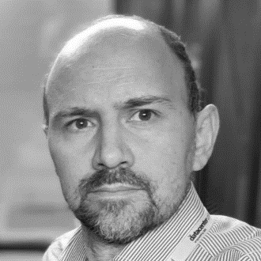


Product Committee
Jeff Bartig | Yan Berthier | Jack Carrozzo – Chair | Yolandi Cloete | Matt Griswold – Vice Chair | Martin Hannigan | Peter Helmenstine
Paul Hoogsteder | Aaron Hughes –Board Liaison | Laurent Jarbinet | Stephen McManus | Arnold Nipper | Terry Sweetser | Leo Vegoda –Product Manager
2025-12-12
GRNOG19 – Athens (Greece)
8
Livio Morina

Slide 9
We (always) Need Beta Testers (pre-news)
Consider using the Beta environment as default
Just over half a percent of users visit beta.peeringdb.com each month
  We recognize that there are good and bad reasons for this!
As of release 2.57.0, beta.peeringdb.com refreshes once an hour
Early access to improvements
Easy feedback mechanism
Try it at https://beta.peeringdb.com
Contact us at pc@peeringdb.com with any questions
2025-12-12
GRNOG19 – Athens (Greece)
9
Livio Morina
Notes:
On the good side, people are pretty happy with www.peeringdb.com. But on the bad side, we only used to refresh the data in beta.peeringdb.com once a month.

Slide 10
2024 Year in Review
 | 2023 | 2024 | Difference | % Increase
Campuses | - | 556 | n/a | n/a
Carriers | - | 8,164 | n/a | n/a
Exchanges | 1,152 | 1,239 | 87 | 7.6
Facilities | 5,282 | 5,633 | 351 | 6.7
Networks | 29,148 | 31,597 | 2,449 | 8.4
Organizations | 27,714 | 30,008 | 2,834 | 10.2
Users | 41,975 | 46,657 | 4,682 | 11.2
2025-12-12
GRNOG19 – Athens (Greece)
10
Livio Morina

Slide 11

News in brief
MFA mandate went smoothly
Completing the move from VMs to containers to allow more elegant scaling
New HOWTOs
We now normalize data for:
  Country name
  Province/state name
  City name
  Street address
Refactor v2 search code with improved automated testing
  Results should be complete and more relevant
2025-12-12
GRNOG19 – Athens (Greece)
11
Livio Morina

Slide 12
New Feature Highlights
We automatically remove ASNs after they are reclaimed by an RIR or NIR
Keyhole Markup Language (KML) export of geographic data
  Import into GIS applications
  Export relevant searches as a .KMZ file
peeringdb-py (HOWTO) enhancements
  Run queries locally on your infrastructure to avoid query limits and to get the best response time
  Reduces PeeringDB load (= cost)
  Setting up peeringdb-py is now just one command, ideal for a laptop
2025-12-12
GRNOG19 – Athens (Greece)
12
Livio Morina

Slide 13
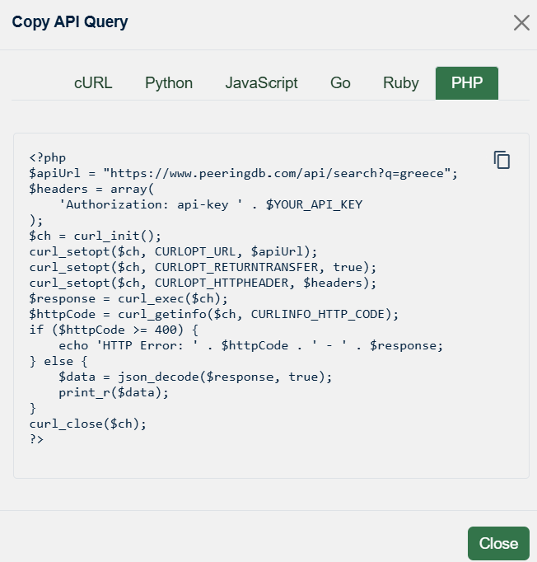
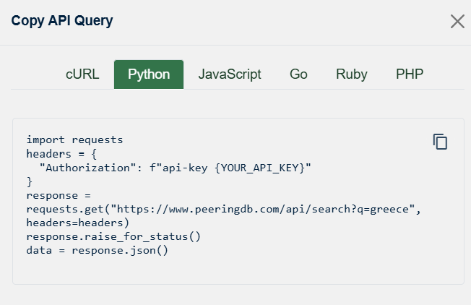
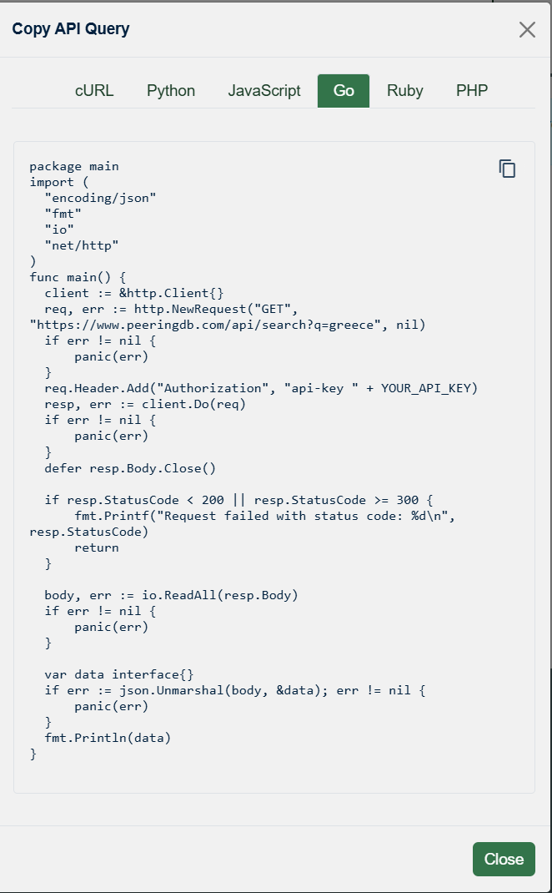
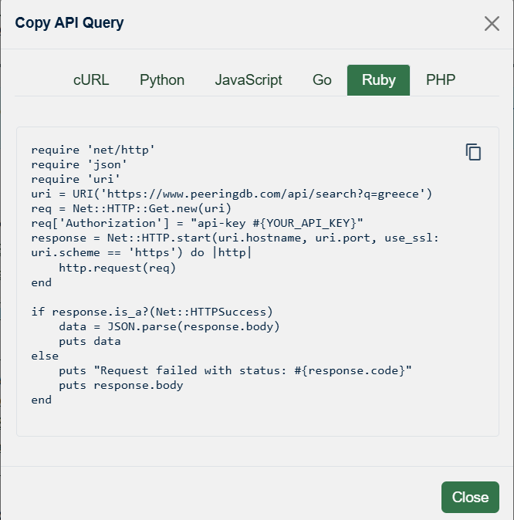
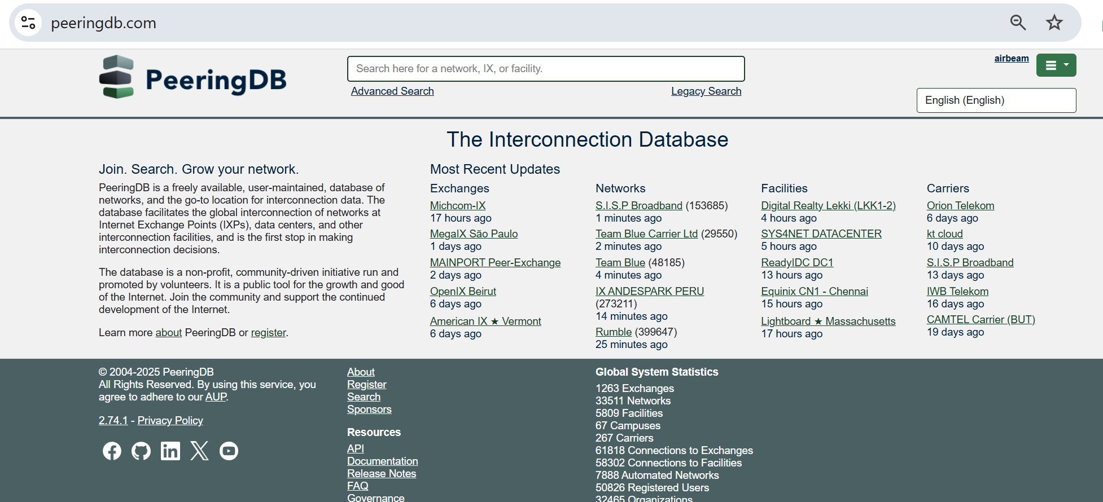
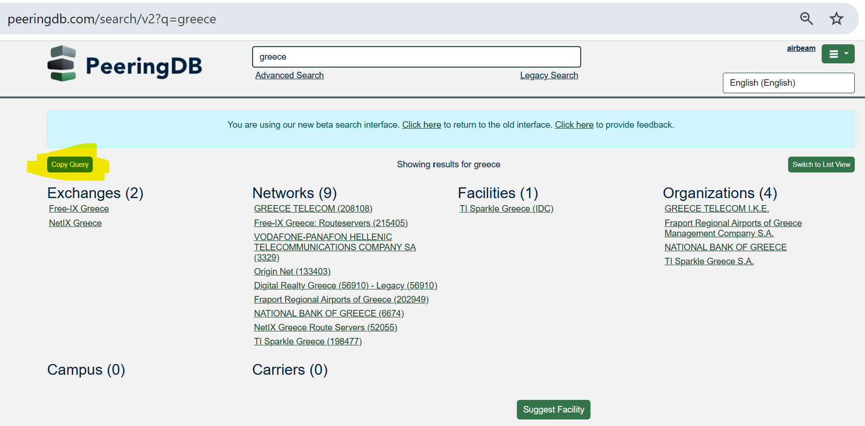
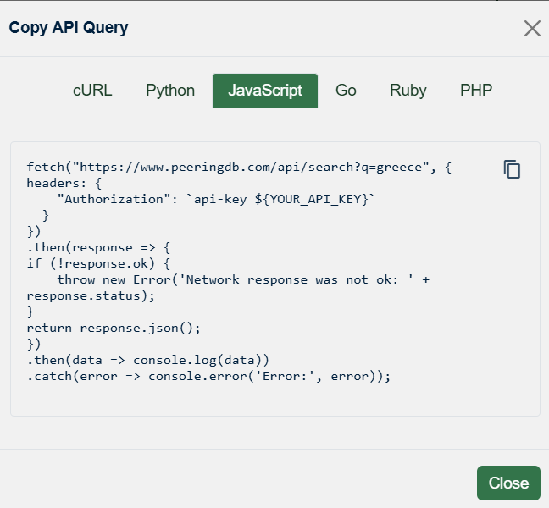
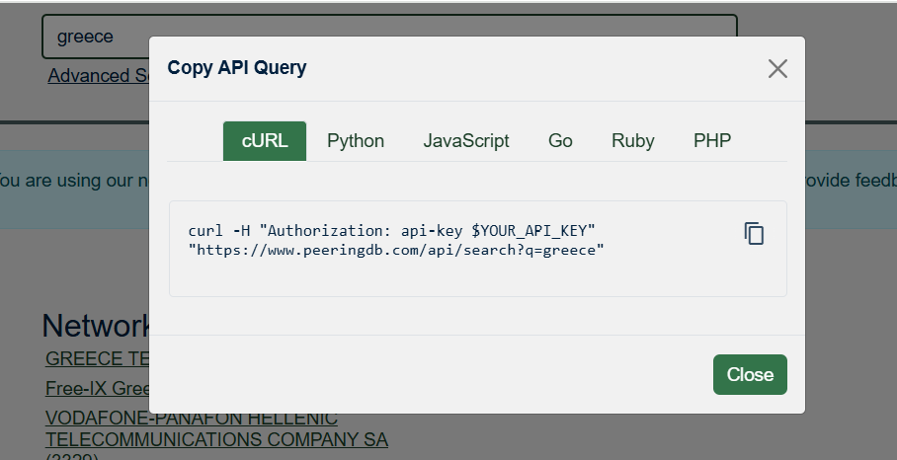
Web search → API query link
2025-12-12
GRNOG19 – Athens (Greece)
13
Livio Morina

Slide 14
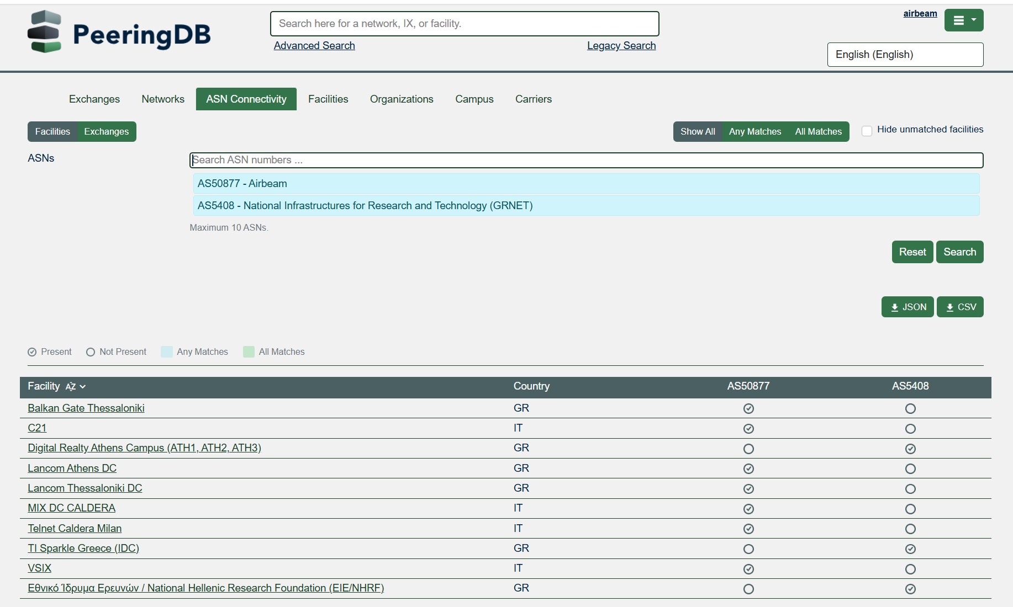
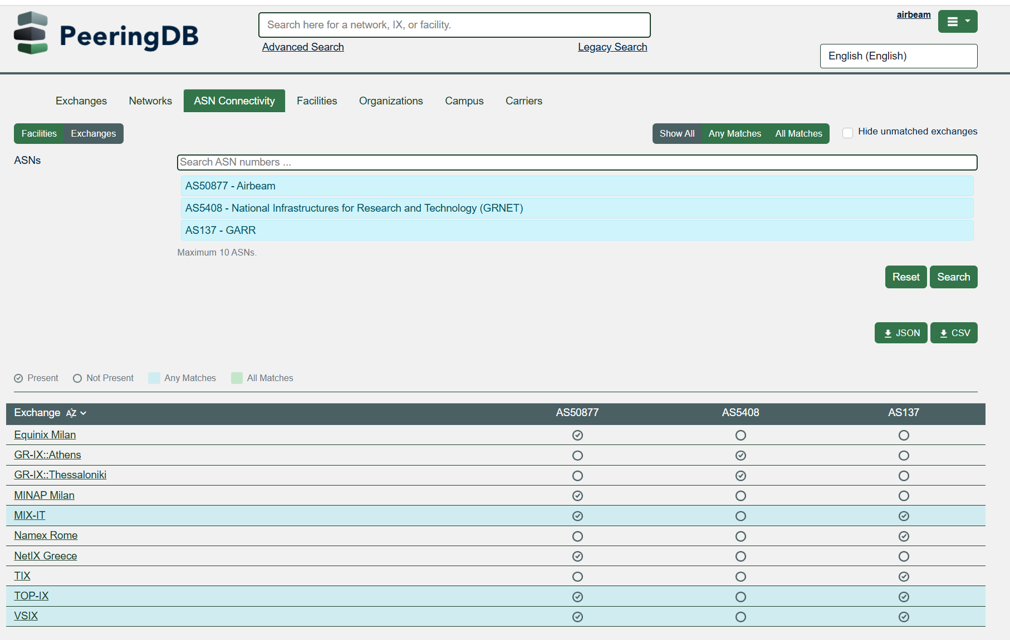
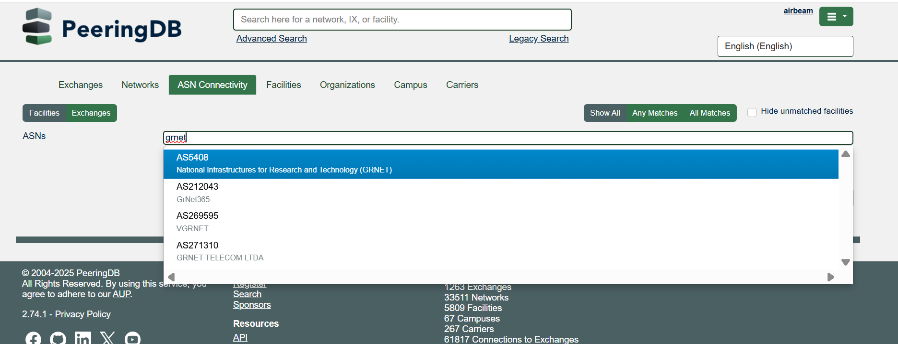
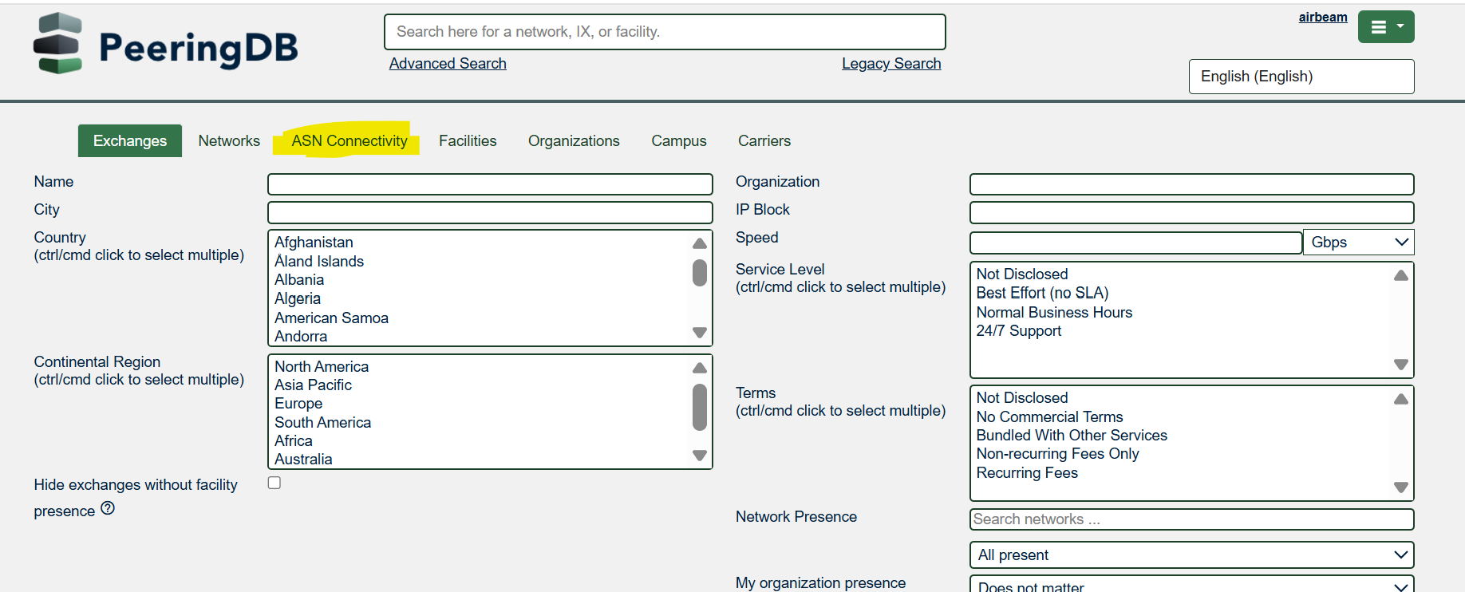
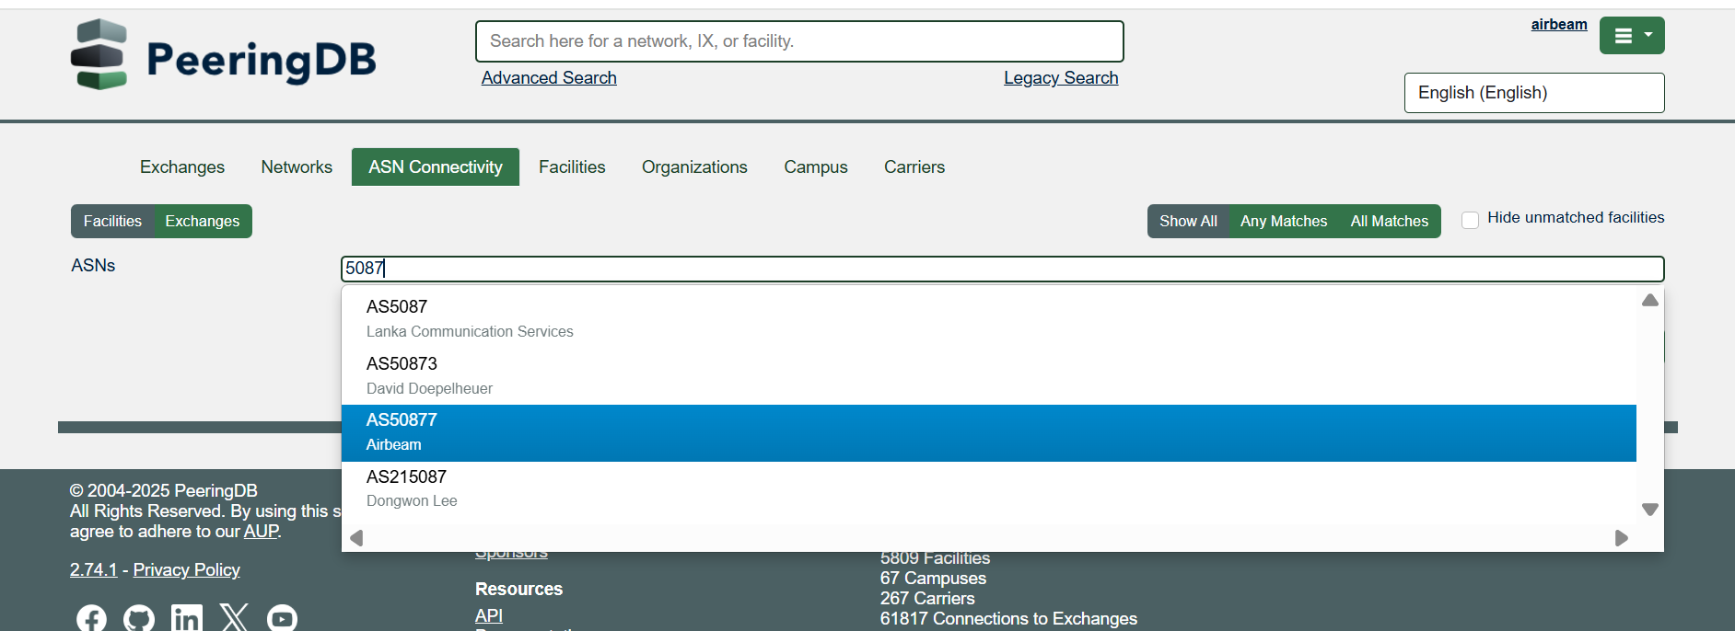
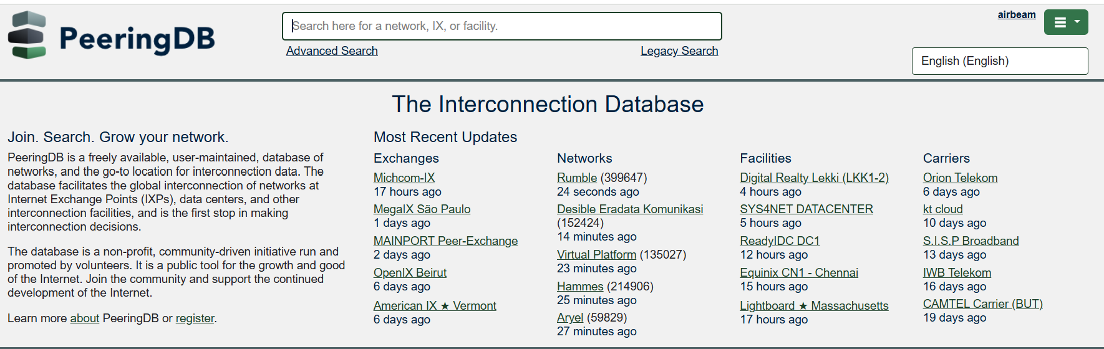
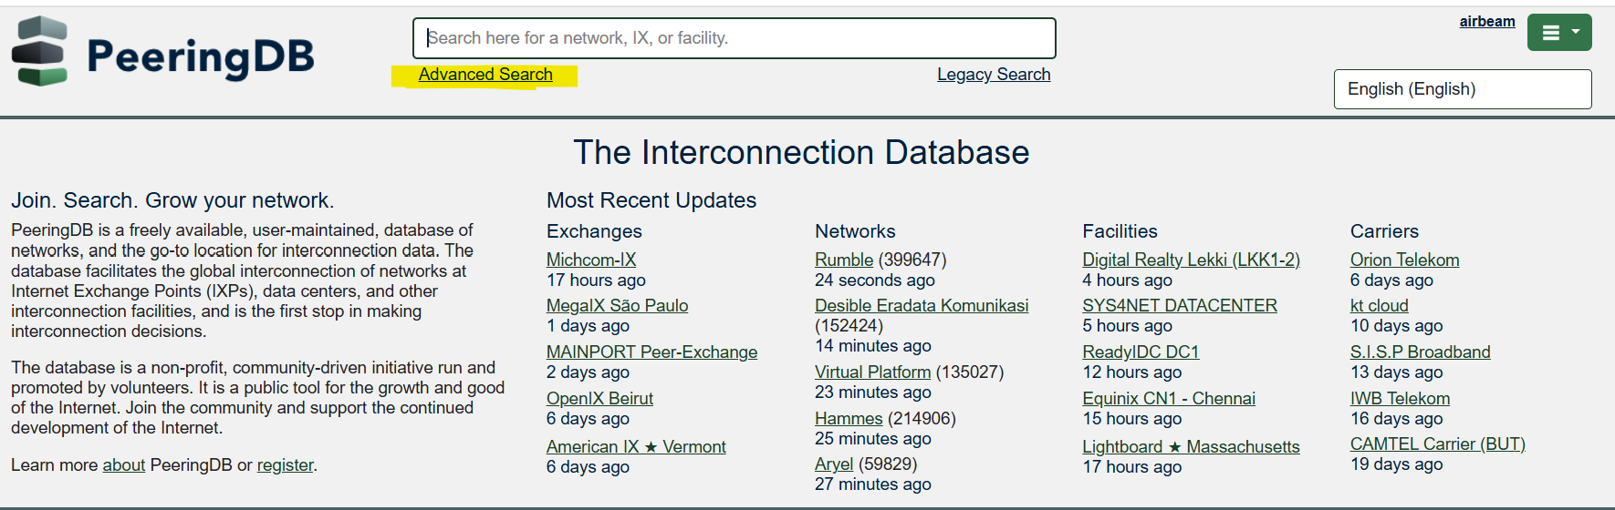
ASN Connectivity
2025-12-12
GRNOG19 – Athens (Greece)
14
Livio Morina

Slide 15
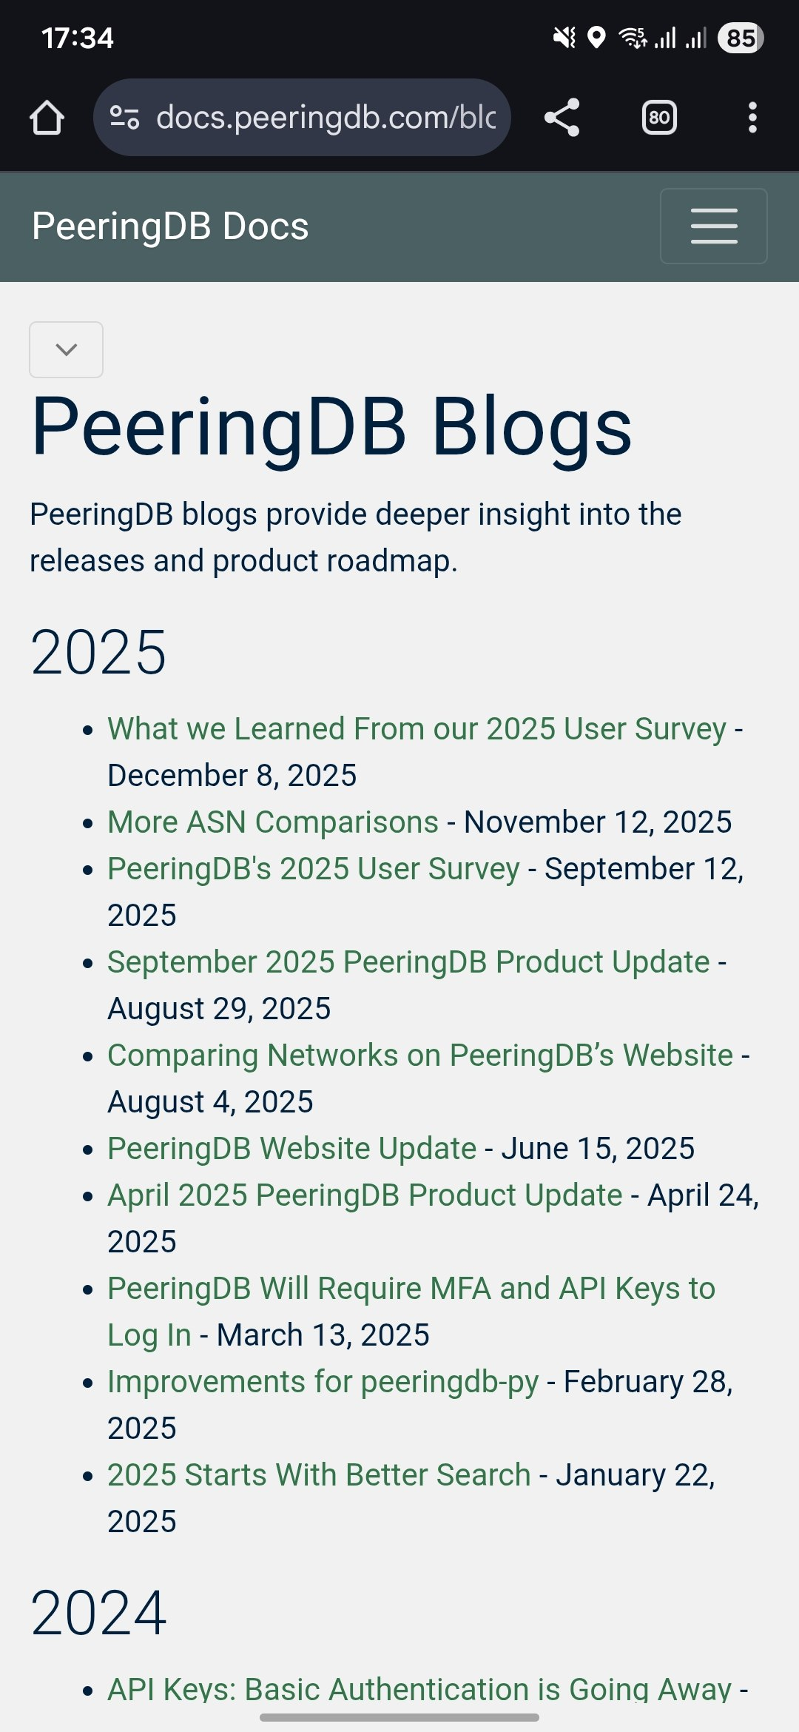



New Feature Highlights
Our blog describes other improvements and changes
Or follow us on social media!
  https://www.facebook.com/peeringdb/
  https://www.linkedin.com/company/peeringdb
  @PeeringDB
2025-12-12
GRNOG19 – Athens (Greece)
15
Livio Morina

Slide 16
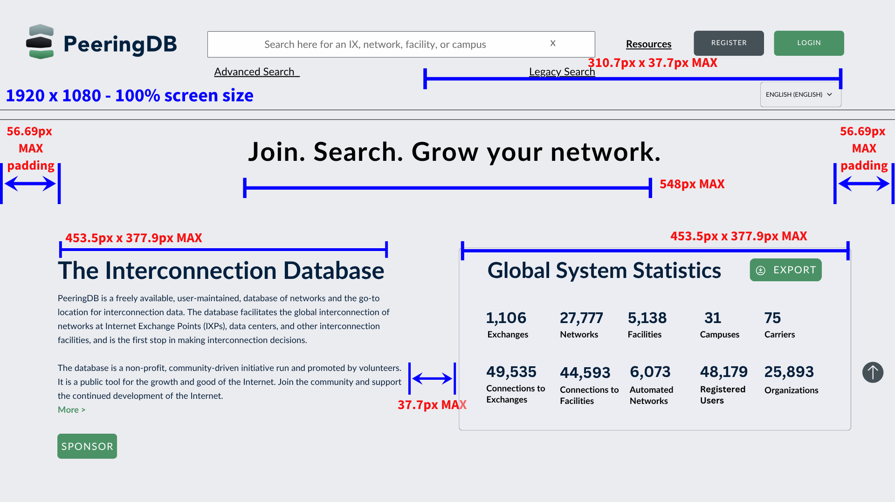
Website
Better support for wide screens
Better support for mobile users
No radical change, no need to relearn
Deployed new design to PeeringDB volunteers and iterating based on feedback
1-in-5 users will be opted in
They can opt-out
Version control is next to dark mode control in profile
2025-12-12
GRNOG19 – Athens (Greece)
16
Livio Morina

Slide 17
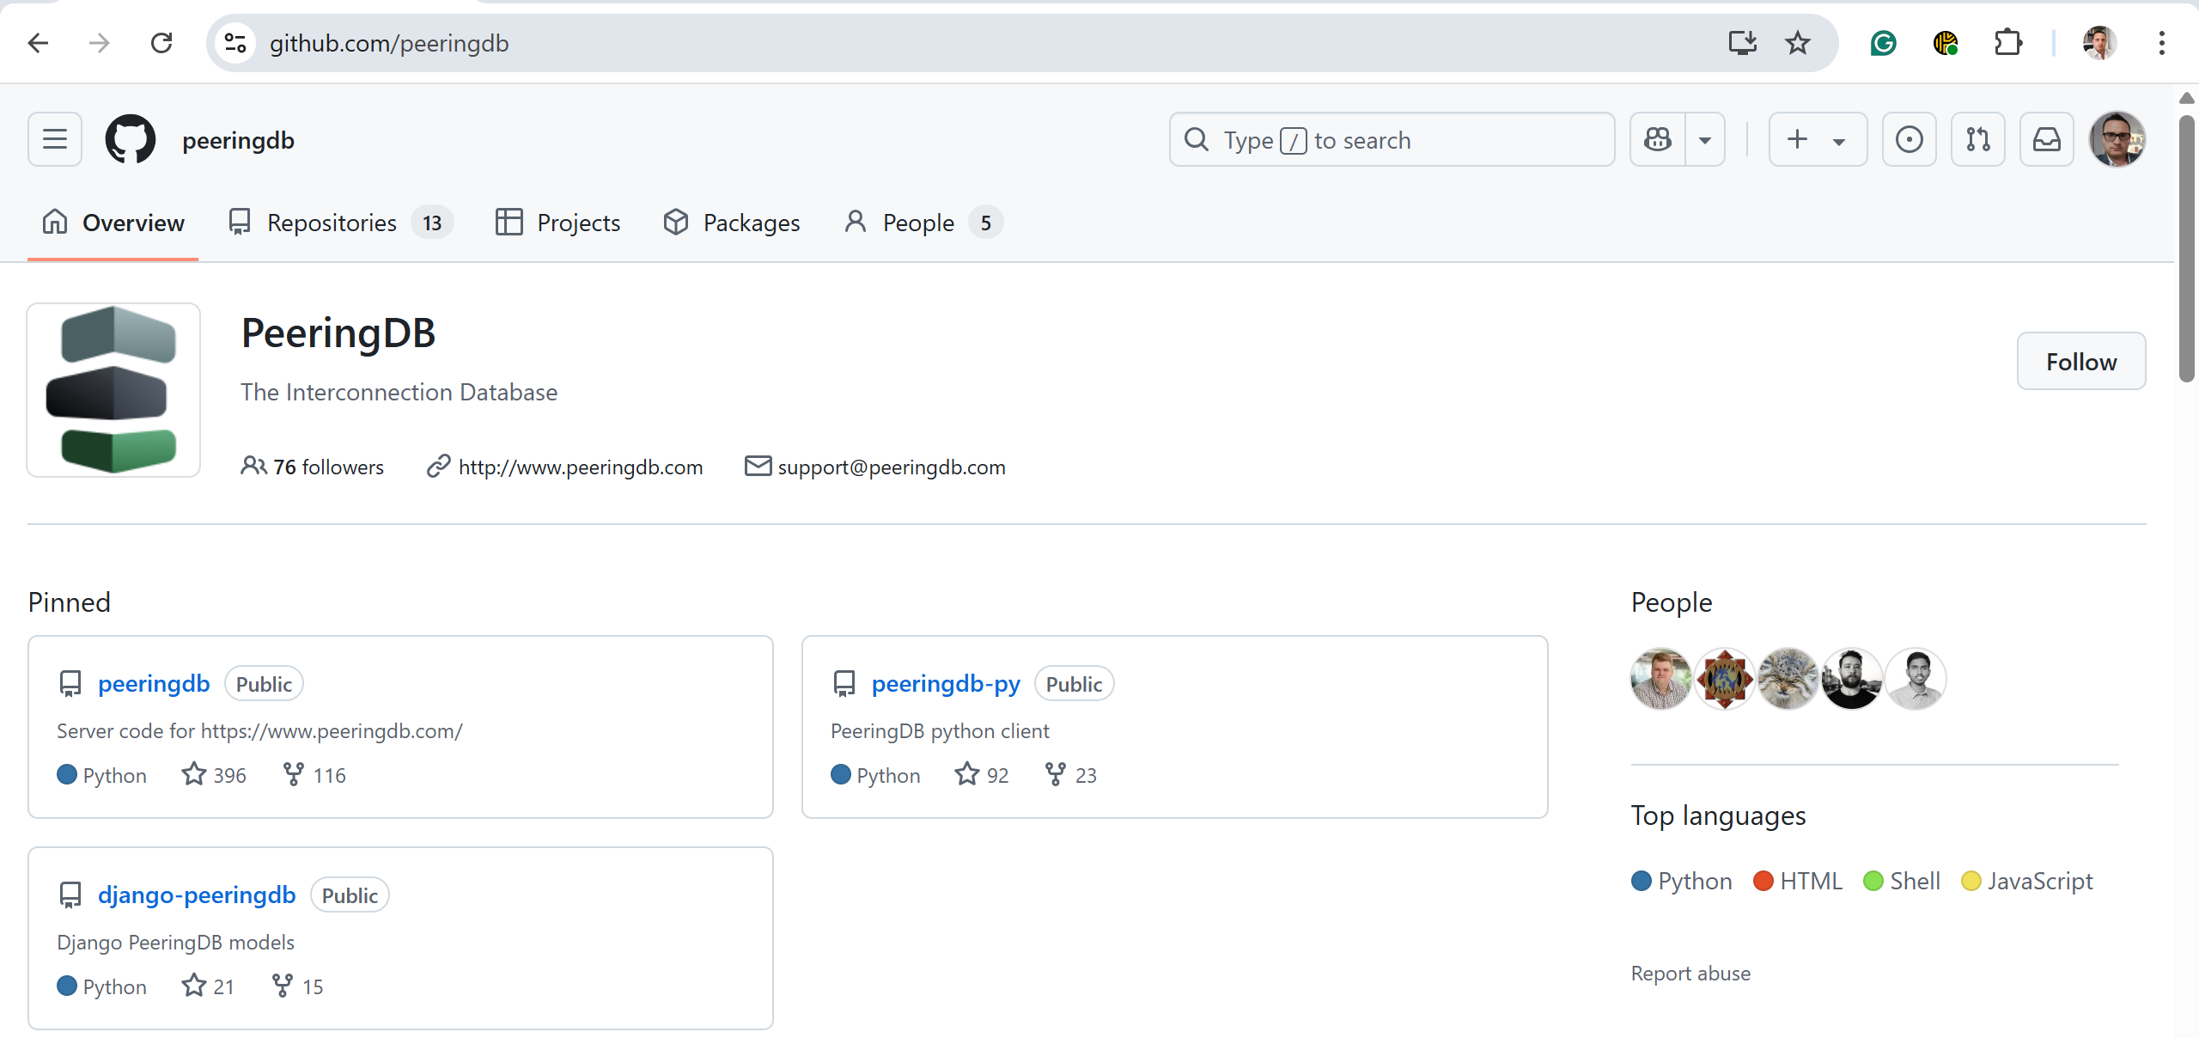
GitHub
2025-12-12
GRNOG19 – Athens (Greece)
17
Livio Morina

Slide 18


Information and Resources
Announce list: http://lists.peeringdb.com/cgi-bin/mailman/listinfo/pdb-announce
Governance list: http://lists.peeringdb.com/cgi-bin/mailman/listinfo/pdb-gov
Technical list: http://lists.peeringdb.com/cgi-bin/mailman/listinfo/pdb-tech
User Discuss list: http://lists.peeringdb.com/cgi-bin/mailman/listinfo/user-discuss
Docs, presentations, guides, tools: http://docs.peeringdb.com/
Board and Officers: stewards@lists.peeringdb.com
Admins: support@peeringdb.com
Presentation requests: outreachcom@lists.peeringdb.com
Uptime status: http://status.peeringdb.com/
Bugs and feature requests: https://github.com/peeringdb/peeringdb/
Social media:
https://www.facebook.com/peeringdb/
https://www.linkedin.com/company/peeringdb
@PeeringDB
https://www.youtube.com/channel/UCOrYWUg-dbL9UTFV_Lry6Wg
2025-12-12
GRNOG19 – Athens (Greece)
18
Livio Morina

Slide 19
PeeringDB in Greece
CC | IXP/OP | ASN | LASN | Colo/OP | ASN | LASN | TASN | TLASN | PDB | RIR | Routed
2023 | 5/4 | 77 | 42 | 10/7 | 73 | 41 | 102 | 50 | 60 | 228 | //
2024 | 6/5 | 98 | 53 | 10/7 | 86 | 47 | 124 | 58 | 79 | 241 | 213
2025 | 8/7 | 112 | 66 | 10/7 | 101 | 57 | 141 | 73 | 96 | 256 | 226
CC: Country Code IXP: Internet Exchange
OP: Operator ASN: Autonomous System
LASN: Local ASN Colo: Colocation
TASN: Total ASN (IXP+Colo) TLASN: Total Local ASN
PDB: PeeringDB RIR: Regional Internet Registry
Routed: in DMZ
2025-12-12
GRNOG19 – Athens (Greece)
19
Livio Morina

Slide 20
Greece and its bordering countries from PeeringDB POV
CC | IXP/OP | ASN | LASN | Colo/OP | ASN | LASN | TASN | TLASN | PDB | RIR | Rtd | %
2024 - 2025
AL | 1/1 | 19 | 12 | 6/6 | 12 | 8 | 23 | 15 | 42 | 128 | 114 | 32.8%
AL | 1/1 | 21 | 14 | 6/6 | 14 | 11 | 27 | 20 | 50 | 129 | 120 | 38.8%
BG | 7/7 | 205 | 87 | 29/14 | 201 | 71 | 302 | 104 | 149 | 732 | 659 | 20.4%
BG | 7/7 | 242 | 93 | 30/15 | 217 | 76 | 334 | 110 | 157 | 738 | 670 | 21.3%
GR | 6/5 | 98 | 53 | 10/7 | 86 | 47 | 124 | 58 | 79 | 241 | 213 | 32.8%
GR | 8/7 | 112 | 66 | 10/7 | 101 | 57 | 141 | 73 | 96 | 256 | 226 | 37.5%
MK | 1/1 | 13 | 6 | 5/3 | 4 | 3 | 13 | 6 | 14 | 66 | 58 | 21.2%
MK | 1/1 | 16 | 9 | 5/3 | 6 | 4 | 17 | 9 | 17 | 68 | 60 | 25.0%
TR | 4/4 | 91 | 44 | 48/37 | 170 | 105 | 202 | 113 | 237 | 1032 | 809 | 23.0%
LASN: Local ASN, ie. ASN in CC TASN: Total ASN (IXP + Colo) TLASN: Total Local ASN
2025-12-12
GRNOG19 – Athens (Greece)
20
Livio Morina
Notes:
LASN Local ASN (i.e. those registered in CC according to RIR)
TASN Total ASN (IXP + Colo)TLASN Total local ASN
TLASN Total local ASN

Slide 21























































Thank you to our sponsors!
2025-12-12
GRNOG19 – Athens (Greece)
21
Livio Morina

Slide 22
PeeringDB is Open Source Software!
Open source release announcement on 2018-11-10
  Released under the 2-Clause BSD License: https://opensource.org/licenses/BSD-2-Clause
Beneficial to the peering and interconnection community by promoting innovation
  Allows volunteers to contribute
  Makes it easier for third parties to bid on new features specified by the Product Committee
  A process for accepting contributions will be announced
Source code is available on GitHub: https://github.com/peeringdb/peeringdb
2025-12-12
GRNOG19 – Athens (Greece)
22
Livio Morina

