Slide 1

“Cybersecurity and Data Protection:
cooperation as a pillar of trust”
Ioannis Alexakis
LLB, LLM, NSPA, ISO 27001 LA, CISM, Cert. DPO
General Director for Strategic Planning
National Cybersecurity Authority
Vicky Konstantinopoulou
CIPM, CIPP/E, Cert. DPO
Deputy Data Protection Officer
GRNET S.A.

Slide 2
Introductory remarks - current Threat Landscape
National CS legislation and requirements
Data Protection implementation
Cooperation as a pillar of trust
Concluding remarks

Slide 3

Introductory remarks
Current Threat Landscape

Slide 4
Why cybersecurity matters
Rapidly changing European security environment
  COM(2020) 605 final "on the EU Security Union Strategy": In 28 pages the term "cybersecurity" is repeated 45 times
Impact of cyber-attacks: The provision of critical services such as energy, transport, health, financial sector depends on both physical and digital infrastructure, which increases vulnerabilities and the possibility of service delivery disruption.
ICT Penetration and ICT Benefits in Our Economic and Social Life: Making Cybersecurity a matter of Strategic importance
Great power competition – an issue of geopolitical importance and a field/arena of conflict and influence
Protection of privacy and human rights in the digital world, emerging threats and building public trust
Internet backbone infrasture: Cyber-espionage, APTs and hybrid threats

Slide 5
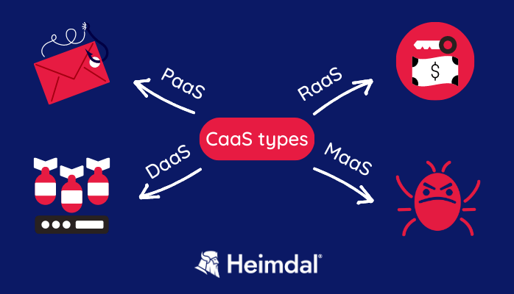
The problem: Cybercrime as a Service (CaaS)
Annual global cost of cybercrime: 2021 : $5.5 trillion – 2023-2025: $10 trillion – expected at $20 trillion soon: A key asset for the EU, critical to protecting our economies and societies
More profitable than drug smuggling. The 3rd largest "economy" worldwide.
CaaS: business model for organized cybercrime, where cybercriminals offer their tools/services for purchase/rental to anyone with malicious intent. No expertise is required from the attacker.
A professionalised and resilient criminal ecosystem
  Response to law enforcement actions
  Taking advantage of regulatory gaps
  RaaS models have further lowered barriers to entry
Artificial intelligence has become a defining element, esp. AI-supported phishing campaigns, with adversaries enhancing their operational effectiveness.

Slide 6
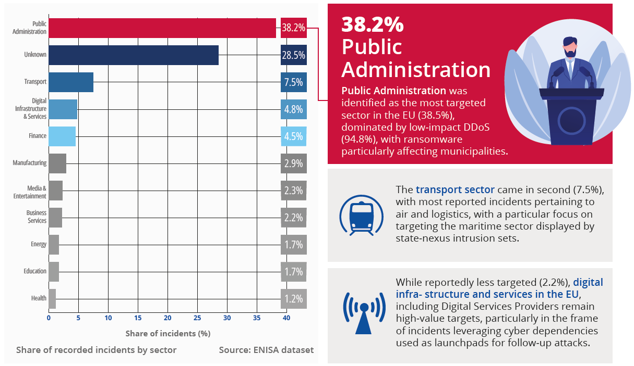
EU Level sectors affected

Slide 7
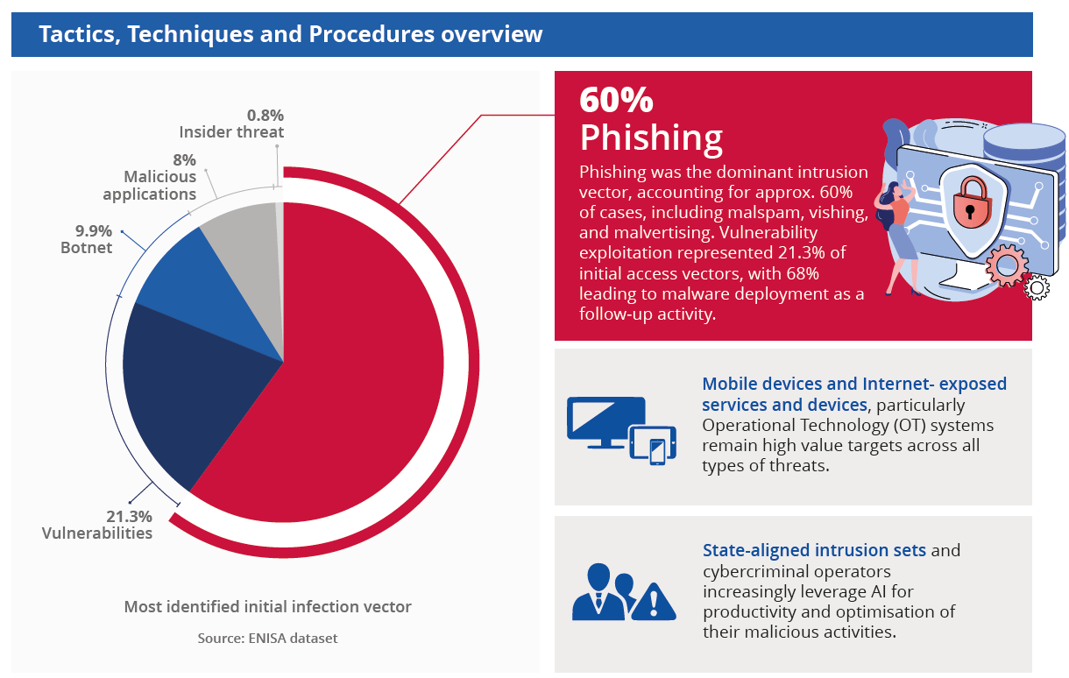
EU Level
Tactics, Techniques and Procedures overview

Slide 8
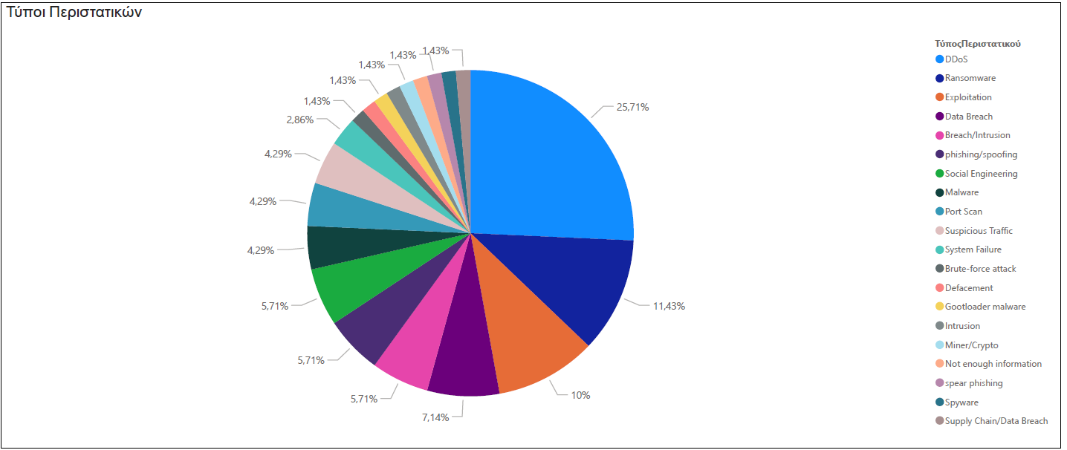
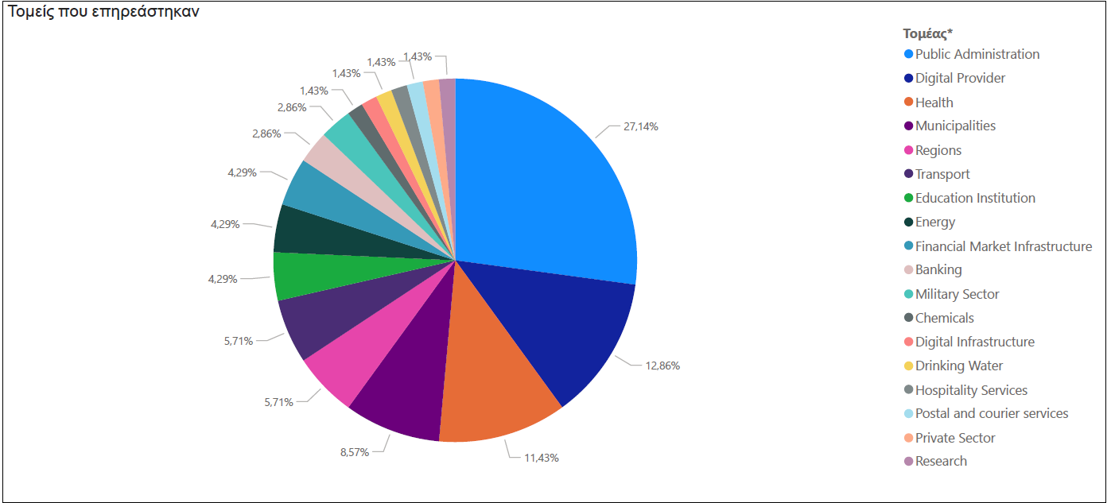

National level: reported incidents (2025)
Incident type

Slide 9
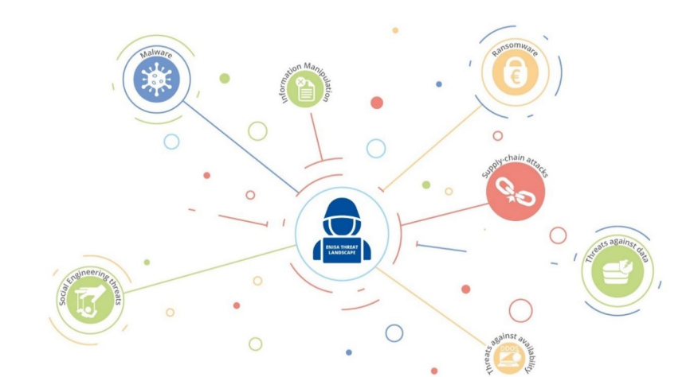
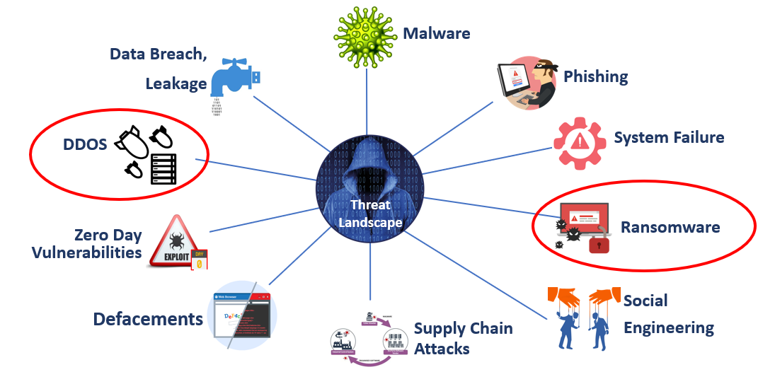
Threat Landscape Overview
Eu level
National level

Slide 10
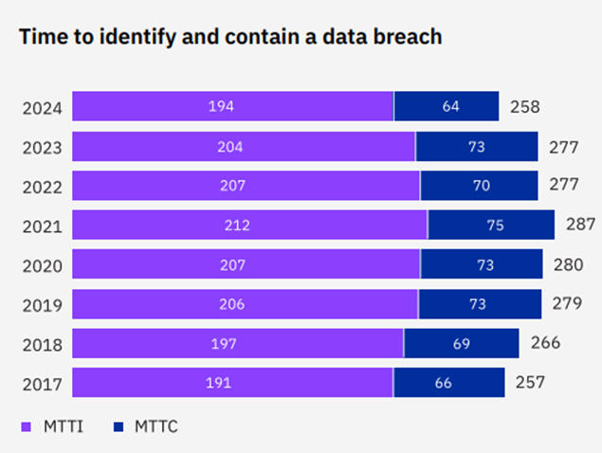
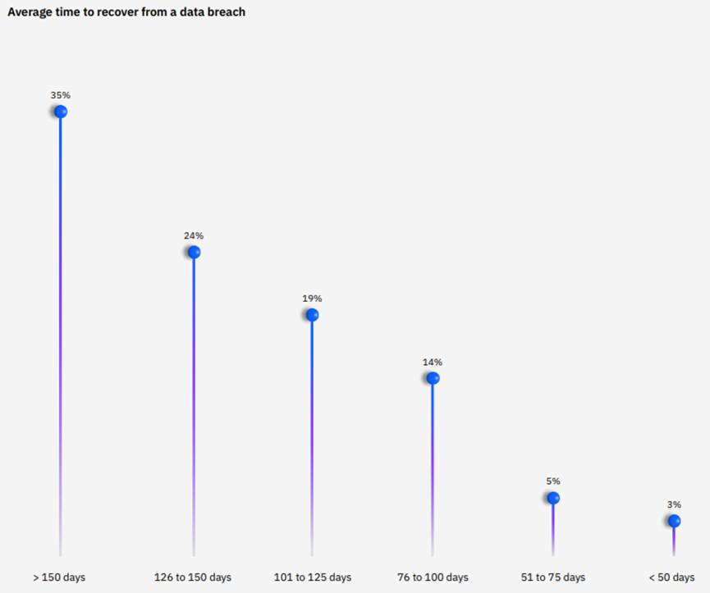
Impact at organization level (private sector)
Direct economic cost 2022: 250.000 € (2021: 200.000 €) + cost of recovery, reputational damage, fines etc
90% of companies in EU expect the cost and volume of cyberattacks to raise in the following year
While, recovering takes time…

Slide 11
National CS legislation and requirements

Slide 12
II. Regulation: National cybersecurity legal framework (penal provisions not incl.)
MD 1381
NIS2 registration platform
GDPR in effect
MD 1689
L. 4727/2020
Electronic network code
National Cybersecurity Requirements Framework
L. 4624/2019
DPA, GDPR implementation measures
PD 40/2020
GD SC COMPETENCES
MD 1899
2019
MD NCSS 2020-2025
2022
2024
CISO requirements, responsibilities
2018
2020
2023
2025
L. 4624/2019
DPA, GDPR implementation measures
L 4961/2022
Emerging technologies, e-gov enhancement
L. 5086/2024
National Cybersecurity Authority
MD 31877/2022
CS Self – assessment guide
L. 5160/2024
NIS2 transposition
L. 4635/2019
GD of Cybersecurity
L. 5002/2022
Data protection and cybersecurity governance
COM Impl. Regulation (EU) 2024/2690
requirements of cybersecurity risk-management measures
DNS, TLD, CLOUD, DATA CETRES, CDN,M(S)SSP, TSP
MD 1027/2019
NIS 1 implementation measures

Slide 13
Enhanced risk management measures
Stricter accountability and responsibility of top management (a. 20 NIS2)
Risk based approach: Appropriate and proportionate technical and organizational measures (a. 21 NIS2)

Slide 14
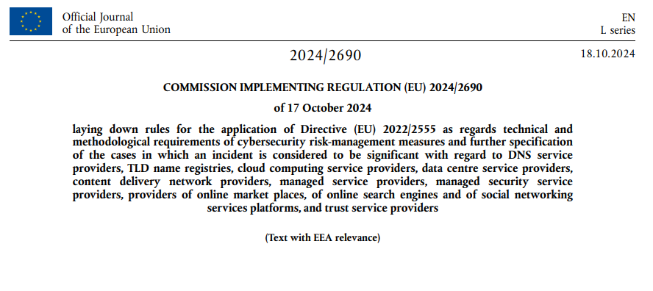
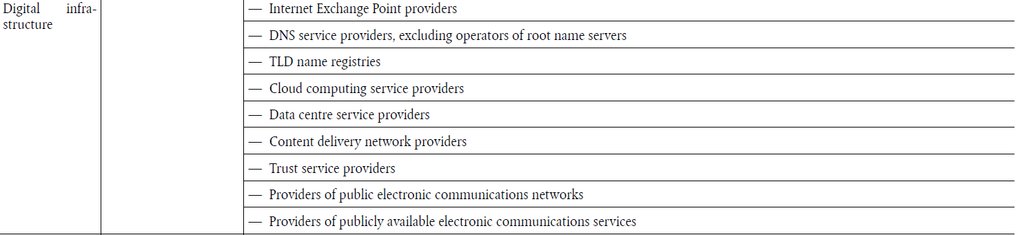
NIS2 and Digital Infrastructure

Slide 15
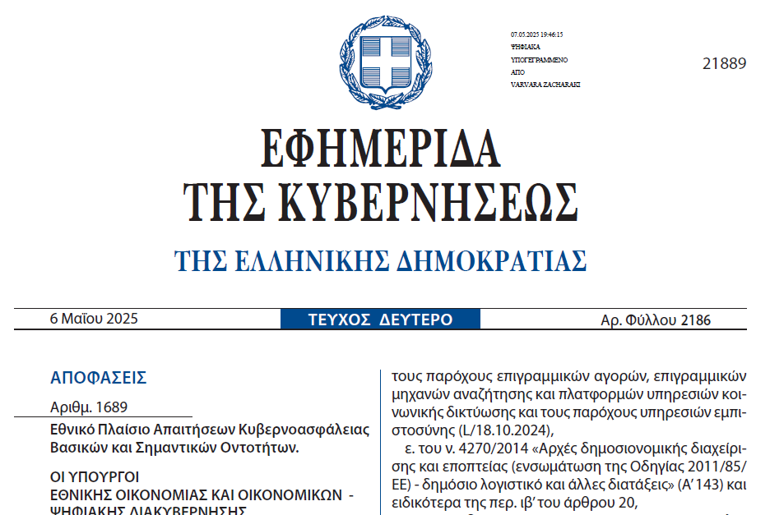
Detailed risk management measures (MD 1689/2025)

Slide 16
Technical, Organizational and Operational measures
Top management accountability
Risk management framework
CS policies and procedures
Roles and competencies
Independent CS audit
Compliance monitoring procedures
Human recourses security
SW and HW management
Supply chain security
Access control and account management
Secure configuration (SW, HW, services and network)
Secure SW development
Change management
Vulnerabilities management and disclosure
Assessment of the effectiveness of cybersecurity risk management measures
Network security
Malware protection
Cybersecurity training and awareness
Encryption
Physical and environmental security
Incident handling
Business continuity and crisis management

Slide 17
Essential and important Entities – key actions to recover from an incident
Before the incident occurs
During the incident
Ex post the incident
Appointment of a CISO
Initial Incident detection
Recovery and “back to normal” operation
Risk assessment
Determination of severity and potential impact
Submission of final report
ISMS implementation
Incident handling
Incident assessment
Reporting to the competent CSIRT/Authorities
Notification to service recipients and proposed measures
Review of plans and procedures, if required
Early warning within 24h
In case of Personal Data Breach, notification to DPA within 72h
Dealing with financial and legal consequences
Type of incident
According to GDPR
Actions to avoid similar incidents
Estimated impact
Report to LEA
Cross boarder cooperation, if needed
Immediate measures taken
Report to sectoral authorities
DORA / Enectricity Network Code / Aviation Horizontal Rule/ national legislation
Update report to CSIRT – much detailed
Within 72h
Interim report upon CSIRT request
Final report within one month
More detailed information and interim results
Detailed description of the incident
Vulnerabilities exploited by the attack
Type of threat or root cause
Proposed mitigation and recovery measures
Mitigation measures
Cross-border impact, if applicable
Verity incident containment

Slide 18
Data protection implementation

Slide 19
Cybersecurity and Data Protection: Two Sides of the Same Coin
Cybersecurity protects:
  Systems
  Networks
  Data integrity & availability
Data Protection safeguards:
  Privacy
  Lawful and fair processing
  Data minimisation & rights

Slide 20
4 Pillars for Data protection by EDPB
Enhancing harmonization and promoting compliance
Reinforcing a common enforcement culture and effective cooperation
Safeguarding data protection in the developing digital and cross-regulatory landscape
Contributing to the global dialogue on data protection

Slide 21

Data Protection Principles
Lawfulness, Fairness, and Transparency
Purpose Limitation
Data Minimisation
Accuracy
Storage Limitation
Integrity and Confidentiality (Security)
Accountability

Slide 22
The accountability principle
You must be able to prove compliance.
Managing your risks better – not just to your data subjects (customers, employees, etc.), but also to your organisation;
Keeping track of what data you’re collecting and why, and destroying data you’re not using or no longer need; and
Making your processes more efficient and have more confidence in your data.

Slide 23
The principle of by design
Security by design: integration of secure architectures.
Penetration testing, auditing, encryption, and authentication policies.
Privacy by design: data minimization and role-based access.

Slide 24
A synergetic relationship of principles
Accountability demands compliance
By design embeds compliance and provides evidence
A reinforcing cycle: design → operate → prove → improve.

Slide 25
Best Practices for Privacy Compliance
Map data flows involving incident management and reporting.
Integrate GDPR and NIS2 compliance into your incident response plan.
Conduct Data Protection Impact Assessments (DPIAs) where relevant.
Train teams on data protection in cybersecurity contexts.
Coordinate with DPOs and Information Security Officers.

Slide 26
Documentation Requirements for an incident
Description of incident: nature, scope, affected services / systems
Severity & impact (operational disruption, downtime, number of affected users, collateral damage)
Indicators of compromise
Likely root cause or threat type (e.g. ransomware, external attack, insider, misconfiguration)
Measures already taken (containment, mitigation) and ongoing remediation
Cross-border or cross-entity impacts (if applicable)
Contact information for responsible persons / incident management team

Slide 27
Documentation Requirements for an incident
Nature of the breach (unauthorised access, data leak, theft, accidental disclosure, etc.)
Categories and approximate number of data subjects affected
Categories and approximate number of data records (personal data records) affected
Likely consequences / risks to data subjects (e.g. identity theft, loss of confidentiality)
Measures taken or proposed to address / mitigate the breach (containment, recovery, prevention)
Contact information of the data protection officer or other responsible entity

Slide 28
What is next?
Recovery Plan
Lessons Learned & Follow-up

Slide 29
Cooperation as a pillar of trust

Slide 30
Why Cooperation is important?
Siloed teams (IT Security vs DPO) create more risk gaps.
Compliance alone does not equal security.
The CISO implements controls that the DPO relies on for GDPR compliance
NIS2, GDPR demand integrated reporting & governance
In a breach incident they must cooperate in order to be on time with the timeline requirements
Duplicated documentation leads to unnecessary complexity, inconsistencies, and operational chaos.

Slide 31
CS & Privacy Responsibilities keep growing
The landscape of regulation and compliance is ever changing.
Cyberattacks have become more frequent and target data, not just infrastructure
Digitalisation creates more data and more attack surface
Privacy impacts CISO’s role
Organisational Complexity Is Increasing (Hybrid cloud, Third-party vendors, Outsourcing, APIs, interoperability)

Slide 32








Holistic approach in GDPR and CS legislation implementation
Coordination
Shared responsibility
Common standards and Policies
Resource Sharing
Cross-Agency Training and Awareness
Incident Response Coordination
Policy Alignment
Engagement with External Stakeholders

Slide 33
Concluding remarks

Slide 34
Concluding remarks
CS legislation aims at protecting the organization whereas privacy legislation aims at protecting the individual
Common elements: risk based approach, aligned technical and organisational measures, common “by design” principles and incident reporting obligations.
The organizations in scope need to apply both regulatory regimes
Alignment at organizational level is a prerequisite, not an option!
Regulation is crucial; however NOT a mere compliance exercise: we need to focus on (and leave room for…) effective implementation
‹#›

Slide 35

Trust requires demonstrated cooperation.
DPO–CISO coordination strengthens resilience.
Security chain: as strong as the weakest link
Human error
Education – awareness

Slide 36
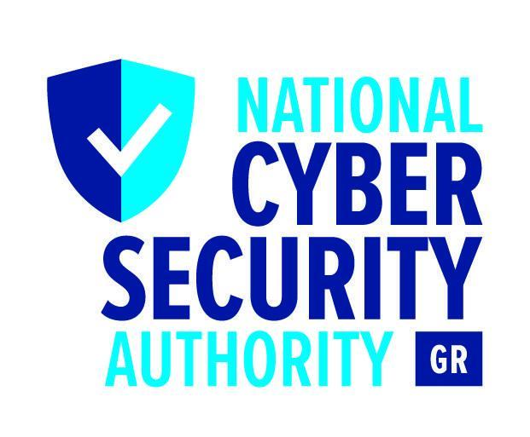
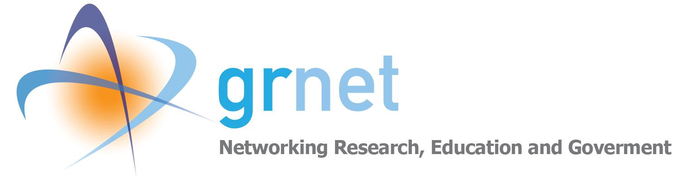
Thank you for your attention!
Ioannis Alexakis
Director General
General Directorate of Strategic Planning
National Cybersecurity
Authority of the Hellenic Republic
i.alexakis@cyber.gov.gr
https://cyber.gov.gr
gdsp@cyber.gov.gr
Vicky Konstantinopoulou
Deputy Data Protection Officer
GRNET S.A.
vickyk@admin.grnet.gr
dpo@admin.grnet.gr

