Slide 1

WebPKI, automation
and the push for more agility
Dimitris Zacharopoulos
PKI Manager — HARICA
SCWG Chair — CA/B Forum
GRNOG20 · June 30, 2026

Slide 2






What is HARICA?
A business activity of the Greek Universities Network (GUnet) that is both a Publicly-Trusted Certification Authority (PT-CA) and an EU Qualified Trust Service Provider (QTSP), ensuring compliance with different regulatory frameworks and standards for issuing and managing certificates and timestamps.
Publicly Trusted
EU Qualified
Standards-aligned
Dimitris Zacharopoulos · HARICA · GRNOG #20
2

Slide 3
Certificate Types
HARICA issues certificates and offers remote signing services that comply with the following:
CAB Forum Baseline Requirements
EU Regulation 910/2014 (eIDAS)
International standards by the CA/Browser Forum — minimum requirements for issuing & managing trustworthy public certificates.
EU legal framework for electronic identification & trust services — e-signatures, e-seals, time-stamping and qualified web authentication.
TLS
S/MIME
eSignature
eSeal
DV · IV · OV (simple / wildcard), EV
IV · OV · Sponsored (IV+OV) · email-only
IV / IV+OV (advanced · qualified)
incl. PSD2 (advanced · qualified)
Code Signing
Client Auth
QWAC
Qualified Timestamping
IV · OV · EV
IV · OV · IV+OV
OV · EV (+ PSD2 variants)
RFC 3161 trusted time
Dimitris Zacharopoulos · HARICA · GRNOG #20
3

Slide 4




Agenda
01
Reduction of TLS certificate and evidence re-use period
02
PQC challenges
03
Automation
04
Identity in WebPKI Certificates
Dimitris Zacharopoulos · HARICA · GRNOG #20
4

Slide 5
The Velocity of Trust
Shortened lifecycles and the DCV evidence window
The Lifespan Collapse — maximum TLS certificate validity (days)
Dimitris Zacharopoulos · HARICA · GRNOG #20
5

Slide 6



The Rationale: Security First
Stale Domains
CDN Dynamics
Key Exposure
Prevents “zombie” certificates, where domain ownership has lapsed but the certificate remains valid for impersonation.
Rapid switching of hosting and CDN providers requires certificates to expire faster, minimizing the impact of misconfigurations.
A reduced validity window naturally limits the utility of a compromised private key, improving overall ecosystem health.
Dimitris Zacharopoulos · HARICA · GRNOG #20
6

Slide 7

The DCV Deadline
47 days
10 days
398 days
certificate validity by 2029
DCV evidence re-use window
identity re-use (down from 825)
Manual validation is no longer viable. Identity and DNS must be linked via automated challenges (ACME) or CA-proprietary APIs to maintain continuous uptime at scale.
Dimitris Zacharopoulos · HARICA · GRNOG #20
7

Slide 8
The PQC Signature Problem
Algorithm | Security Level | Public Key Size | Signature Size
ECDSA P-256 | Classical 128-bit | 64 bytes | 64 bytes
ML-DSA-44 | NIST Level 2 (PQ) | 1,312 bytes | 2,420 bytes
ML-DSA-65 | NIST Level 3 (PQ) | 1,952 bytes | 3,309 bytes
ML-DSA-87 | NIST Level 5 (PQ) | 2,592 bytes | 4,627 bytes
PQ public keys and signatures are 20–70× larger than ECDSA. Source: FIPS 204
Dimitris Zacharopoulos · HARICA · GRNOG #20
8

Slide 9
THE PQC SIGNATURE PROBLEM
SIZE
Massive certificate growth
Certificate Transparency (CT) ecosystem under stress

Slide 10



Re-engineering WebPKI to support PQC
Merkle-Tree Certificates (MTC): “Don’t LOG (in CT) what you issue — ISSUE by logging (in your own CT).”
IETF PLANTS WG
Chrome Root Store
MTC draft under standardization
Draft MTC Root Store Policy
Chrome validation
Industry effort
Code landed to validate MTCs
- chrome://flags/#tls-trust-anchor-ids
- chrome://flags/#verify-mtcs
Cloudflare, Let’s Encrypt & several CAs working on MTCs
Dimitris Zacharopoulos · HARICA · GRNOG #20
10

Slide 11
PQ Certificate Sizes
Relative certificate size (ECDSA P-256 = 1×)
*Source: Aaron Gable, Let’s Encrypt — CA/B Forum Teleconference, 2026-06-04
11
Notes:
MTC Landmark-Relative:
No Signatures: No issuer signatures are included
Instead of signatures it contains a Merkle inclusion proof that maps the certificate directly to a recent, trusted “landmark” (tree head)
Out-of-Band Trust: Verifies must pre-distribute or cache the landmark tree state (highly efficient but there is a delay for distribution)
Fallback to MTC standalone: Servers deploy a standalone MTC alongside the landmark certificate as a fallback mechanism

Slide 12

Prepare for Automation
WebPKI is for public web sites
Servers not meant for browsers — or sites behind firewalls — should switch to private PKIs.
Multi-Perspective Issuance Corroboration (MPIC)
Verification from multiple remote locations (5 by Dec 2026). Keep authoritative name servers publicly accessible.
DNSSEC
MUST be performed. Failures prevent issuance — except where the domain is “Insecure” per RFC 4035 §4.3.
Dimitris Zacharopoulos · HARICA · GRNOG #20
12

Slide 13
Automation — crypto/policy agility
ACME (RFC 8555)
Persistent DCV (method #22)
Plenty of ACME clients don’t interoperate with every ACME server.
Ensure your client (and CA) supports ACME Renewal Info (ARI).
Prefer the dns-01 challenge.
Restrict DNS-zone access via a regex on the _acme-challenge TXT record.
Domain owner delegates DCV to the preferred CA(s).
Set it and forget it — unless you enable the persistUntil parameter.
Keeps issuance continuous without repeated manual validation.
Dimitris Zacharopoulos · HARICA · GRNOG #20
13

Slide 14
Before you go…
One more thing about identity
14

Slide 15
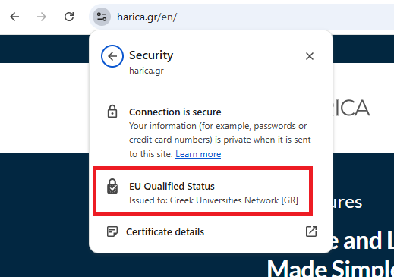
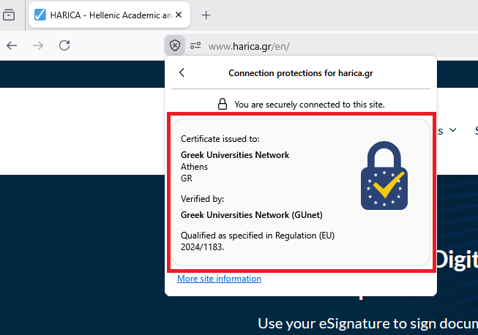
Identity is not dead in WebPKI!
Qualified Website Authentication Certificates (QWACs)
Chrome
Enable chrome://flags/#verify-qwacs
Firefox
Enable about:config “security.qwacs.enabled”
Dimitris Zacharopoulos · HARICA · GRNOG #20
12

Slide 16
Thank you
Dimitris Zacharopoulos
dzacharo@harica.gr
GRNOG20 · June 30, 2026

