Slide 1

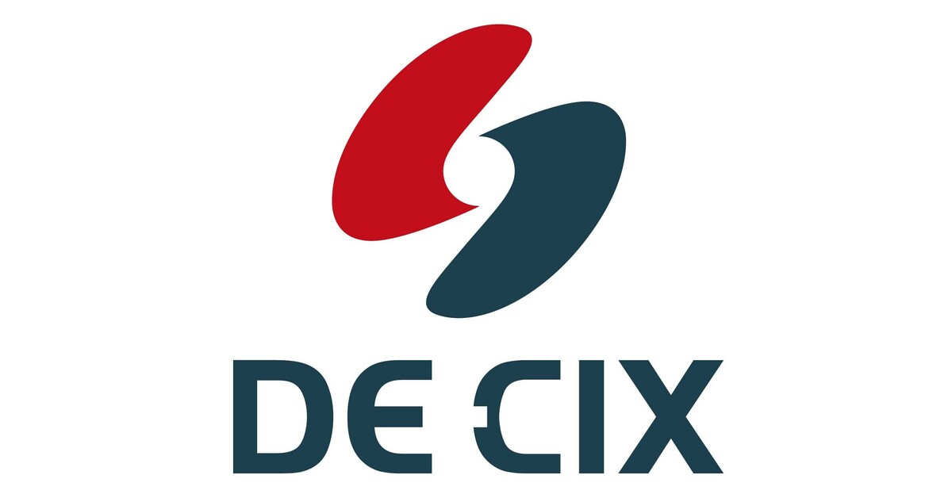
A comprehensive analysis of the IRR landscape
S. Konstantaras (AMS-IX)
M. Wichtlhuber (DE-CIX)
D. Wagner (DE-CIX)
T. Striffler (DE-CIX)
C. Luik (DE-CIX)
GRNOG20
Athens 30-06-2026
Notes:
Stavros

Slide 2
BCP proposal
IXP operator must trust and use only the following IRR databases for building and maintaining Route Server filters:
The adoption of this policy will probably result in a massive transfer of RPSL objects. Therefore, a grace period of 12 months is introduced in which the list of allowed databases is supplemented by these:
  RADB
  RIPE-NONAUTH
  NTT
  LEVEL3
  AFRINIC
  ARIN
  RIPENCC
  LACNIC
    NIC.MX
    NIC.BR
  APNIC
    APJJ
    CNNIC
    JPNIC
    KRNIC
    TWNIC
    VNNIC
    IRINN
Notes:
* Bit much text, can probably be simplified

Slide 3
BCP Proposal
IXP operator must use only RIR IRR databases (or their official delegates) for Route Server filters
The adoption of this policy will probably result in a massive transfer of RPSL objects
  Grace period of 12 months is introduced in which the list of allowed databases is supplemented by IRRs with more than 1% of global route objects
    RADB
    RIPE-NONAUTH
    NTT
    LEVEL3
Notes:
Stavros

Slide 4
Community Reaction
Do authoritative IRRs represent operators better than third-party IRRs?
Is the juice worth the squeeze?
  Can’t we wait for RPKI to take over?
What about legacy space?
  It can’t be transferred
Notes:
Stavros

Slide 5
Method
We correlate and analyze a large number of data sources
  WHOIS dumps from all 5 RIRs and 14 third-party IRRs
  BGP data
    Route server dumps from AMS-IX and DE-CIX
    MRT dumps from RIPE RIS collectors
  RPKI ROA repository data
  RIR specific sources on legacy data
  NRO delegation files
We talked a lot to RIRs about their databases and processes for IRR and legacy space
Notes:
Matthias

Slide 6
Why the analysis?
The policy was introduced back on RIPE 86
Progress and updates were shared in the following RIPE and EURO-IX meetings
A last call for adoption was issued at the Connect-WG on June 5th 2024 (after RIPE 88)
Many concerns were raised in the Mailing List regarding the impact of adopting this BCOP
AMS-IX & DE-CIX decided to join forces and analyze the impact to prove feasibility
Notes:
Fundamental questions on the mailing list
Do authoritative IRRs represent operators better than third-party IRRs?
Is the juice worth the squeeze?
What about legacy space?
Now we answer them with a large-scale analysis
Rereference at the end and answer them

Slide 7



Disclaimer(s)
DISCLAIMER
Work in progress!
These are preliminary results, still many questions to be answered
Analysis by AMS-IX (Stavros) & DE-CIX (Matthias, Daniel, Tobias)
Many questions & results were cross-checked with RIR employees
  RIPE, LACNIC, APNIC
Notes:
Skip this slide …

Slide 8
List of concerns that raised
There is no actual problem to solve
  Legacy space Quality of data
Use IRRDv4 to fight object conflicts
  Quality of data Impact on RS tables
Unofficial contain some unique info
  Legacy space Quality of data Impact on traffic
Concentration of authority / Regulatory concerns
No widespread deployment
  Legacy space Quality of data
Companies have registered resources around
  Impact on RS tables Impact on traffic
Key focus areas of our research
  Legacy space
  Quality of data
  Impact on RS tables
  Impact on traffic
Notes:
Skip or move to backup

Slide 9
Q: Do authoritative IRRs represent operators better than third-party IRRs?
Notes:
Matthias

Slide 10
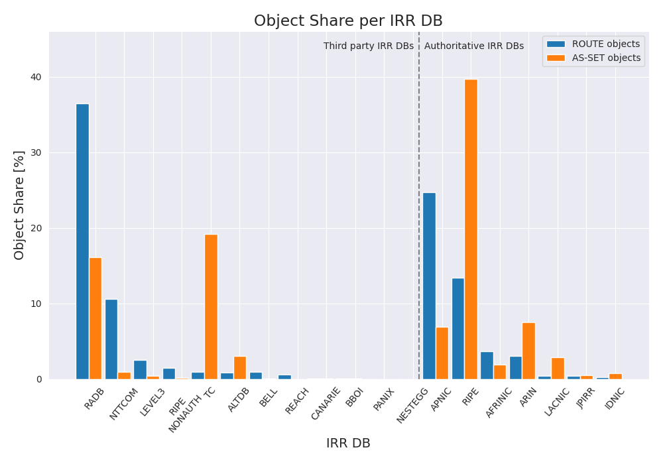
Where are the objects stored?
Object | Authoritative IRRs | Third-party IRRs
ROUTE objects | 46% | 54%
AS-SET objects | 60% | 40%
AUT-NUM objects | 79% | 21%
→ many third-party IRRs hold less
than 1% of global objects, some less than 10.
Notes:
Annotate directly in plot
Third-party IRRs account for half of all objects in total (53%), while the other half is stored in authoritative databases (47%).
Route objects are roughly equally distributed to third-party/authoritative IRRs (54%/46%), AS-SETs are more frequently stored in authoritative IRRs (40%/60%).
The same is true for AUT-NUM objects (21%/79%, not shown above).

Slide 11
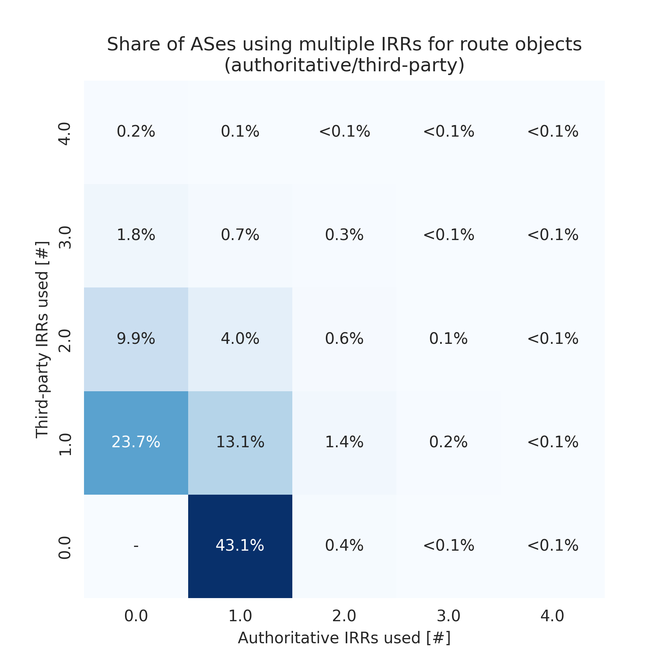
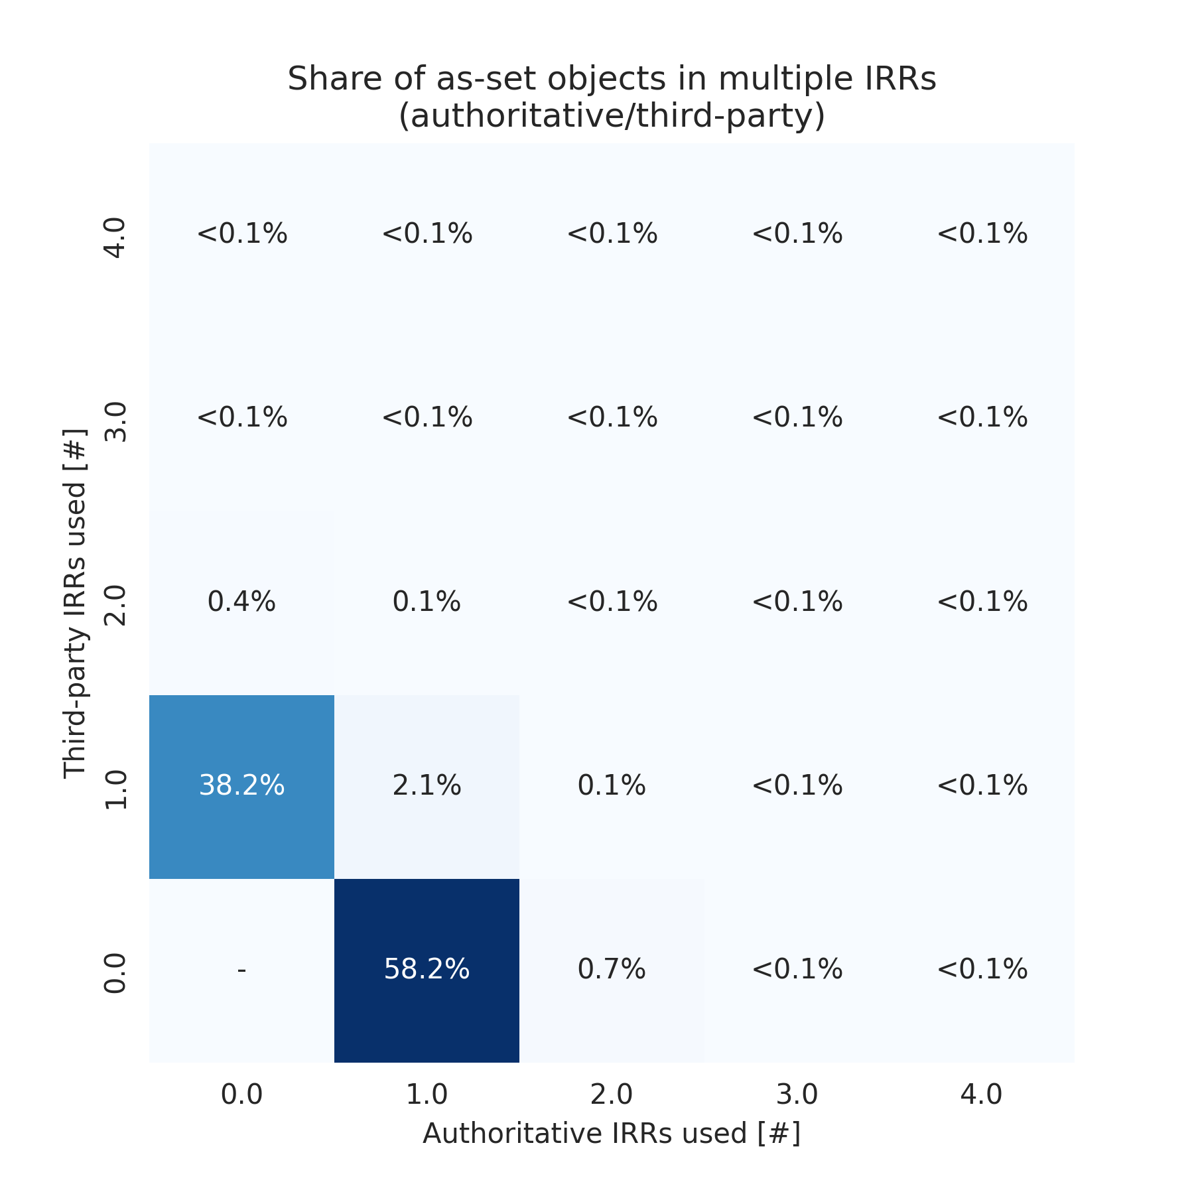
Do networks use multiple IRR DBs?
ROUTE objects →
← AS-SETs
All values covered by textboxes are below 0.1%
Notes:
Split to two slides? Give it a try …

Slide 12
Do networks use multiple IRR DBs?
ROUTE objects →
← AS-SETs
33% of Ases use one to two third-party IRRs only
60% of Ases use one auth. IRR and up to two third-party IRRs in addition
All values covered by textboxes are below 0.1%
Notes:
Split to two slides? Give it a try …

Slide 13
Do networks use multiple IRR DBs?
ROUTE objects →
← AS-SETs
33% of Ases use one to two third-party IRRs only
60% of Ases use one auth. IRR and up to two third-party IRRs in addition
All values covered by textboxes are below 0.1%
Notes:
Split to two slides? Give it a try …

Slide 14
Do networks use multiple IRR DBs?
ROUTE objects →
← AS-SETs
33% of Ases use one to two third-party IRRs only
38% of Ases use one third-party IRR
60% of Ases use one auth. IRR and up to two third-party IRRs in addition
58% of Ases use one authoritative IRR
All values covered by textboxes are below 0.1%
Notes:
Split to two slides? Give it a try …

Slide 15
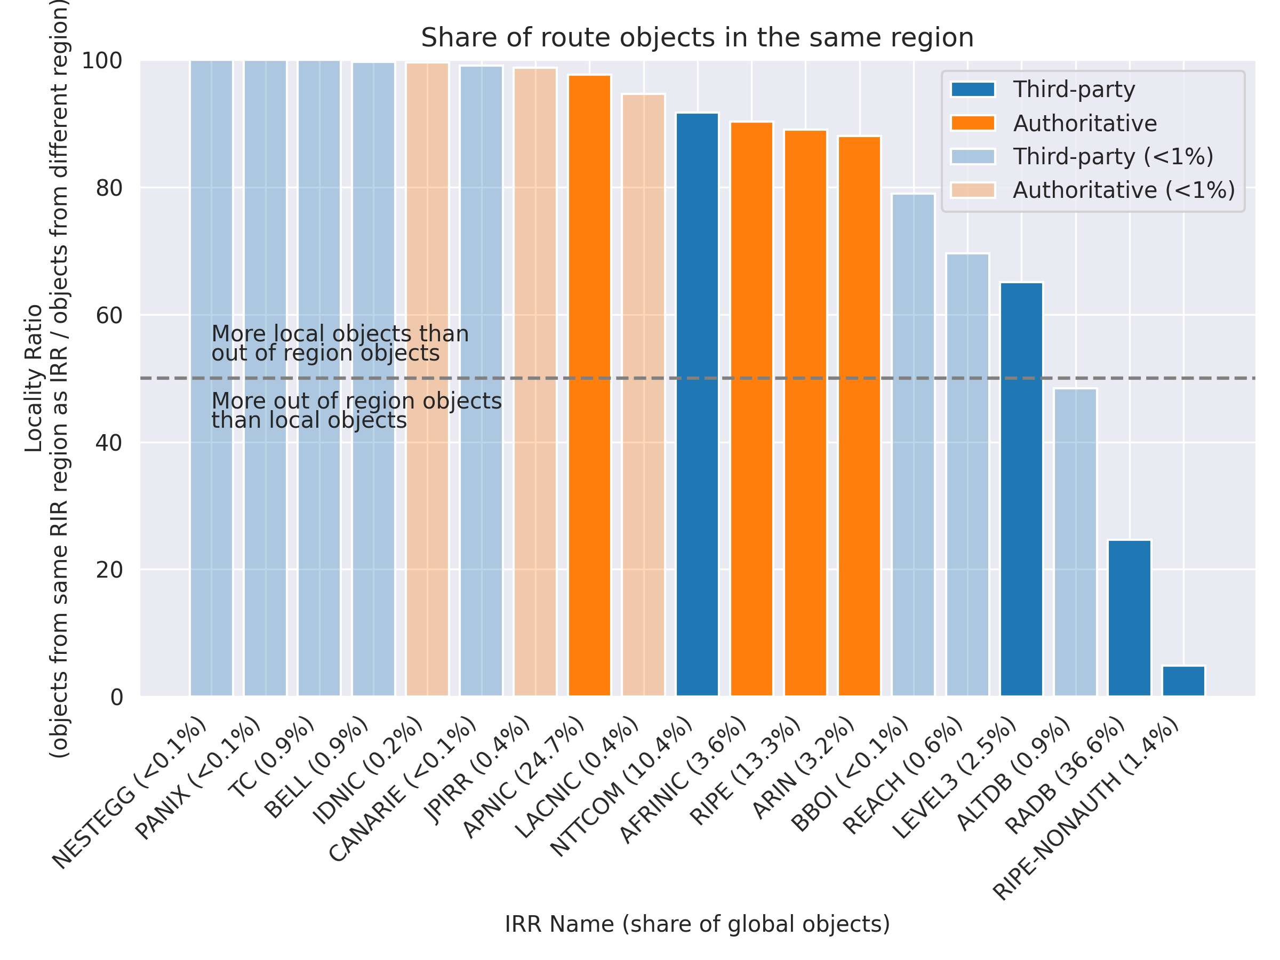
Global or local* relevance?
ROUTE objects →
More local route objects
More global route objects
*local = same RIR region
as maintainer org’s HQ
Notes:
Explain shades

Slide 16
Global or local* relevance?
ROUTE objects →
More local route objects
More global route objects
Very small IRRs have highly local* scope.
*local = same RIR region
as maintainer org’s HQ
Notes:
* Global or local relevance?

Slide 17
Global or local* relevance?
Auth. IRRs are mostly localized*
ROUTE objects →
More local route objects
More global route objects
Very small IRRs have highly local* scope.
*local = same RIR region
as maintainer org’s HQ
Notes:
* Global or local relevance?

Slide 18
Global or local* relevance?
Auth. IRRs are highly localized*
ROUTE objects →
More local route objects
More global route objects
Three larger third-party IRRs have global scope
Very small IRRs have highly local* scope.
*local = same RIR region
as maintainer org’s HQ
Notes:
* Global or local relevance?

Slide 19
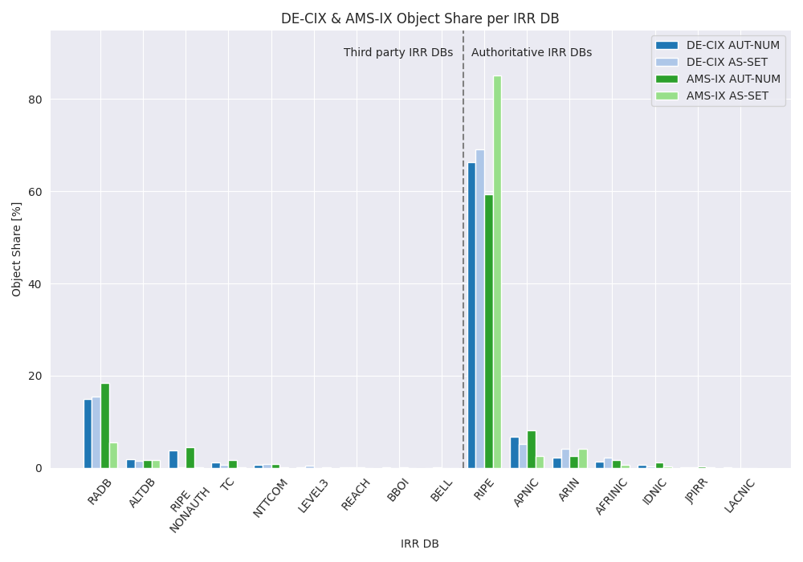
RIR DB preference based on RPSL objects
Vast majority of the
AUT-NUM/AS-SET objects advertised in AMS-IX/DE-CIX Route Servers can be found in authoritative DBs.
Notes:
Update – I don’t know what to make out of this.

Slide 20
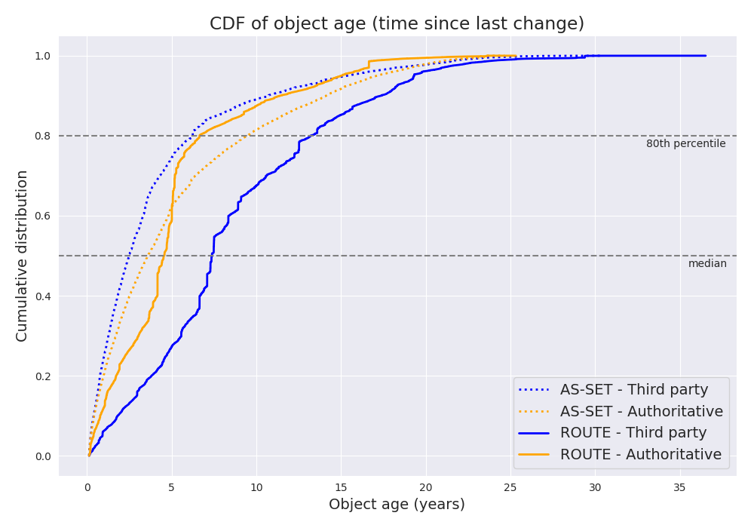
How often are objects updated?
Good performance →
The plot shows that route objects are updated twice as frequently in authoritative IRRs compared to third-party IRRs.
The median time elapsed since the last update of a route in authoritative IRRs is ~4.5 years, whereas it is ~7.5 years for third-party IRRs.
← bad performance
Notes:
Annotate directly on plot
Replot without TC

Slide 21
How often are objects updated?
The plot shows that route objects are updated twice as frequently in authoritative IRRs compared to third-party IRRs.
The median time elapsed since the last update of a route in authoritative IRRs is ~4.5 years, whereas it is ~7.5 years for third-party IRRs.
ROUTE objects in authoritative IRRs are updated much more regularly
Notes:
* Annotate directly on plot

Slide 22
How often are objects updated?
AS-SET updates look a bit better for third-party IRRs. This is caused by TC!
The plot shows that route objects are updated twice as frequently in authoritative IRRs compared to third-party IRRs.
The median time elapsed since the last update of a route in authoritative IRRs is ~4.5 years, whereas it is ~7.5 years for third-party IRRs.
Notes:
* Annotate directly on plot

Slide 23
How often are objects updated?
AS-SET updates look a bit better for third-party IRRS. This is caused by TC!
The plot shows that route objects are updated twice as frequently in authoritative IRRs compared to third-party IRRs.
The median time elapsed since the last update of a route in authoritative IRRs is ~4.5 years, whereas it is ~7.5 years for third-party IRRs.
ROUTE objects in authoritative IRRs are updated much more regularly
Notes:
* Annotate directly on plot

Slide 24
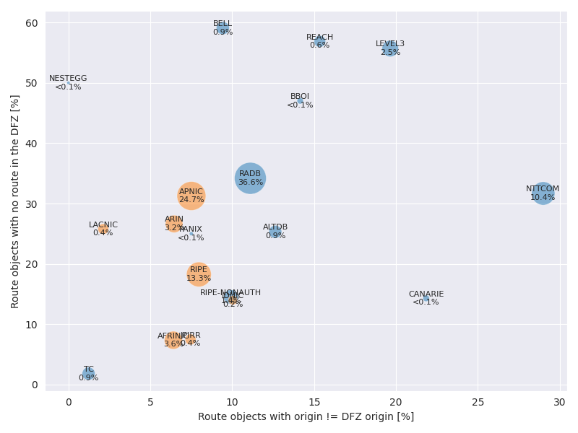
Do objects match with the DFZ?
← bad performance
Good performance →
Notes:
Updaten mit aktueller version.

Slide 25
Do objects match with the DFZ?
The size of the bubbles indicates the share of overall route objects the respective database holds.
The more on the bottom left a database is, the more relevant information it contains and the more accurately it reflects the information reflects the situation in the DFZ.
TC is the unlikely winner. We asked them: they enforce strict rules.
Notes:
Updaten mit aktueller version.

Slide 26
Do objects match with the DFZ?
Nearly all third-party IRRs have worse alignment with the DFZ.
The size of the bubbles indicates the share of overall route objects the respective database holds.
The more on the bottom left a database is, the more relevant information it contains and the more accurately it reflects the information reflects the situation in the DFZ.
TC is the unlikely winner. We asked them: they enforce strict rules.
Notes:
Updaten mit aktueller version.

Slide 27
Do objects match with the DFZ?
Nearly all third-party IRRs have worse alignment with the DFZ.
The size of the bubbles indicates the share of overall route objects the respective database holds.
The more on the bottom left a database is, the more relevant information it contains and the more accurately it reflects the information reflects the situation in the DFZ.
Auth. IRRs have better alignment with the DFZ.
TC is the unlikely winner. We asked them: they enforce strict rules.
Notes:
Updaten mit aktueller version.

Slide 28
Q: Do authoritative IRRs represent operators better than third-party IRRs?
A: Yes. Authoritative IRRs are less in conflict with the DFZ and have a higher object update frequency. The only exception is TC, which has highly localized relevance in LACNIC (Brazil) and holds <1% of the global route objects.
Notes:
Matthias

Slide 29
Q: Is the juice worth the squeeze?

Slide 30
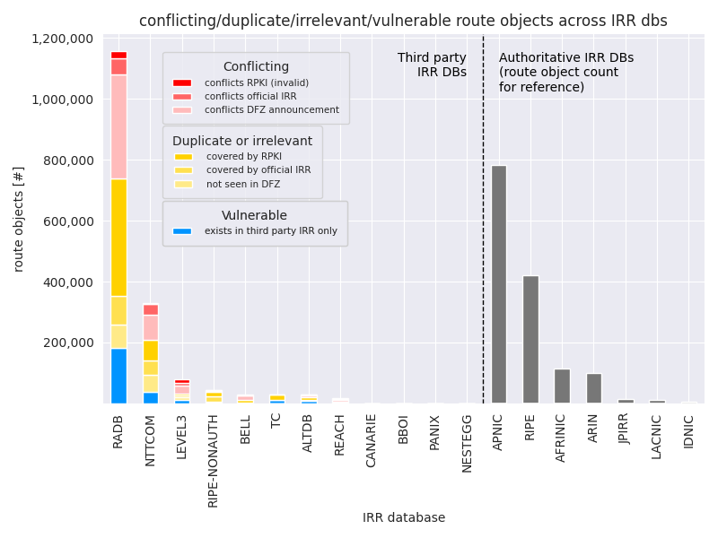
What about data quality of route objects?
Conflicting (red): these objects are in one way or another contradicting more authoritative information (RPKI invalids, newer RIR IRR records, or have DFZ announcements with a different origin).
Duplicate or irrelevant (yellow): these route objects are either irrelevant (not seen in the DFZ or covered by official IRR/RPKI without conflict).
Vulnerable (blue): these objects exist only in third party DBs and are covering some route in the DFZ.
Notes:
Make heavy use of animation here to guide the audience visualize
Grey out other parts that are not relevant
Why is this vulnerable? Injection of competing route objects in other DBs.

Slide 31
What about data quality of route objects?
Conflicting (red): these objects are in one way or another contradicting more authoritative information (RPKI invalids, newer RIR IRR records, or have DFZ announcements with a different origin).
Duplicate or irrelevant (yellow): these route objects are either irrelevant (not seen in the DFZ or covered by official IRR/RPKI without conflict).
Vulnerable (blue): these objects exist only in third party DBs and are covering some route in the DFZ.
1M route objects (84%) in RADB are conflicting or irrelevant.
Notes:
Make heavy use of animation here to guide the audience visualize
Grey out other parts that are not relevant
Why is this vulnerable? Injection of competing route objects in other DBs.

Slide 32
What about data quality of route objects?
Conflicting (red): these objects are in one way or another contradicting more authoritative information (RPKI invalids, newer RIR IRR records, or have DFZ announcements with a different origin).
Duplicate or irrelevant (yellow): these route objects are either irrelevant (not seen in the DFZ or covered by official IRR/RPKI without conflict).
Vulnerable (blue): these objects exist only in third party DBs and are covering some route in the DFZ.
1M route objects (84%) in RADB are conflicting or irrelevant.
However 200k relevant vulnerable route objects remain (16%).
Notes:
Make heavy use of animation here to guide the audience visualize
Grey out other parts that are not relevant
Why is this vulnerable? Injection of competing route objects in other DBs.

Slide 33
What about data quality of route objects?
Conflicting (red): these objects are in one way or another contradicting more authoritative information (RPKI invalids, newer RIR IRR records, or have DFZ announcements with a different origin).
Duplicate or irrelevant (yellow): these route objects are either irrelevant (not seen in the DFZ or covered by official IRR/RPKI without conflict).
Vulnerable (blue): these objects exist only in third party DBs and are covering some route in the DFZ.
1M route objects (84%) in RADB are conflicting or irrelevant.
Comparable shares can be observed for other third-party IRRs.
However 200k relevant vulnerable route objects remain (16%).
Notes:
Make heavy use of animation here to guide the audience visualize
Grey out other parts that are not relevant
Why is this vulnerable? Injection of competing route objects in other DBs.

Slide 34
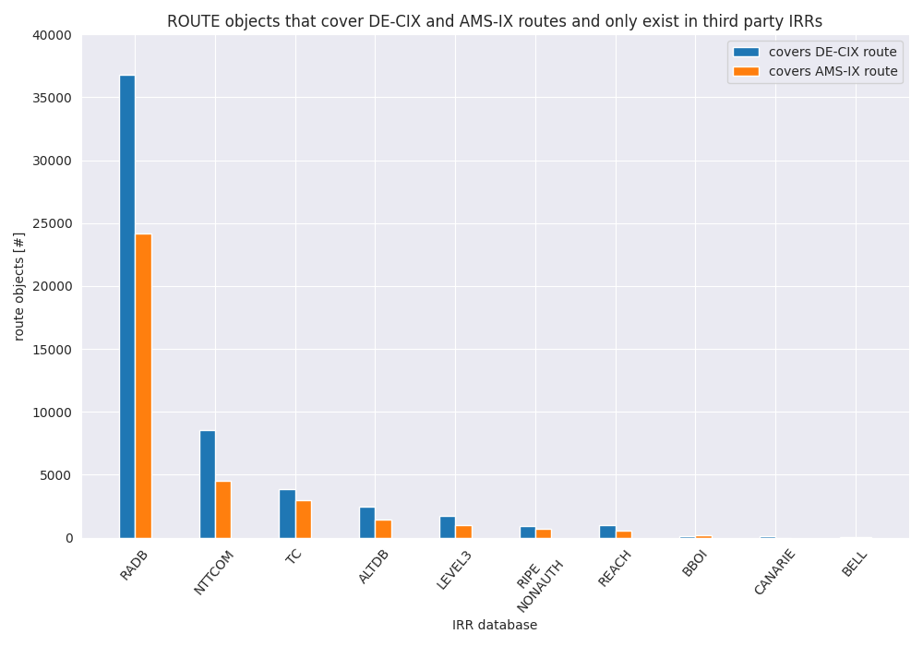
Vulnerable objects covering AMS-IX/DE-CIX routes
In total we identified 36k/56k vulnerable route objects relevant for AMS-IX/DE-CIX routes. >50% of them are in RADB.
Notes:
* Zoom in on the blue part -> how many of the “blue” objects are routed at AMS-IX and DE-CIX?

Slide 35
Q: Is the juice worth the squeeze?
A: Yes. There are still >230k route objects that are only stored in third-party IRRs that can be easily hijacked. All of these are routed in the DFZ and 36k/56k cover AMS-IX/DE-CIX routes.

Slide 36

Q: What about Legacy Space?
Notes:
Stavros

Slide 37
Let’s talk about Legacy space
In general, Legacy space is the space allocated to Organizations before the 5 RIRs where established
  But not all RIRs were established at the same time
  Oldest: RIPE NCC, founded in April 1992
  Youngest: AFRINIC, established in October 2004
Different ways of handling their corresponding Legacy space

Slide 38
Different RIR, different legacy approach
RIR | IRR access | RPKI access | Due diligence process
AFRINIC | no service agreement | service agreement | Yes*
APNIC | All** APNIC legacy space is under contract or was returned to IANA.
ARIN | service agreement | service agreement | Yes*
LACNIC | no service agreement | no service agreement | Yes*
RIPE NCC | no service agreement | service agreement | Yes*
* for service agreement
** To a level of 99%

Slide 39
Different RIR, different legacy approach
RIR | IRR access | RPKI access | Due diligence process
AFRINIC | no service agreement | service agreement | Yes*
APNIC | All APNIC legacy space is under contract or was returned to IANA.
ARIN | service agreement | service agreement | Yes*
LACNIC | no service agreement | no service agreement | Yes*
RIPE NCC | no service agreement | service agreement | Yes*
ARIN legacy remains the main obstacle.
* for service agreement

Slide 40
Different RIR, different legacy approach
All RIRs require due diligence for service agreement.
RIR | IRR access | RPKI access | Due diligence process
AFRINIC | no service agreement | service agreement | Yes*
APNIC | All APNIC legacy space is under contract or was returned to IANA.
ARIN | service agreement | service agreement | Yes*
LACNIC | no service agreement | no service agreement | Yes*
RIPE NCC | no service agreement | service agreement | Yes*
ARIN legacy remains the main obstacle.
* for service agreement

Slide 41
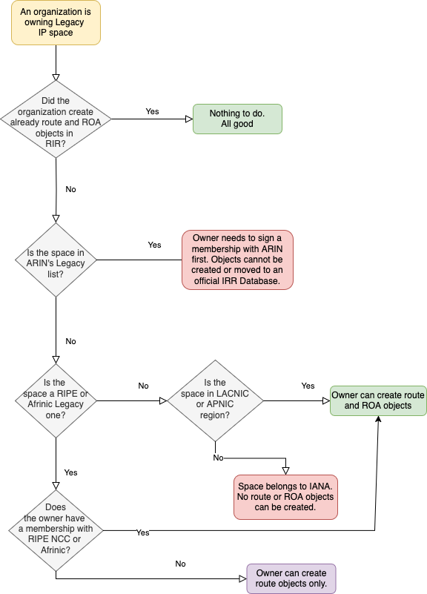
Legacy space reconsidered
Legacy Space is not an issue for everyone
  All legacy space except ARIN is “movable” to authoritative IRRs without a new service agreement
  ARIN legacy space requires a new service agreement
  New service agreement → convince RIR the space is yours

Slide 42
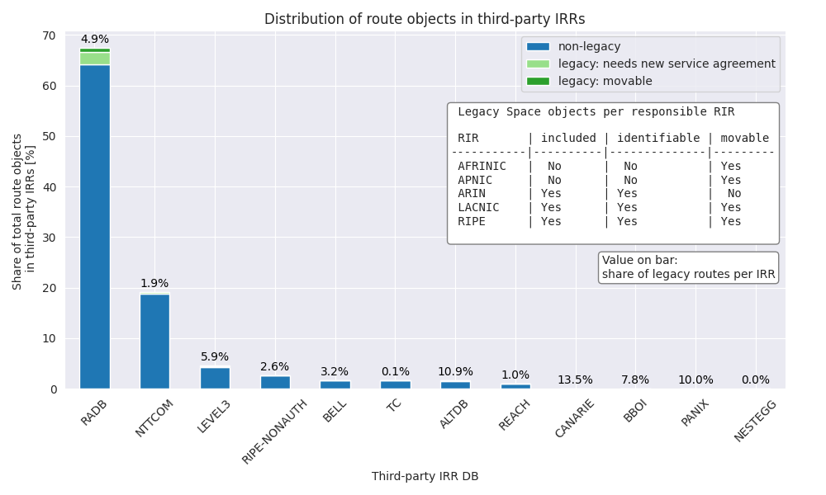
Where does legacy live?

Slide 43
Where does legacy live?
Only based on ARIN, LACNIC, RIPE data

Slide 44
Where does legacy live?
Mainly in RADB (4.9% of RADB objects)

Slide 45
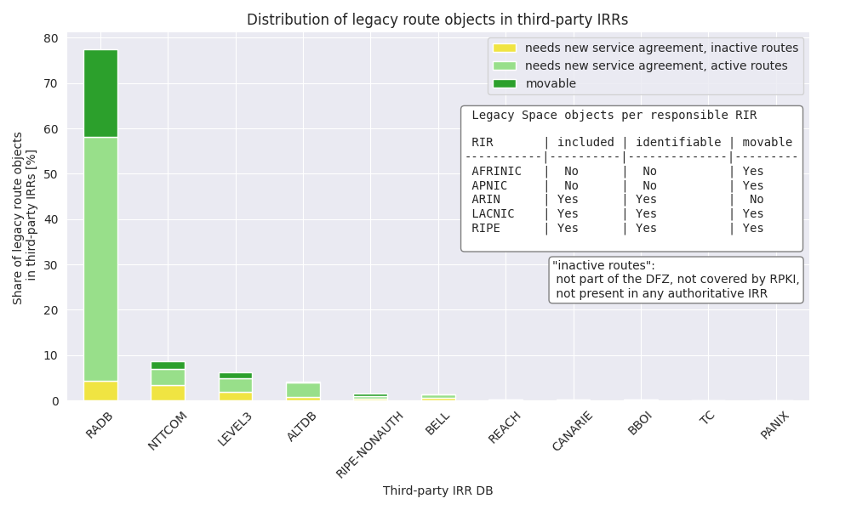
Global share per third-party IRR

Slide 46
Global share per third-party IRR
Movable = not ARIN
Not movable = ARIN
Possibly orphaned objects

Slide 47
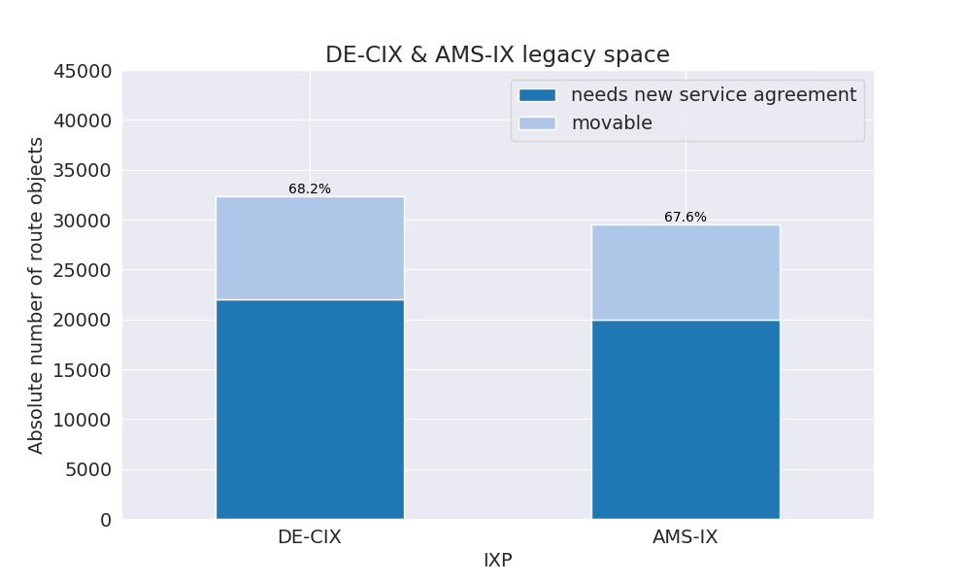
Per-IXP fraction plot of route objects
Not sure if we want to show that result in the presentation.

Slide 48
Q: What about Legacy Space?
A: 3 of 4* relevant RIRs provide IRR services to non-member legacy space holders. ARIN legacy remains problematic with a share of 3.27% of all global route objects in third-party IRRs. These route objects need a new service agreement.
* excluding APNIC

Slide 49
Conclusions
Do authoritative IRRs represent operators better than third-party IRRs?
  They do → more frequent updates, more coherence with DFZ
Is the juice worth the squeeze?
  >80% of low quality objects exist in third-party IRRs like RADB
  We found more than 230k injectable/vulnerable route objects
What about legacy space?
  ARIN remains problematic, for other RIRs non-member IRR services exists
  We found 3.27% ARIN legacy route objects in third-party IRRs, mostly in RADB

Slide 50

Outlook
The following study will be conducted during the next period
Extract the vulnerable prefixes that exist in AMS-IX/DE-CIX Route Servers
Identify the ones that might be lost and map them to organizations
Measure the amount of traffic flowing into the lost prefixes.

Slide 51
Sneak peek !!!
Can RPKI replace the missing ROUTE/ROUTE6 objects ?
  Created full emulations of AMS-IX & DE-CIX Route Server eco-system
    All peers and their advertised prefixes are emulated against a production
    replica Route Server
    Utilized IRRDv4 to create pseudo ROUTE/ROUTE6 objects based on ROAs.
  Generated configurations for the Route Servers following different scenarios
    AUT-NUM + AS-SETs from all IRR DBs but ROUTE/ROUTE6 objects
    from AUTH IRR DBs + RPKI
    AUT-NUM/AS-SETs/ROUTE/ROUTE6 objects from AUTH IRR DBs only
  Comparing export tables before/after to identify exactly what is being lost.

Slide 52
Extra take aways
Leading IXPs are investigating ways to abandon 3rd party IRRDBs
RIPE initiated discussions to ditch RIPE-NONAUTH
IETF introducing drafts (draft-romijn-grow-rpsl-registry-scoped-members-01) for scoped members, therefore minimizing the need for storing multi-IRR objects in 3rd party DBs
Discussion in PeeringDB to include a “supported IRRDBs” field.

Slide 53

Thank you
P.S:
We publish the results of our research in a series of RIPE Labs articles. You can find the first two in the following URLs:
https://labs.ripe.net/author/stavros-konstantaras/the-irr-landscape-where-do-ases-keep-their-routes
https://labs.ripe.net/author/tobias-striffler/the-irr-landscape-data-quality-the-good-the-bad-and-the-outdated/
Notes:
* Extra backup slides?

Slide 54
RIPE NCC & AFRINIC
Both follow the same approach
  Legacy resource holders without a membership signed have access to WHOIS DB and are allowed to create RPSL objects
  Without a membership signed, resource holders are excluded from RPKI
  It is possible to import your Legacy space and have it fully registered by completing the necessary paperwork (and thus receive RPKI services).

Slide 55
APNIC and LACNIC
All LACNIC assigned space (even the legacy one) already exists in the DB.
  Legacy resource holders without membership are allowed to both
  IRR and RPKI services (but these are very few cases).
  APNIC reclaimed their legacy space (without active contract) via a policy.
  After several years of effort this project is concluded and even some of the reclaimed space was given back to IANA.
    Nowadays, all APNIC account holders with historical resources can now access RPKI services
Notes:
* Very few cases is hearsay, isn’t it?

Slide 56
The ARIN way
  If a user or a company wants to import its legacy space in ARIN, he needs to sign an agreement with ARIN and pay full ARIN membership.
    If no agreement is signed, no IRR and RPKI services are given to them by ARIN
    (but they can have an account and maintain e.g. reverse DNS delegations).
    ARIN keeps track of its legacy space which is being exported in a separate FTP export.
  HOWEVER: On January 16th former US president Biden ordered the FCEB agencies to take actions to ensure that all of their assigned Internet number resources (IP address blocks and ASNs) are covered by a Registration Services Agreement with the American Registry for Internet Numbers or another appropriate regional Internet registry.
Notes:
Remove the Presidential decree stuff?

Slide 57
Conclusions
From the presented results, we can safely conclude that data quality in third party IRR DBs is disappointing
  Contain outdated or irrelevant information
  Contain duplicated information
  Authorization model cannot be applied, posing serious trust and security risks
Notes:
Should relate back to the first slide with questions and how we answer them

