Slide 1

KINDNS
An Initiative to Promote DNS Operational Best Practices
Ulrich Wisser
Regional Technical Engagement Manager, Europe
ICANN

Slide 2

What Is It?
Knowledge-sharing and Instantiating Norms for DNS (Domain Name System) and Naming Security
A simple framework that can help a wide variety of DNS operators, from small to large, to follow both the evolution of the DNS protocol and the best practices that the industry identifies for better security and more effective DNS operations.
….. is pronounced ”kindness”

Slide 3
Targeted Operators
TLDs & Critical Zones
SLDs
Authoritative Operators
Close & Private
Shared Private
Public
Resolver Operators
Hardening the Core System
Each category has 6-8 practices that we will encourage operators to implement. See www.kindns.org, for more details
By joining KINDNS, DNS operators are voluntarily committing to adhere to these identified practices and act as “goodwill ambassadors” within the community.

Slide 4

Authoritative DNS Operators of Critical Zones
1. MUST be DNSSEC signed and follow key management best practices
2. Transfer between authoritative servers MUST be limited
3. Zone file integrity MUST be controlled
TLDs & Critical Zones
4. Authoritative and recursive nameservers MUST run on separate infrastructure
5. A minimum of two distinct nameservers MUST be used for any given zone
6. There MUST be diversity in the operational infrastructure: Network, Geographical, Software
7. The infrastructure that makes up your DNS infrastructure MUST be monitored

Slide 5
Authoritative DNS Operators of SLDs
1. MUST be DNSSEC signed and follow key management best practices
2. Transfer between authoritative servers MUST be limited
3. Zone file integrity MUST be controlled
SLDs
4. Authoritative and recursive nameservers MUST run on separate infrastructure
5. A minimum of two distinct nameservers MUST be used for any given zone
6. Authoritative servers for a given zone MUST run from diversified infrastructure
7. The infrastructure that makes up your DNS infrastructure MUST be monitored

Slide 6
Closed & Private Resolver Operators
Private resolvers are not publicly accessible and cannot be reached over the open internet. They are typically found in corporate networks or other restricted-access networks
1. DNSSEC validation MUST be enabled
2. Access control list (ACL) statements MUST be used to restrict who may send recursive queries
3. QNAME minimization MUST be enabled
Closed & Private resolvers
4. Authoritative and recursive nameservers MUST run on separate infrastructure
5. At least two distinct servers MUST be used for providing recursion services
6. The infrastructure that makes up your DNS infrastructure MUST be monitored
7. DoT (DNS-over-TLS) or DoH (DNS-over-HTTPS) SHOULD be enabled

Slide 7
Public Resolver Operators
“Fully open” public DNS resolvers are available to any users on the Internet freely to use, whether they are stub resolvers (clients) or recursive servers using the open resolver as a forwarding service.
1. DNSSEC validation MUST be enabled
2. DoT (DNS-over-TLS) or DoH (DNS-over-HTTPS) MUST be enabled
3. QNAME minimization MUST be enabled
Closed & Private resolvers
4. Authoritative and recursive nameservers MUST run on separate infrastructure
5. At least two distinct servers MUST be used for providing recursion services
6. The infrastructure that makes up your DNS infrastructure MUST be monitored
7. DNS Query data MUST only be retained for as long as is necessary for the sound operation of the service offered

Slide 8
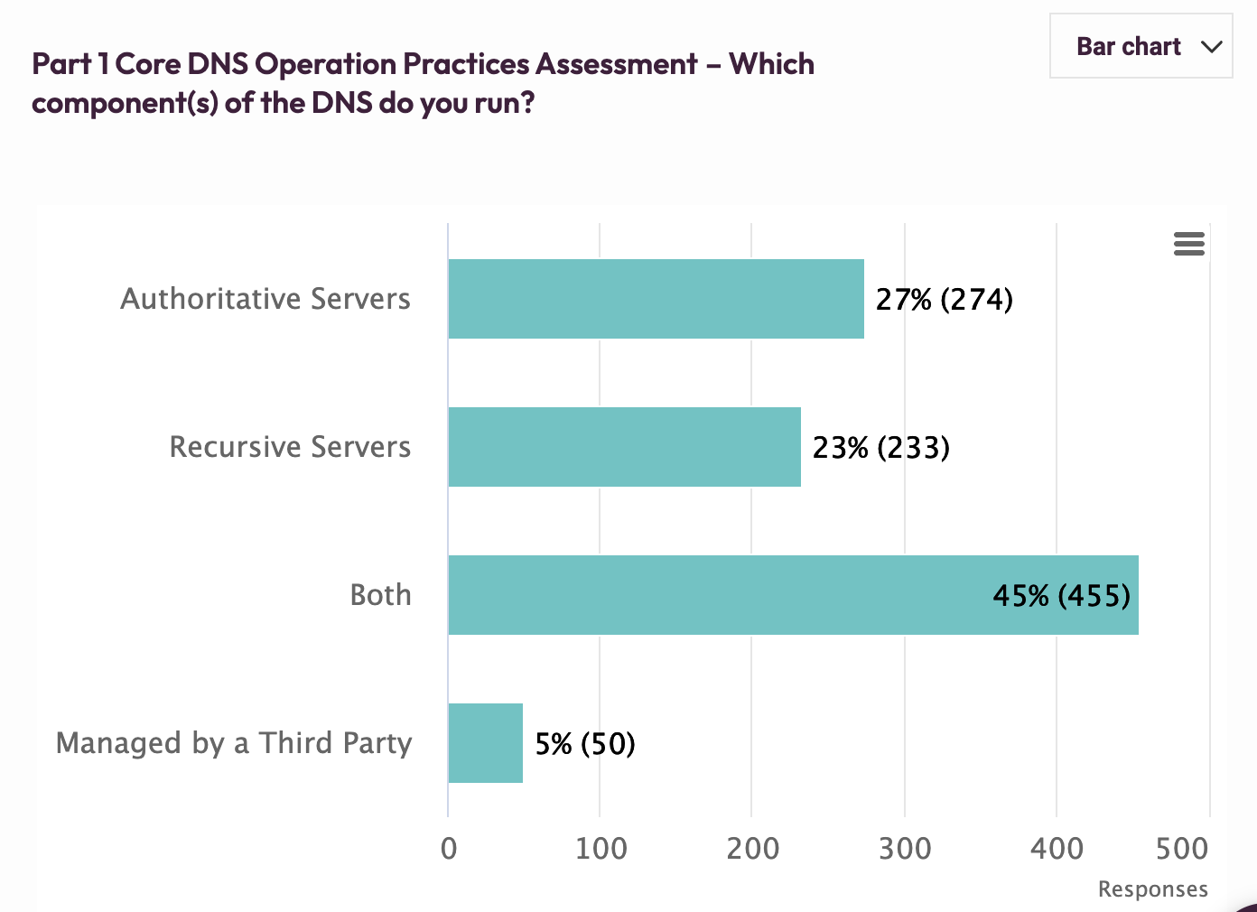

Slide 9
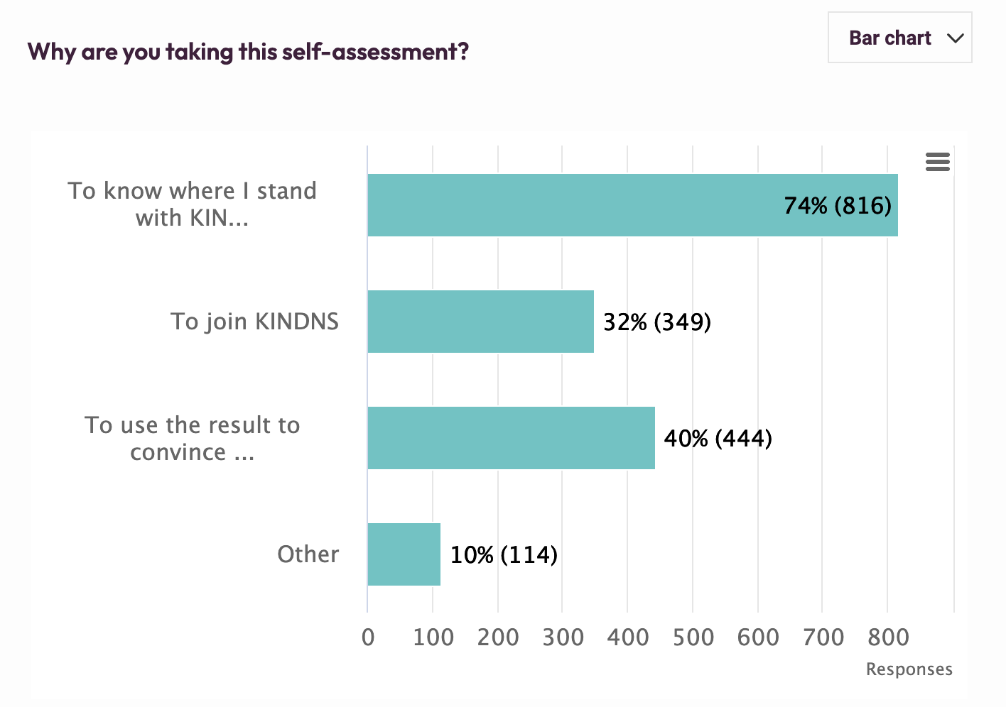

Slide 10
DNSSEC Statistics

Slide 11
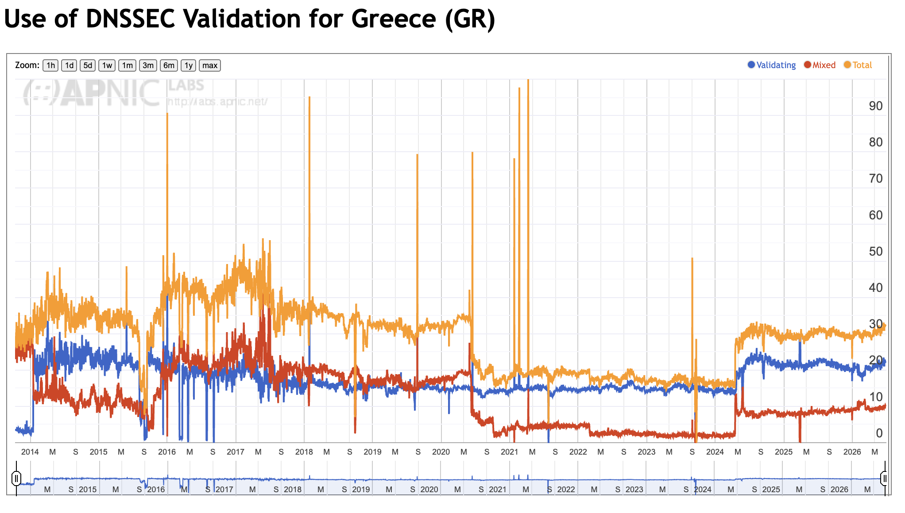
Source: APNIC Labs https://stats.labs.apnic.net/dnssec/GR

Slide 12
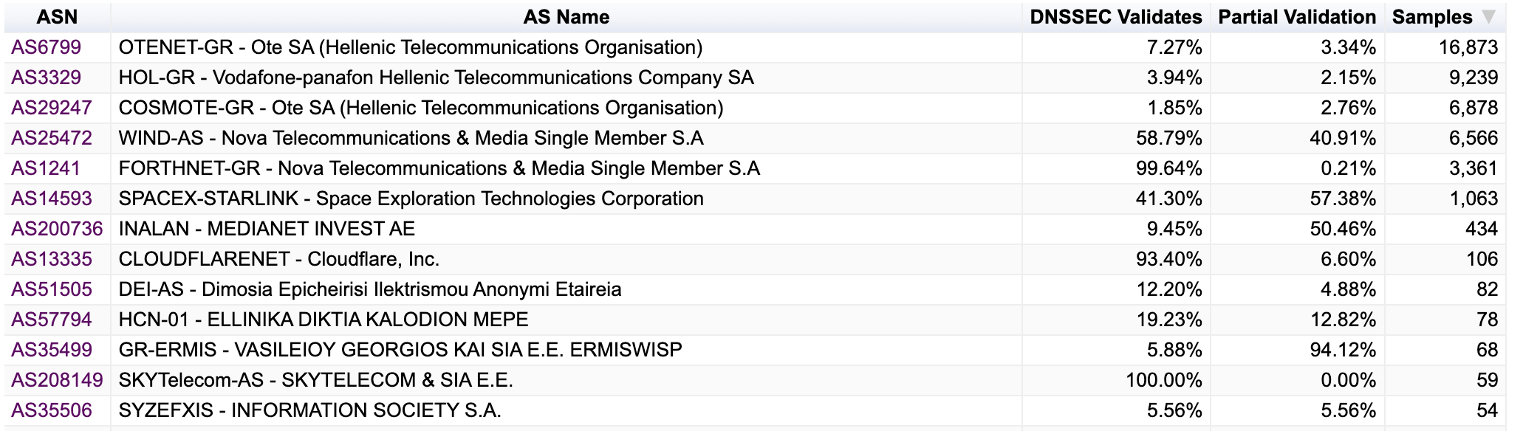
Source: APNIC Labs https://stats.labs.apnic.net/dnssec/GR

Slide 13
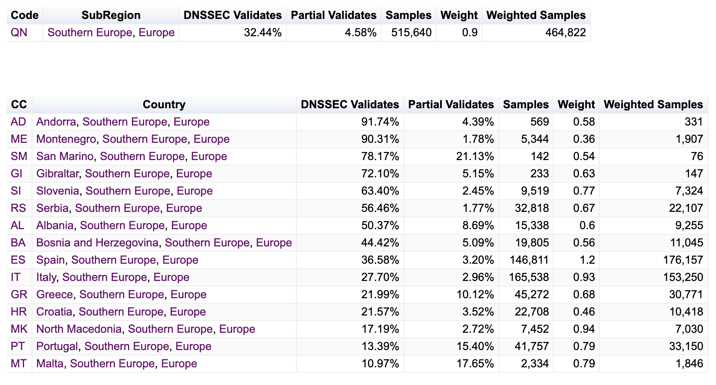
Source: APNIC Labs https://stats.labs.apnic.net/dnssec/QN

Slide 14
KSK Rollover

Slide 15
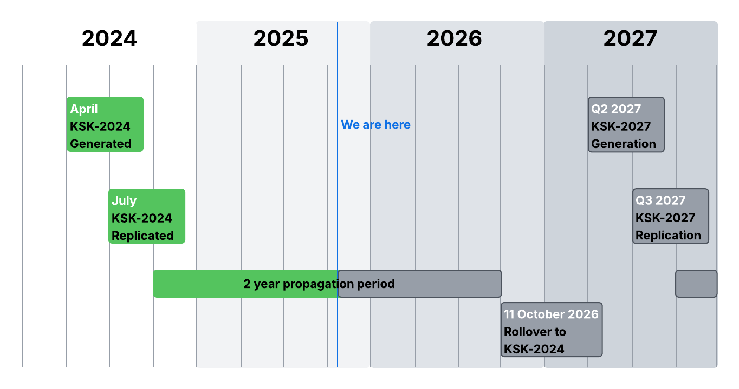
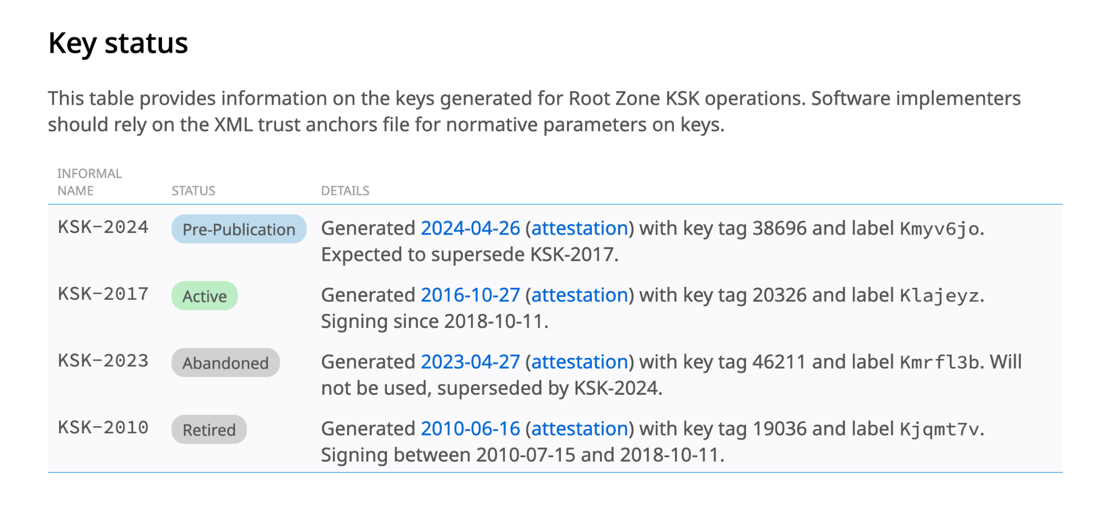
KSK Rollover
Introduces a new Root Zone KSK (KSK-2024)
Updates the DNS root trust anchor
Gradually transitions systems to trust the new key
Notes:
Explain that cryptographic keys should not remain in use indefinitely.
The rollover replaces the current trust anchor with a new one through a carefully managed and phased process.
Compare this to changing passwords or renewing security certificates as part of good security hygiene.
Emphasize that this is a planned transition conducted under normal operational conditions to help maintain long-term trust in the DNS.

Slide 16
Trust Anchor Management
Trust anchors are critical for validation
Resolvers using RFC 5011 can:
Automatically learn new trust anchors
Update trust anchors without manual intervention
Resolvers not using RFC 5011 may require:
Manual trust anchor updates
Configuration validation
Additional operational testing
Risk: Resolvers without the new trust anchor may return SERVFAIL responses
Notes:
Explain that validating resolvers rely on the root KSK as their trust anchor.
If a resolver does not trust the new KSK after the transition, DNSSEC validation may fail.
RFC 5011 provides the standard mechanism for automated trust anchor updates and significantly reduces operational burden.
Operators should verify:
RFC 5011 support is enabled,
updates function correctly,
and policies do not block automated trust anchor updates.
Organizations relying on manual trust anchor management should update and test configurations well before activation milestones.

Slide 17
Operator Preparation Checklist
Preparation checklist
✔ Verify RFC 5011 support
✔ Confirm trust anchor configuration
✔ Test validating resolvers
✔ Review monitoring and alerting
✔ Update operational documentation
✔ Follow ICANN and IANA updates
Notes:
Present this slide as the practical operational takeaway.
Encourage organizations to prepare early rather than waiting for key milestones.
Routine testing, monitoring, and configuration reviews remain the best defenses against operational problems during the rollover.

Slide 18
Checking my Resolver Readiness

Slide 19
Let’s check if your resolver does do DNSSEC validation
Run the following command for all your Resolvers, where you replace <ip-address> with the IP address of each resolver.
dig @<ip-address> dnssec-failed.org +dnssec
If the answer contains status: SERVFAIL
Your resolver does do DNSSEC validation and you should follow on with this guide.
If you got an answer with an IP address, your resolver does not perform DNSSEC validation and you don’t need to do anything about the Root-Key rollover. But you should of course consider switching on DNSSEC validation.

Slide 20
DNS as a Service
Protective DNS is used by many organizations. Obviously you can’t do anything about the Root KSK Rollover as you don’t run DNS Resolvers your own, but you can ask your service provider what they are doing.

Slide 21
Commercial Software
If you use a commercial software the new key should already be included in one of your latest updates. You should install the latest updates and if you for some reason can’t do that, you should plan for an update some time before 11 October 2026. Talk to your vendor about the Root KSK Rollover and ask in what update the new key is/will be included.

Slide 22
New Trust Anchors, where to find them
You can use curl or wget to obtain the official trusted anchors file in XML format directly from the IANA data repository:
curl -O https://data.iana.org/root-anchors/root-anchors.xml

Slide 23
New Trust Anchors, where to find them
You can use a command similar to the following to extract all the keys in the generally accepted format for the BIND Resolver configuration for example:
awk '/<KeyDigest/,/<\/KeyDigest>/ {print}' root-anchors.xml | awk '
/<\/KeyDigest>/ { if(tag!="") print " . static-ds " tag " " alg " " type " \"" dig "\";"; tag=""; alg=""; type=""; dig="" }
/<KeyTag>/ {gsub(/<\/?KeyTag>/,""); gsub(/[ \t]/,""); tag=$0}
/<Algorithm>/ {gsub(/<\/?Algorithm>/,""); gsub(/[ \t]/,""); alg=$0}
/<DigestType>/ {gsub(/<\/?DigestType>/,""); gsub(/[ \t]/,""); type=$0}
/<Digest>/ {gsub(/<\/?Digest>/,""); gsub(/[ \t]/,""); dig=$0}
'
You should get something similar to this:
. static-ds 19036 8 2 "49AAC11D7B6F6446702E54A1607371607A1A41855200FD2CE1CDDE32F24E8FB5";
. static-ds 20326 8 2 "E06D44B80B8F1D39A95C0B0D7C65D08458E880409BBC683457104237C7F8EC8D";
. static-ds 38696 8 2 "683D2D0ACB8C9B712A1948B27F741219298D0A450D612C483AF444A4C0FB2B16";

Slide 24
Open Source Software: BIND
There are several methods of configuring DNSSEC validation in BIND.
Please check your BIND configuration for the following statement “dnssec-validation auto;”.
BIND will update the trust-anchor automatically. In the latest versions of BIND this configuration is the default. If “dnssec-validation” is not configured at all, it means you are on “auto”.
If your configuration says “dnssec-validation yes;” please consider changing to “auto”.
If you can’t change to “auto” you will need to update the key file manually. Please see below for the correct content.
If your bind configuration contains a section called “trust-anchors”
  you should have a list of keys, which starts with “. initial-ds” or “. initial-key”.
  If you see a definition containing “. static-ds” or “. static-key” you need to either change the “static” to “initial” or add the new key manually to your configuration.
Notes:
Please check with the vendor of your software. They will probably already have a plan or update that you should install.
From here on there is the process to check some the most popular open-source resolvers.

Slide 25
Open Source Software: BIND
Run “rndc managed-keys status”
It should display two keys, one with keyid 20326 (current KSK from 2017 to be replaced) and one with keyid 38696 (new replacement KSK 2025).
Run “rndc secroots”
It writes a file called “named.secroots” (see below for folders to check). It should contain two keys as
./RSASHA256/20326
./RSASHA256/38696
If you do not use views, your current initial set of trust-anchors should be in a file named “bind.keys” (usually in /etc/bind) and the dynamic set of trust-anchors “managed-keys.bind” (usually in /var/cache/bind), usually found where your bind configuration lives. If you use views, you should have one or more “.mkeys” files. Check the files, they should contain two keys.
Notes:
Folders to check may include:
/etc/bind/
/etc/named/
/var/lib/bind/
/var/named/
/var/cache/bind/
/var/named/dynamic

Slide 26
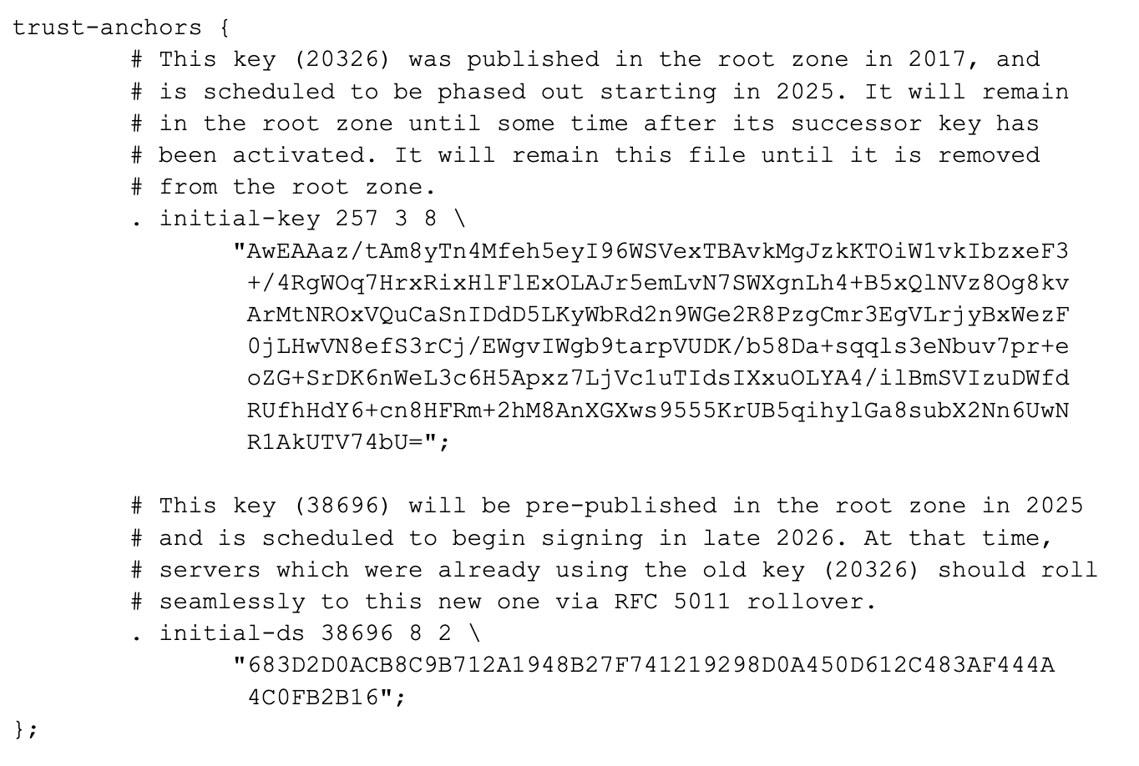
Open Source Software: BIND
Here is an example of the file bind.keys contents that is created by a current version of bind when you first install bind on a machine:
Notes:
Explain this may change if you have installed BIND long time ago.

Slide 27
Open Source Software: UNBOUND
There are several methods of configuring DNSSEC validation in unbound.
Please check your unbound configuration for the following statement "auto-trust-anchor-file:” Unbound will update the trust-anchor automatically. Check the file for correct contents.
If your configuration uses "trust-anchor-file:" or “trusted-keys-file:” statements please consider changing to auto-trust-anchor-file. If you can't change to auto-trust-anchor-file you will need to update the key file manually. Please see below for the correct content.
If your unbound configuration contains "trust-anchor:" the keys are defined explicit. Check that both keys (keyid 20326 and 38696) are in the list. Preferably switch to “auto-trust-anchor-file:”.

Slide 28
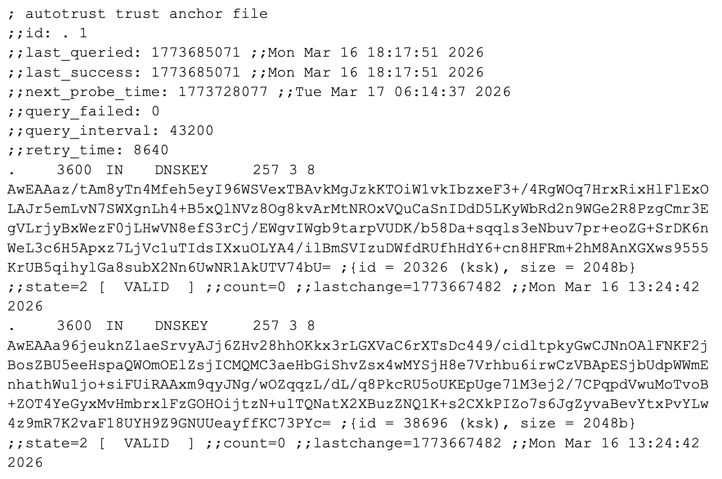
Open Source Software: UNBOUND
Depending on the configuration statement you use, please check the file configured to have a content similar to the content below.

Slide 29
Open Source Software: UNBOUND
Finally run
dig @<ip-address> trustanchor.unbound CH TXT +noall +nocomments +answer
Against your resolver. The answer should contain one line with
trustanchor.unbound. 0 CH TXT ". 20326 38696"

Slide 30
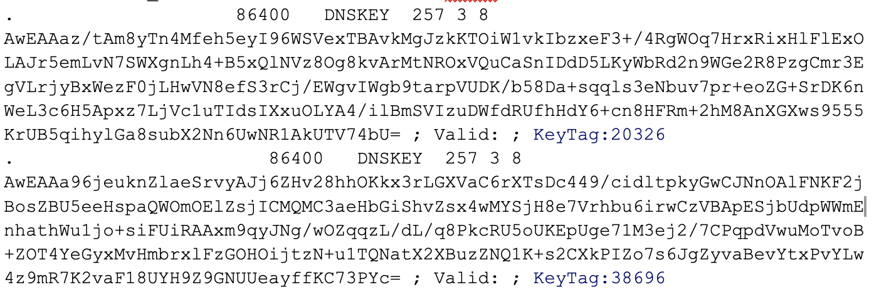
Open Source Software: KNOT
Since version 4.0 Knot Resolver has switched on DNSSEC validation by default. No trust-anchor file is needed, everything is compiled into the executable.
Check your configuration for any appearance of “trust_anchors”. Please check with the Knot documentation at https://knot-resolver.readthedocs.io/en/stable/config-dnssec.html how to proceed.
There is an undocumented way of checking (given to us by the Knot developers), this may or may not work in your version of the knot-resolver.
$ echo 'trust_anchors.summary()' | sudo socat - /run/knot-resolver/control/0

Slide 31
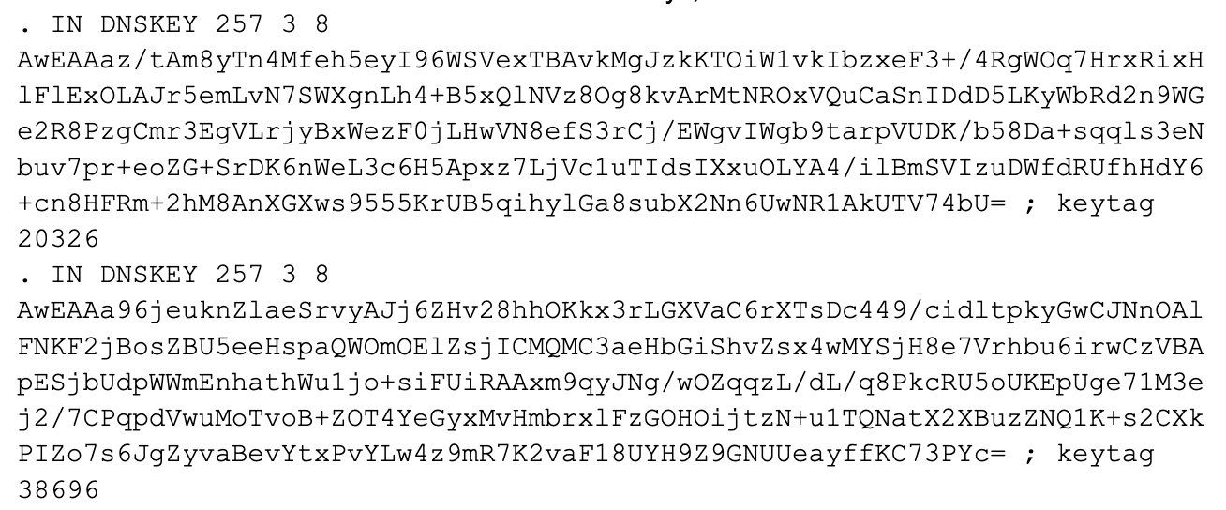
Open Source Software: PowerDNS
Please check your configuration for “trustanchorfile“. It gives you the location of the file to check for the trust-anchors. Please make sure the file contains both keys, similar to

Slide 32
Open Source Software: PowerDNS
Additionally you can run
rec_control get-tas
The output should look like this
Configured Trust Anchors:
.
20326 8 2
e06d44b80b8f1d39a95c0b0d7c65d08458e880409bbc683457104237c7f8ec8d
38696 8 2
683d2d0acb8c9b712a1948b27f741219298d0a450d612c483af444a4c0fb2b16
When you restart your resolver, please check for a message saying something similar to
you need to update package with trust anchor
In that case you should strongly consider changing to an updated version of Knot Resolver. The new key is shipped with Knot since summer 2024.

Slide 33

Stay Informed and Contribute
Website | www.kindns.org
Twitter | https://twitter.com/4KINDNS
E-Mail | info@kindns.org
Mailing list | kindns-discuss@icann.org

