Slide 1




DNS4EU:
Public DNS Resolver Infrastructure
Panagiotis Palias | Sr. Technical Consultant
Project number: 101095329 21-EU-DIG-EU-DNS
Project name: DNS4EU and European DNS Shield.
This project is co-funded by the European Union.

Slide 2


DNS ∩ Cybersecurity
> 20B
connected devices
>90%
of attacks rely on DNS at some point of the cyber kill chain
Notes:
Let’s consider the following facts
On the one hand nowadays there are 15B connected devices
This number is expected to grow to 23B by the end of this year
A security nightmare trying to protect each and every one of these.
Someone could ask? Is there any common denominator? Is there something we can apply at-scale?
Here the answer would be YES!
Industry-wide research shows that more than 94% of attacks rely on DNS at some point of the cyber kill chain.
Adding to the recipe the fact that all the devices regardless of their OS are using DNS resolution,
as defenders,
we have a unique opportunity to protect them at scale

Slide 3
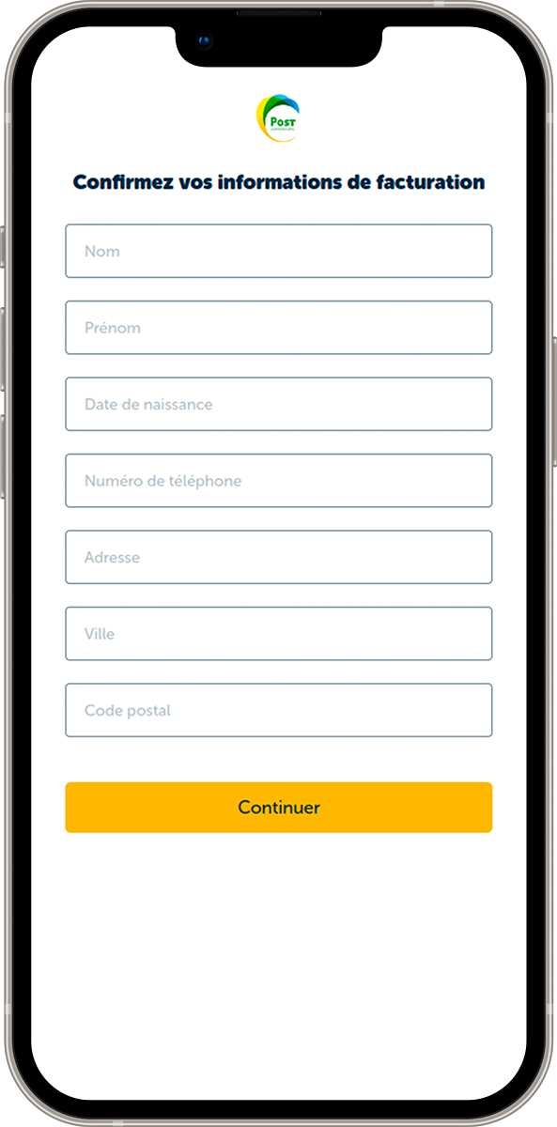
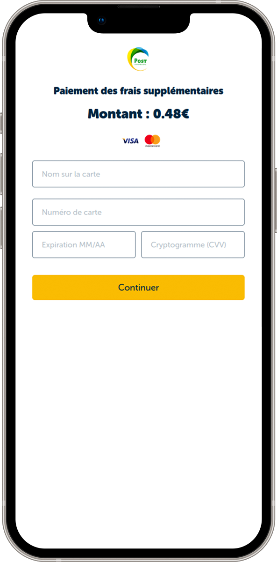
Real-life example: Luxembourg
Fake Post Case (post-client-lu.com)
Personal information
Credit card
SMS
E-mail

Slide 4
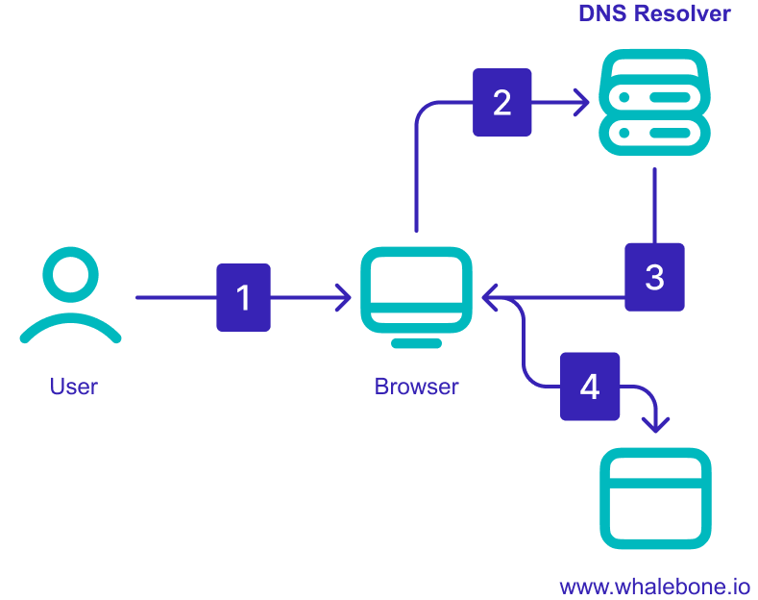

(Protective) DNS Resolvers 101
1) User wants to visit post-client-lu.com
2) What is the IP address of post-client-lu.com?
3) The domain post-client-lu.com is malicious. We do not recommend you visit it.
4)
post-client-lu.com

Slide 5

DNS4EU Introduction

Slide 6
DNS4EU
An initiative of the European Commission to provide an alternative to the dominant public DNS resolvers in the market.
Goal of European Commission
Strengthen the digital security and independence of the European Union.
Provide EU citizens, companies, and institutions with a secure, privacy-compliant, and powerful recursive DNS.
Challenge
EU governmental institutions and citizens are not well protected with slow reaction on threats. Solutions offering DNS level protections are not located in EU.
Solution
Create an independent EU-based DNS protection with real-time reaction on threats with easy distribution to the citizens and institutions.

Slide 7
DNS4EU Consortium
Project Leader
🇨🇿 Whalebone, s.r.o.
Consortium members
Associated partners
🇨🇿 CZ.NIC
🇨🇿 Czech Technical University Prague
🇧🇪 Time.lex
🇩🇪 deSEC
🇭🇺 Sztaki
🇮🇹 ABI Lab Centro di Ricerca e Innovazione per la Banca
🇵🇱 Naukowa i Akademicka Sieć Komputerowa
🇷🇴 Directoratul Național de Securitate Cibernetică
🇧🇬 Ministry of Electronic Governance
🇨🇿 CESNET
🇫🇮 F-Secure
🇵🇹 Centro Nacional de Cibersegurança
Notes:
Whalebone is a cybersecurity company that brings next-generation DNS security to T1 Telcos, regional ISPs, and enterprises all over the world.
Their products already protect more than 350 companies and millions of their customers from malware, phishing schemes, and other malicious attacks targeted at all types of internet-connected devices.
Whalebone’s mission is to bring cybersecurity to 1 billion internet users by the end of the decade.

Slide 8
DNS4EU goal:
Protect 100 million EU citizens on the DNS level
How will this goal be achieved?
Central protection of government institutions such as hospitals, schools or municipalities which are highly vulnerable because they handle sensitive data.
Superior DNS resolution for MNOs and ISPs to safeguard their networks and monetize premium security services.
Strengthened collaboration with CERTs and CSIRTs, endorsing their participation to enhance threat intelligence exchange, effectively addressing both global and local cybersecurity threats.
Public EU resolver, providing a free, rapid, reliable, and private DNS resolution service accessible to the end-users.

Slide 9
Input
Threat intelligence data
In-house research
External feeds
CERT feeds
Basic Pillars
Output
Protection
of millions of users
and organisations

Slide 10

European
DNS Shield
ISP
resolver
Telco
resolver
Government
resolver
CERT
Poland
Banks
CERT
Czech republic
Government
Retail
CERT
Romania
Information Sharing
& Analysis Centre
Threats,
IoCs
CERT
Portugal
Postal Service

Slide 11




Main distribution channels
DNS4EU Threat Intelligence
DNS4EU for Telcos & ISPs
Main distribution channel
Millions of users covered
Offered as added-value service
DNS4EU for Public
Pure resolution
Protected resolution
(Protected resolution
with Adult filtering)
(Protected resolution
with Ad-filtering)
DNS4EU for Governments
Main distribution channel
Hierarchical structure
with multi-tenancy
(municipalities VS ministry)

Slide 12
DNS4EU Public DNS Resolvers

Slide 13
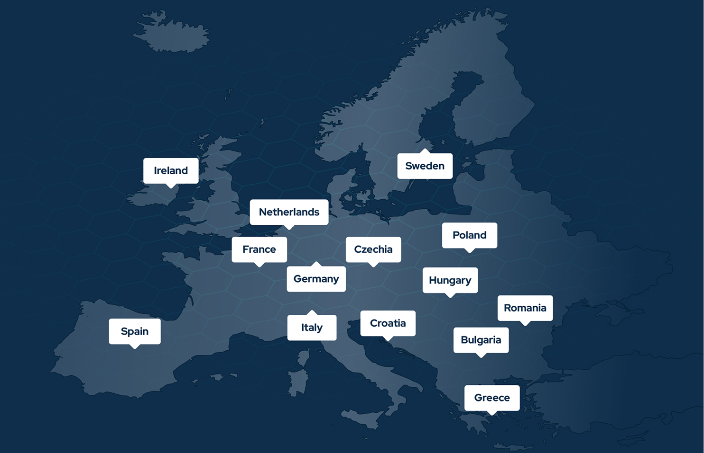
DNS4EU Public Resolvers
14 locations
Most utilized locations:
  Germany
  France
  Netherlands
Anycast with FRR BGP
In-house monitoring and Perfops/RIPE Atlas
2 CPUs 4GB ram / 5k QPS

Slide 14
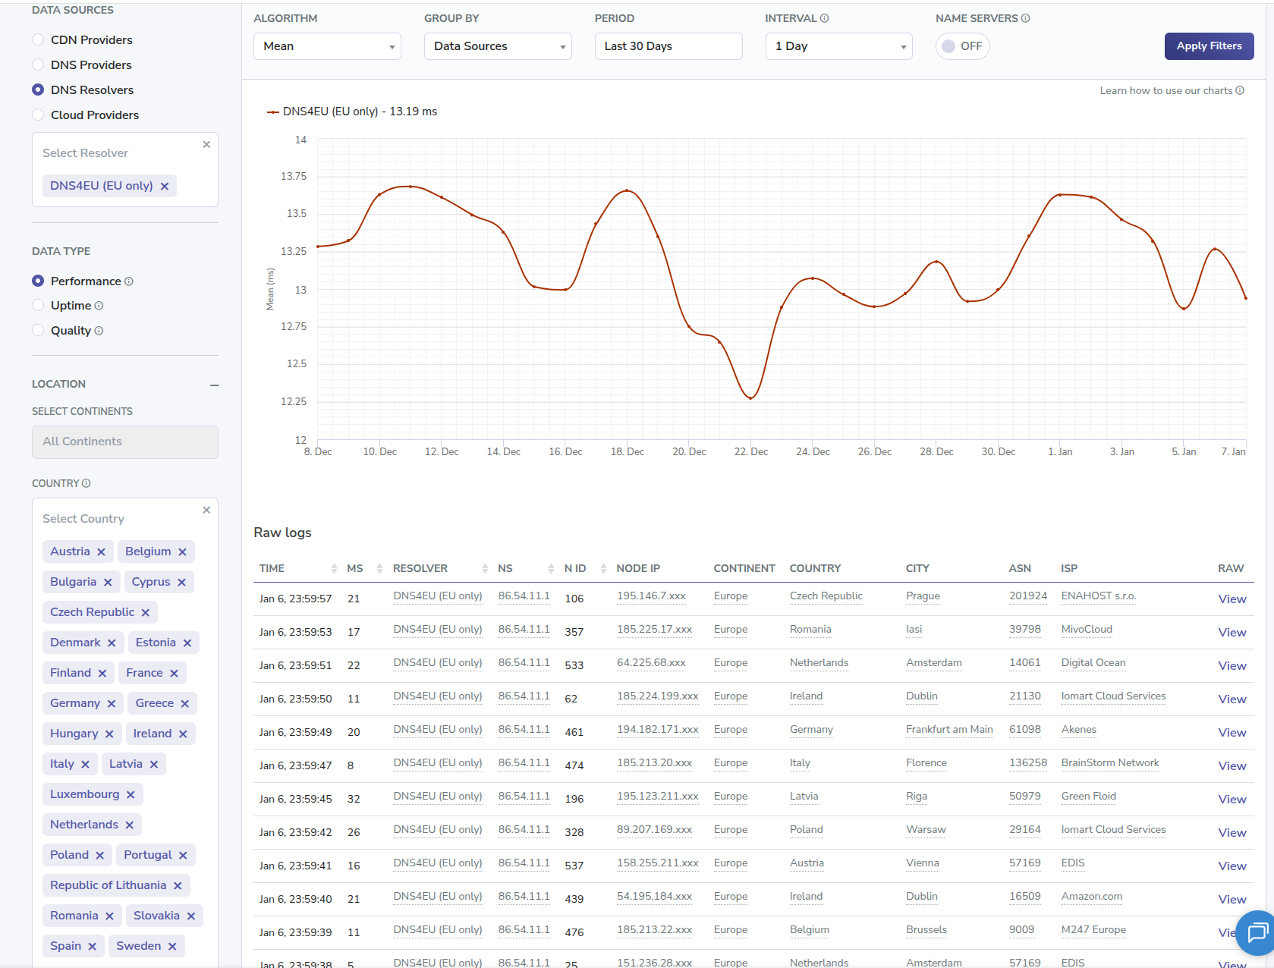
Latency
13.19 ms
average latency within EU
measured by Perfops
7 ms
median latency within EU
measured by Perfops
41.64 ms
p95 latency within EU
measured by Perfops

Slide 15
The 5 variants of Public Service
Type | IP address | DNS over HTTPS | IPv6 | Description
Protective Resolution | 86.54.11.1 86.54.11.201 | protective.joindns4.eu/dns-query | 2a13:1001::86:54:11:1 2a13:1001::86:54:11:201 | Avoid access to websites with fraudulent or malicious content.
Protective Resolution With Child Protection | 86.54.11.12 86.54.11.212 | child.joindns4.eu/dns-query | 2a13:1001::86:54:11:12 2a13:1001::86:54:11:212 | Avoid access to websites inappropriate to children like sexual content, violence or drugs on top of the protective functionality.
Protective Resolution With Ad Blocking | 86.54.11.13 86.54.11.213 | noads.joindns4.eu/dns-query | 2a13:1001::86:54:11:13 2a13:1001::86:54:11:213 | Hide the advertisement on the websites and in the applications on top of the protective functionality.
Protective Resolution With Child Protection & Ad Blocking | 86.54.11.11 86.54.11.211 | child-noads.joindns4.eu/dns-query | 2a13:1001::86:54:11:11 2a13:1001::86:54:11:211 | Avoid access to websites inappropriate to children like sexual content, violence or drugs. Plus filter the advertisement on top of the protective functionality.
Unfiltered Resolution | 86.54.11.100 86.54.11.200 | unfiltered.joindns4.eu/dns-query | 2a13:1001::86:54:11:100 2a13:1001::86:54:11:200 | Option for the users who are confident about security of their devices and connection and looking for fast, reliable and anonymized resolution service.

Slide 16
Usage or the Public DNS Resolver – First 6 months
Daily Volume: ~2.6B Queries
Peak Throughput: ~55k QPS (in Peak Hour)
Unique Daily Users: ~208,000
the calculation considers in average:
12500 queries / day / user

Slide 17
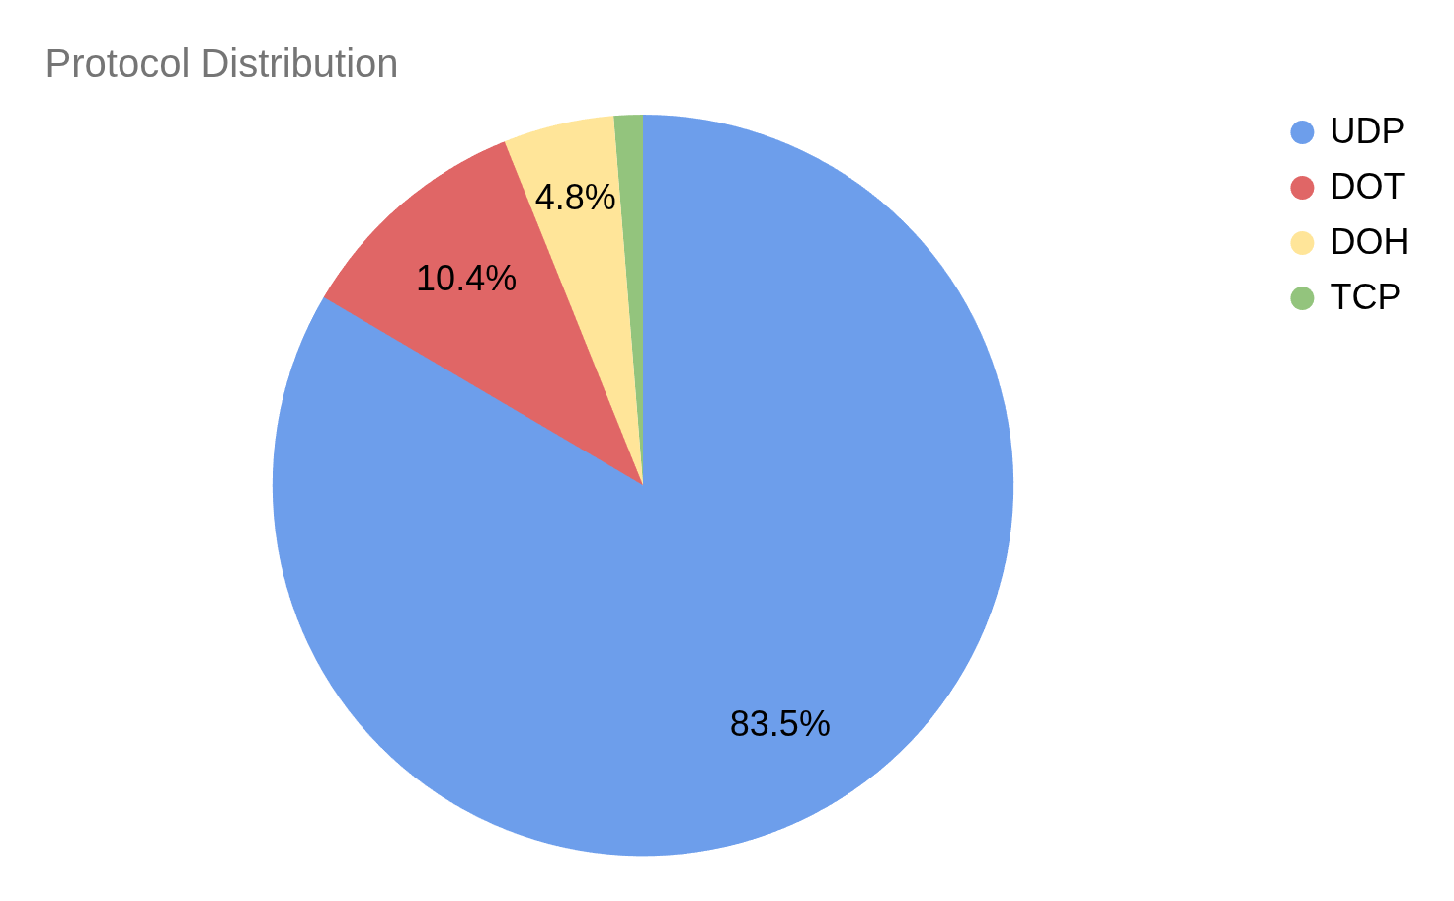
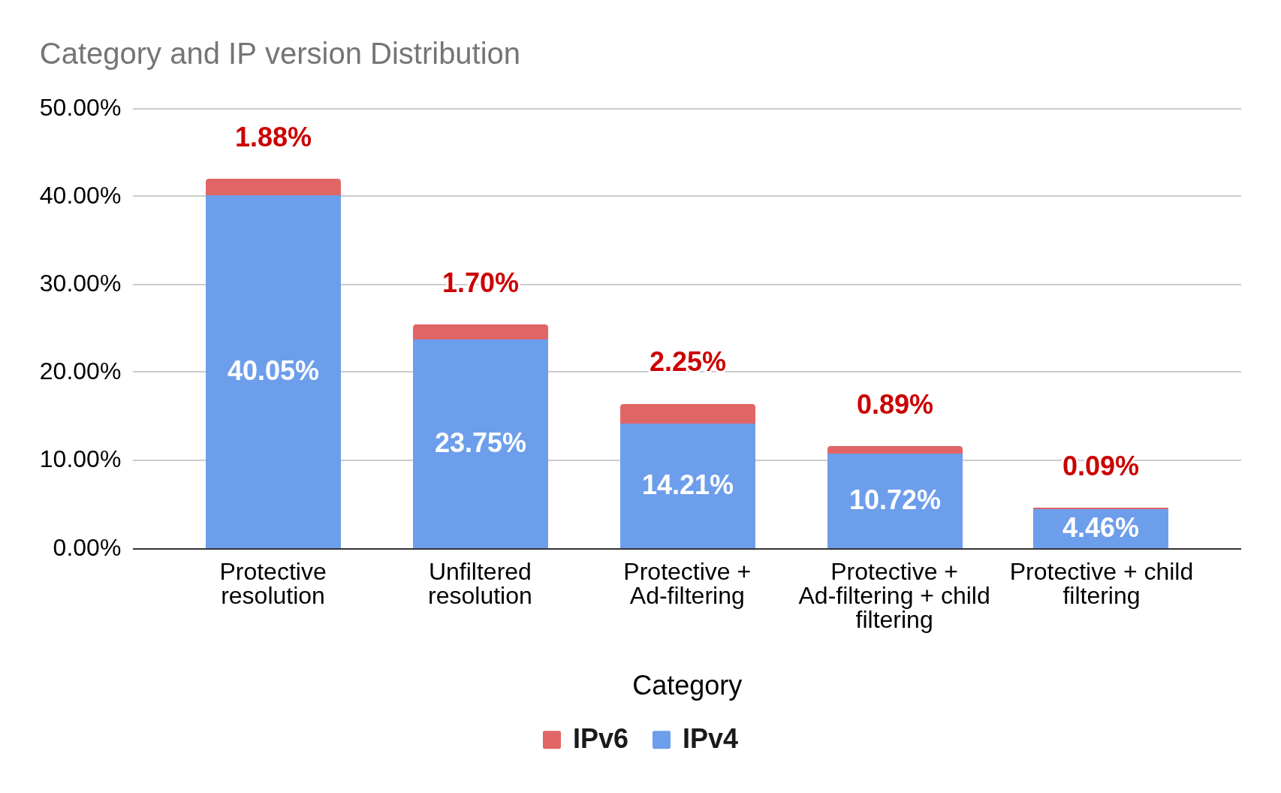
Usage or the Public DNS Resolver 2/2
Protocol Distribution
Category Distribution

Slide 18
Timeline and next steps

Slide 19
DNS4EU / Timeline
2023
2024
2025
2026+
Preparations and kick-offs
Telco and Gov deployments
Attracting
end-users
DNS4EU
post-project
continuation
Technology, Security and standards compliance designs
EU Backend deployment
Research extension
Reaching out to new operators and governments
Regional Threat Intelligence exchange setup
Legislation and Security requirements compliance achieved
Discoverability
Attracting end-users
Scaling the deployments as needed
Sustainability and continuous service improvement

Slide 20
DNS4EU for Public and partnerships
Reasonable funding opportunities to expand the service
Marketing opportunities
  Sponsor
  Co-branding
Technology partnership opportunities
  Threat Intelligence exchange
  Hosting opportunities

Slide 21
DNS4EU for Public and partnerships
Examples of sponsors and partners
Cloud providers - especially European based to double down on the message of European sovereignty
Security sensitive large consumer brands (e.g. banks and financial institutions)
CDN/Anti-DDoS providers
VPN providers
Browsers
Router manufacturers

Slide 22

Thank you.
Panagiotis Palias
whalebone.io
panagiotis.palias@whalebone.io
linkedin.com/in/panagiotis-palias/

