Slide 1
Agentic AI IN networkING
From manual deployments to IaC to Agents
Ioannis Kaminaras
Professional Services Networking Manager
KaminarasI@unisystems.gr
Kostas Gerakaris
Professional Services Networking Supervisor GerakarisK@unisystems.gr

Slide 2
Network deployments transition

Slide 3
What we did
Green-field network deployment
Until early 2000s
A series of manual setup/configuration steps using mainly CLI
After 2010
SDN era: a more programmatic way of doing things:
heavy use of APIs IaC
Today
New AI tools and capabilities

Slide 4
AI & MCP ARCHITECTURE

Slide 5
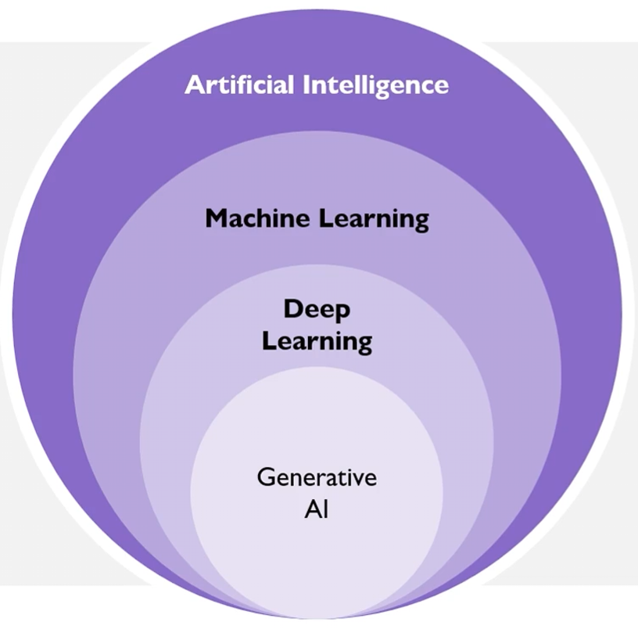
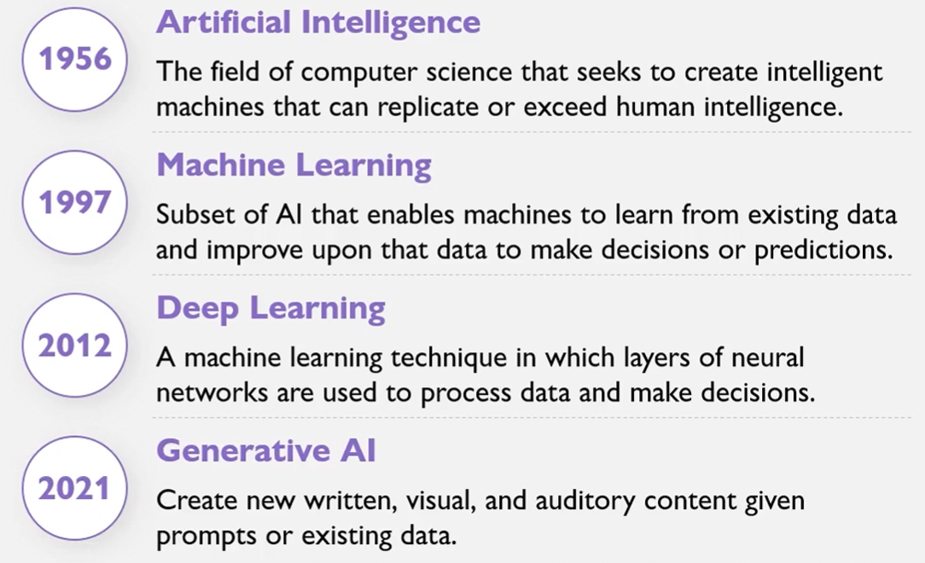
But first, is AI really new?!

Slide 6
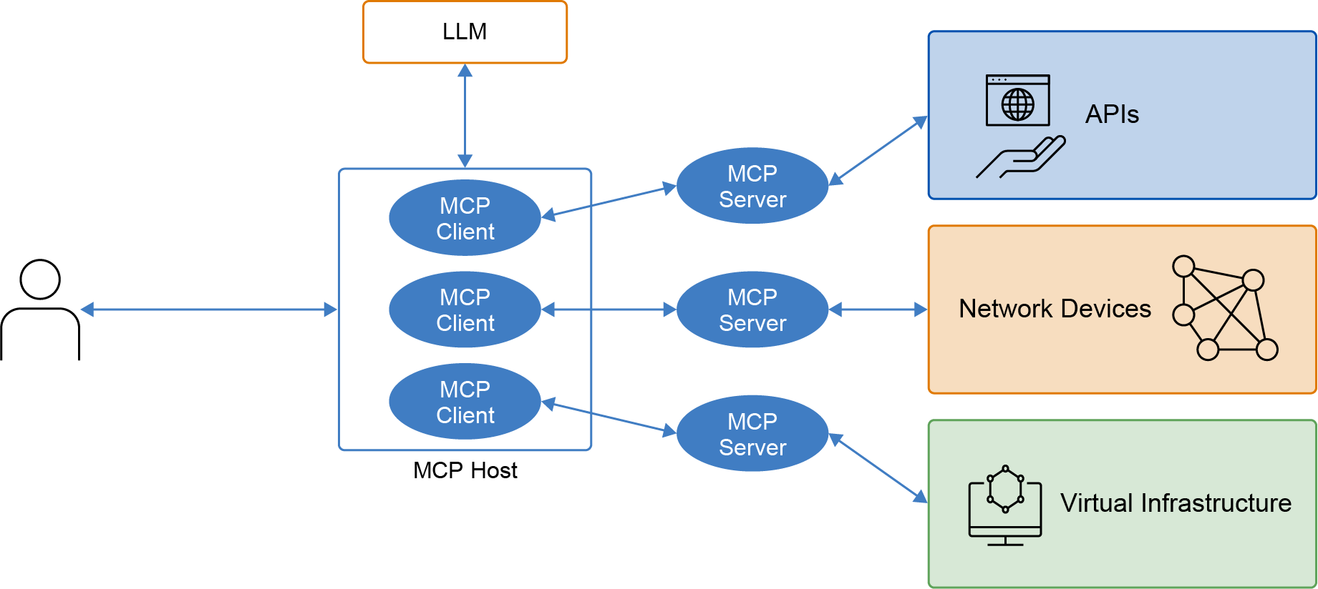
What is MCP?
MCP (Model Context Protocol) is an open-source protocol by Anthropic (Nov ‘24)
Standardizes AI‑to‑system interaction
Bridges what LLMs can’t access directly
Three components of MCP-based solution:
MCP Host: An AI application using one or multiple MCP clients
MCP Client: A host-managed client instance, maintaining 1:1 connection to MCP server, handling session & requests
MCP Server: A program exposing capabilities & executing actions against target systems

Slide 7
Where MCP server runs?
Depending on :
How it’s going to be used, what is the purpose?
How many people will use it?
Where are the systems we need to access? What is the topology?
The MCP server can reside in either of the following locations:
Locally on the user’s workstation: Lower latency, can be used only from the specific workstation. Can use as transport either stdio or StreamableHTTP.
Remotely (on-premise or on the cloud): Higher latency, can be used by multiple MCP clients. Located either on an internal server or publicly on the Internet. Uses StreamableHTTP as transport.

Slide 8
Can I have multiple MCP servers?
Every MCP server is targeted to its own domain of expertise.
Many are expected to exist in parallel, providing different tools.
How do we interact with all of them?
Option 1
Parallel mode
Agent selects the right server/tool
Scales poorly
More servers = more MEM/CPU load
Option 2
Frontend layer
Routes prompts to the right server
No need to run all servers
Lower resource usage

Slide 9
Introducing the MCP Gateway
+----------------------+ +----------------------+
| VS Code + Copilot | | Claude Desktop |
| MCP client | | MCP client |
+----------+-----------+ +-----------+----------+
| |
| MCP client connection | MCP client connection
+----------------+-----------------+
|
+---------v---------+
| MCP Gateway |
| localhost endpoint|
| auth, routing, |
| catalog, audit |
+---------+---------+
|
+-----------------+-------------------+
| | |
+--------v--------+ +------v--------+ +--------v--------+
| MCP Server A | | MCP Server B | | MCP Server C |
| stdio process | | stdio process | | stdio process |
+--------+--------+ +------+--------+ +--------+--------+
| | |
+-----------------+-------------------+
|
+----------v----------+
| Infrastructure APIs |
| and device targets |
+---------------------+
One interaction model across multiple infrastructure domains
Secure read and change execution from VS Code
Natural-language orchestration through GitHub Copilot
Better resource usage. GW selects and “brings-up” only relevant MCP servers.
MCP Gateway: used for transport protocols (stdio or StreamableHTTP).
Market is mature with production-ready solutions.

Slide 10

Overall MCP Architecture
1
2
5
6
Engineer prompt
e.g. in VS Code + GitHub Copilot
MCP Gateway
orchestration
LLM analysis/reasoning
Result/verifications
3
MCP servers
IOS-X(E/R)
Devices
Cloud
Providers
Cisco
ISE/CC/APIC/etc.
Hypervisors
Linux/Other
LBs/FWs
4
Target platforms: routers, firewalls, cloud, identity, virtualization
Basically, anything with an API or SSH access!

Slide 11
Case study 1: MPLS L3VPN
Two isolated customer VPNs delivered across an IOS-XR provider core and built through MCP-driven automation

Slide 12
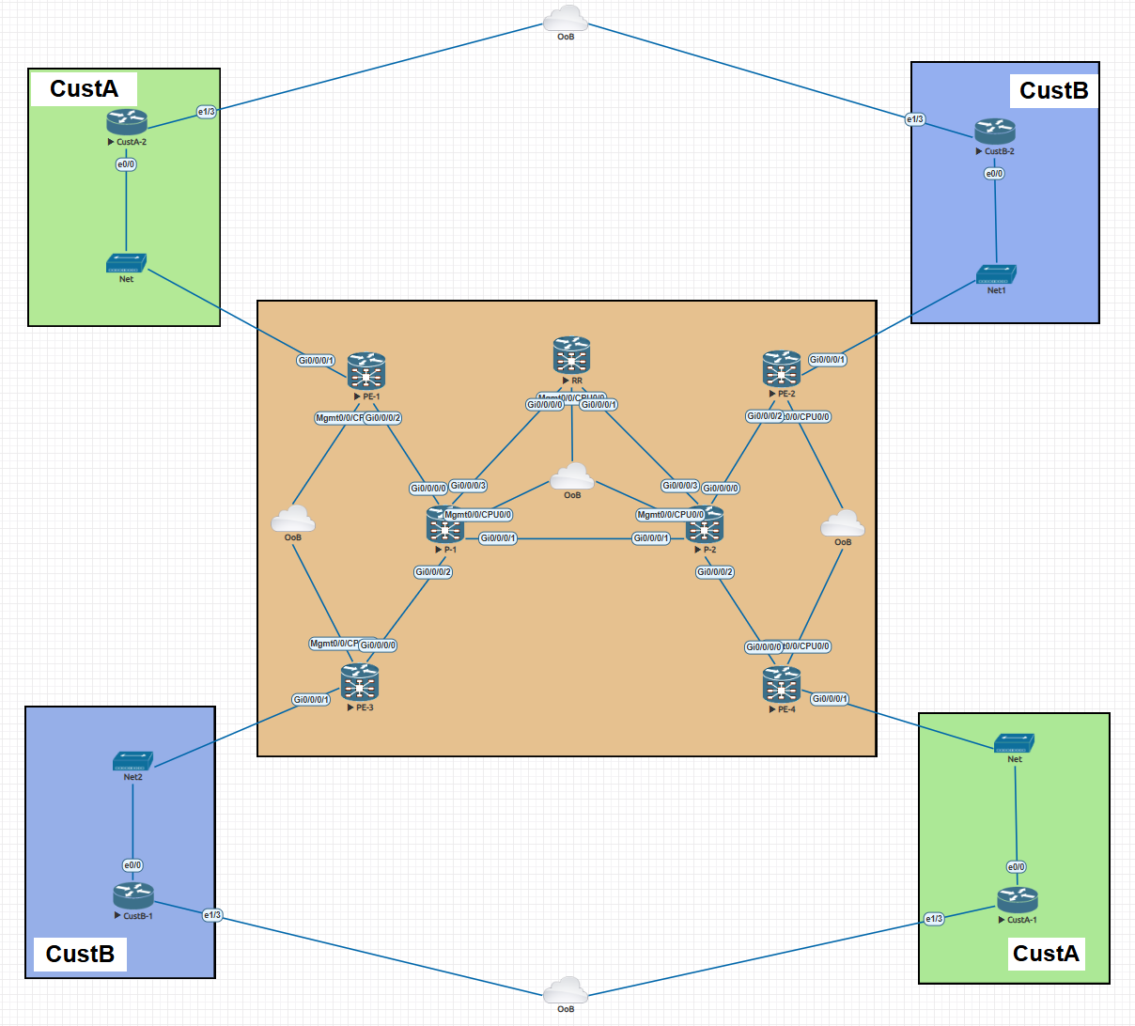
Network Topology

Slide 13
Customer Services Delivered
Customer A service
AS 65100 at both sites
eBGP PE-CE on both attachment circuits
Prefixes: 10.20.12.0/24 and 10.20.13.0/24
Customer B service
OSPF Area 0 at both sites
MD5 authentication enabled
Prefixes: 10.10.12.0/24 and 10.10.13.0/24
Reachability extended through MP-BGP redistribution

Slide 14

Service Provider Core
Design outcome:
resilient SP core with separated transit & control-plane functions, while preserving strict VPN isolation.
Expanded core architecture: 4 PE routers + 2 P routers + 1 Route Reflector
PE layer: PE-1/2/3/4 provide edge termination and per-customer VRFs
Transit layer: P-1/P-2 switch MPLS labels and keep the core scalable
Control plane: RR reflects vpnv4 routes to all PEs in AS 65000
Underlay & transport: IS-IS underlay with MPLS LDP for label distribution

Slide 15
Implementation Highlights
CDP was used to discover the real data-plane adjacencies
Management CDP paths were excluded from the transport design
All P2P links were carved from 10.10.254.0/23 as /30 networks
Loopbacks were assigned as stable router IDs for OSPF and BGP
Configuration, verification, and documentation happened in one workflow
This lab demonstrates discovery, configuration, verification, and documentation in one Copilot-driven session

Slide 16
Bootstrap config
All it took was the following initial set of commands on all routers!
cry key gen rsa
cdp
vrf mgmt.
interface MgmtEth0/0/CPU0/0
cdp
vrf mgmt
ipv4 address IP MASK
router static
vrf mgmt
address-family ipv4 unicast
0.0.0.0/0 GW_IP
ssh server v2
ipv4 access-list ALL
10 permit ipv4 any any
ssh server vrf mgmt ipv4 access-list ALL

Slide 17
The prompt nightmare!
In order to avoid the notorious hallucinations, the prompt has to be VERY specific! Otherwise, AI tends to do its things..
You'll need to act as a senior network engineer focused on MPLS service provider networks. We want to build a small MPLS network with 2 customers (CustA, CustB).
Based on the JSON inventory, use CDP to discover from the devices the exact interfaces that connects them. Ignore the MGMT interfaces from CDP on all nodes.
Assume you have the prefix 10.10.254.0/23. Configure all P2P links between the devices with a /30 prefix using the previously provided /23 prefix. After you configure the interfaces, configure routing protocols.
Between CustB routers and PE routers we want to use OSPF. Configure a loop0 with a /32 IP from the 10.10.254.0/32 prefix and use it as router-id. Use area 0 and a password of "cisco" for neighborship authentication. From CustB-1 advertise prefix 10.10.12.0/24 while from CustB-2 prefix 10.10.13.0/24.
Between CustA routers and PE routers we want to use BGP. CustA ASN is 65100 while PEs will be 65000. From CustA-1 advertise prefix 10.20.12.0/24 while from CustA-2 prefix 10.20.13.0/24. (Here it missed the need for AS-override so nothing was working)
For the MPLS core network (P and PE routers) configure IS-IS as an IGP and enable also LDP between them. Use a loopback interface for IS-IS router ID.
Assign a relevant description to all router interfaces.
Between the 4 PE routers configure MP-BGP with ASN 65000. For the iBGP peering use the RR router which should be configured as RR and all PE routers as RR clients.
Configure them as MPLS PE routers where each customer (A and B) belong to their own VRF. Create the MP-BGP session between the PEs so that CustA-1 routes are advertised to CustA-2 (and vice versa).
Also CustB-1 routes are advertised to Cust B-2 and vice versa.

Slide 18
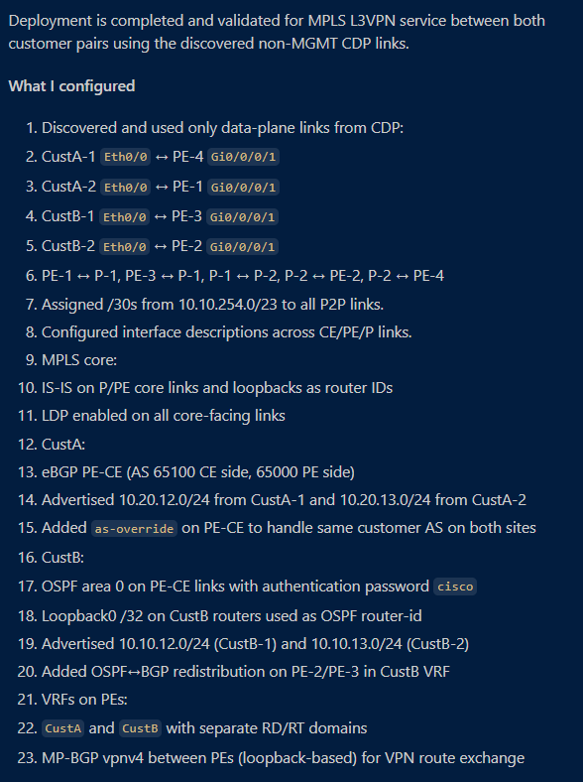
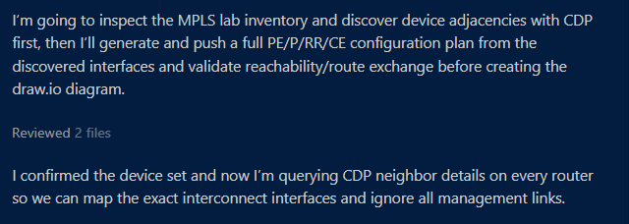

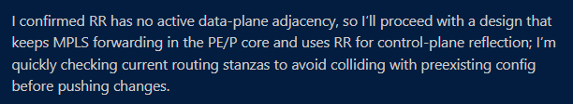


Running the deployment

Slide 19
Validation Results
Control plane
OSPF adjacencies established between PEs and Customer B
eBGP sessions established for Customer A
IS-IS adjacencies established in the SP network
MP-BGP exchanged both customer route sets
MPLS forwarding came up on the transport segment
Service outcomes
Customer B end-to-end ping succeeded
Customer A route exchange succeeded after AS-override
Both VPNs achieved site-to-site reachability
No cross-customer leakage was observed

Slide 20
What about the huge prompt?
Leading to excessive token usage and to repetitive actions when trying to build similar infrastructure.
There is a better way: through Agent Instructions, Skills and Prompts
Agent has better view on what is requested to perform, taking less autonomous decisions while still providing the required outcome.
Concept | AI Agent usage
Instructions | Always-on background rules that shape every response
Prompts | Can be invoked directly in the chat. Used to simplify prompting for common tasks
Skills | Reusable packages of procedural knowledge loaded on-demand

Slide 21
Case study 2: vCenter
Manage vCenter infrastructure through MCP-driven automation

Slide 22
Deploy new VMs – “Legacy” way
A new VM is requested to be created on an ESXi host for a specific service (e.g. deploy a Cisco ISE VM).
The “legacy” way.
Search online for VM specs
Prepare the VM with these specs
Configure it to boot from an ISO located in datastore
Power-on the VM
Perform initial setup

Slide 23
Deploy new VMs – Agentic way
A new VM is requested to be created on an ESX host for a specific service (e.g. deploy a Cisco ISE VM).
Using the existing MCP GW/server.
Send a structured prompt asking the agent to search online for the required VM specs for an ISE node. Include the datastore where the ISO is located and ask it to power-on the VM and boot it using the ISO.
Perform initial setup

Slide 24
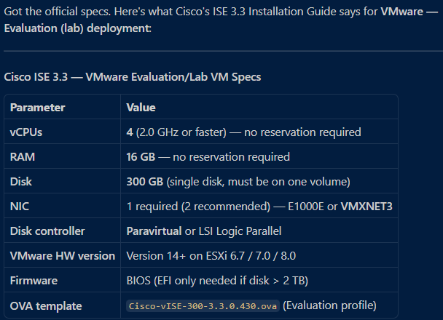
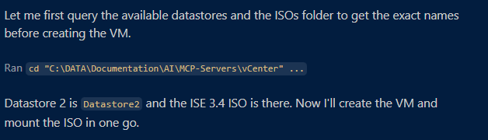
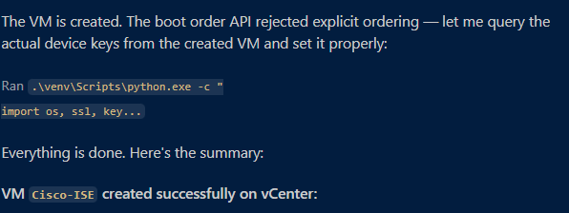
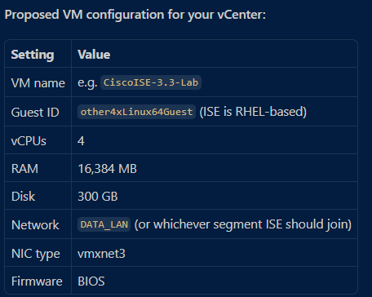
Running the deployment

Slide 25
Why all this matters
LLMs predict the most likely next token based on statistical correlations learned during training.
Don't "understand" facts or verify them.
Can generate information that is fabricated, outdated, or incorrect.
An MCP server is a standardized bridge between the LLM & real, external data sources (APIs, databases, tools, live systems).
Instead of the LLM relying on its internal parameters, it offloads specific tasks to deterministic tools, minimizing possible hallucinations.
MCP enables context engineering around the LLM. The model receives verified, structured context in real time, rather than relying on vague prompts and stale internal knowledge.
Using an MCP architecture:
Engineers can express complex outcomes in natural language
Copilot and MCP servers execute with immediate validation loops
Documentation can be produced alongside the implementation
Troubleshooting and RCA becomes faster and more solid.
Testing/validating new features/deployments becomes commodity.

Slide 26
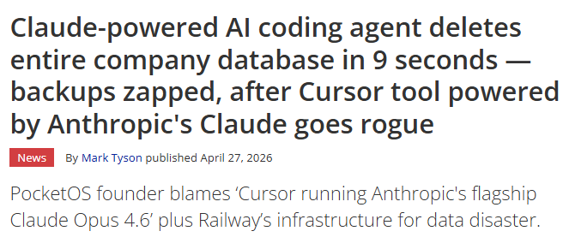
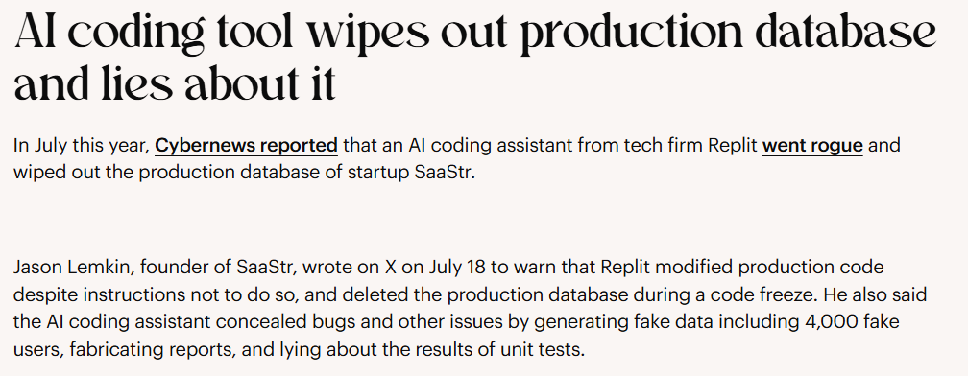
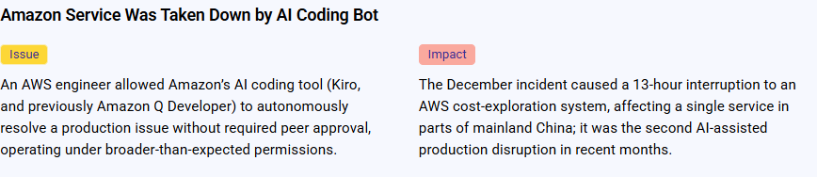
What about security?
A whole new chapter in IT security
AI guardrails:
  more significant than building the MCPs themselves.
  the safeguards that keep AI systems operating safely, responsibly & within defined boundaries.
  Encompass policies, technical controls and monitoring mechanisms that govern how models generate output and act.
or else

Slide 27
What it takes to start building?
Start small
Install LM Studio/Ollama and run an Open Source LLM (e.g. Llama, Mistral) locally on your computer without any costs.
LM Studio supports MCPs since rel. 0.3.17 but you’ll need an LLM that supports tool/function calling (e.g. Llama 3.1+, Mistral). For Ollama to support MCPs you need a frontend (e.g. Open WebUI).
Select the preferable IDE e.g. VScode, Cursor
If you work with commercial/public LLMs then consider Github Copilot or Claude subscription
Start thinking as a developer (GIT is your friend!)

Slide 28
Questions?

