Slide 1
ENHANCING PING AND TRACEROUTE
April 1, 2021

Slide 2
Credits
Developers (Harvey Mudd College)
Ishaan Gandhi
Andreas Roeseler
Spencer Lang
Nick Ludwig
Mentors
Ron Bonica (Juniper Network)
Zach Dodds (Harvey Mudd College)

Slide 3
THE IP OAM TOOLKIT
PING and TRACEROUTE are the most commonly use tools in the IP OAM Toolkit
What do they do?
How do they work?
What can’t they do?
How can they be enhanced?

Slide 4
PING

Slide 5
WHAT DOES IT DO?
Test the liveliness of a reachable interface
Test the liveliness of a reachable node
By testing the liveliness of one of its reachable interfaces

Slide 6
HOW DOES IT WORK?
A probing node sends an ICMP Echo to a probed interface
The probed interface sends an ICMP Echo Reply to the probing node
Nerd Notes
The ICMP Echo may enter the probed node through any of its interfaces
The ICMP Echo reply message may leave the probed node through any of its interfaces
There is no guarantee that that either ICMP message traverses the probed interface

Slide 7
WHAT CAN’T IT DO?
Test the liveliness of less-than-reachable interface
Examples of less-than-reachable interfaces
IPv4 unnumbered
IPv6 unicast with narrowly scoped address (link-local, ULA)
Any interface to which the probing node lacks a route

Slide 8
HOW CAN IT BE ENHANCED? [RFC 8335]
A probing node sends an ICMP Extended Echo Request to a proxy interface
ICMP Extended Echo Request identifies the probed interface
The proxy interface sends an Extended ICMP Echo Reply to the probing node
The extended ICMP Echo Reply reports the liveliness of the probed interface

Slide 9
Proxy
How is interface 3?
Nick’s
Machine
1
2
3
Interface 3 is up.
NL
Notes:
...this motivated Probe. Probe addresses x, y, z by doing a, b, c

Slide 10
RFC 8335 NERD NOTES
The proxy interface can be different from the probed interface
And is different in most cases
The proxy interface must be reachable from the probing node
The proxy interface must reside on one of the following
The same node as the probed interface
A node that is directly connected to the probed interface

Slide 11
Example Usage

Slide 12
SECURITY CONSIDERATIONS
Not enabled by default
Accessible from specified source addresses only

Slide 13
IMPLEMENTATIONS
JUNOS 20.3R1
LINUX Kernel(5.12)
LINUX IP Utils Ping (in progress)
Wireshark (3.4.4)
TCPDUMP (in progress)

Slide 14
TRACEROUTE

Slide 15
WHAT DOES IT DO?
Elicit feedback from each node on the delivery path between a probing interface and a destination interface
Identify nodes along the delivery path

Slide 16
HOW DOES IT WORK?
A probing node sends a series of UDP packets to a destination interface
Sets the TTL to 1 on the first packet, so that it expires on the first node along the delivery path
Increments the TTL on each subsequent, so that it expires on the next node along the delivery path
When a packet expires on a node along that delivery path, that node sends a ICMP Time Expired message to the probing node

Slide 17
NERD NOTES
Regarding the UDP probe messages
By default, on the first packet, the probing node sets the UDP destination port to 33434
Increments UDP destination port on each subsequent packet
Regarding the ICMP Time Expired message
The source address may not identify the interface upon which the UDP probe message arrived
IPv4: Identifies the interface through which the ICMP message left the reporting node
IPv6: It’s complicated. See RFC 6724.

Slide 18
WHAT CAN’T IT DO?
Identify interfaces along the delivery path

Slide 19
HOW CAN IT BE ENHANCED? [RFC 5837]
UDP Probe message is unchanged
ICMP Time Expired message can contain extensions that identify
Interface upon which the UDP probe message arrived
Interface through which the message would have been routed had the TTL not expired
Attributes of those interfaces (name, IP address, MTU)

Slide 20
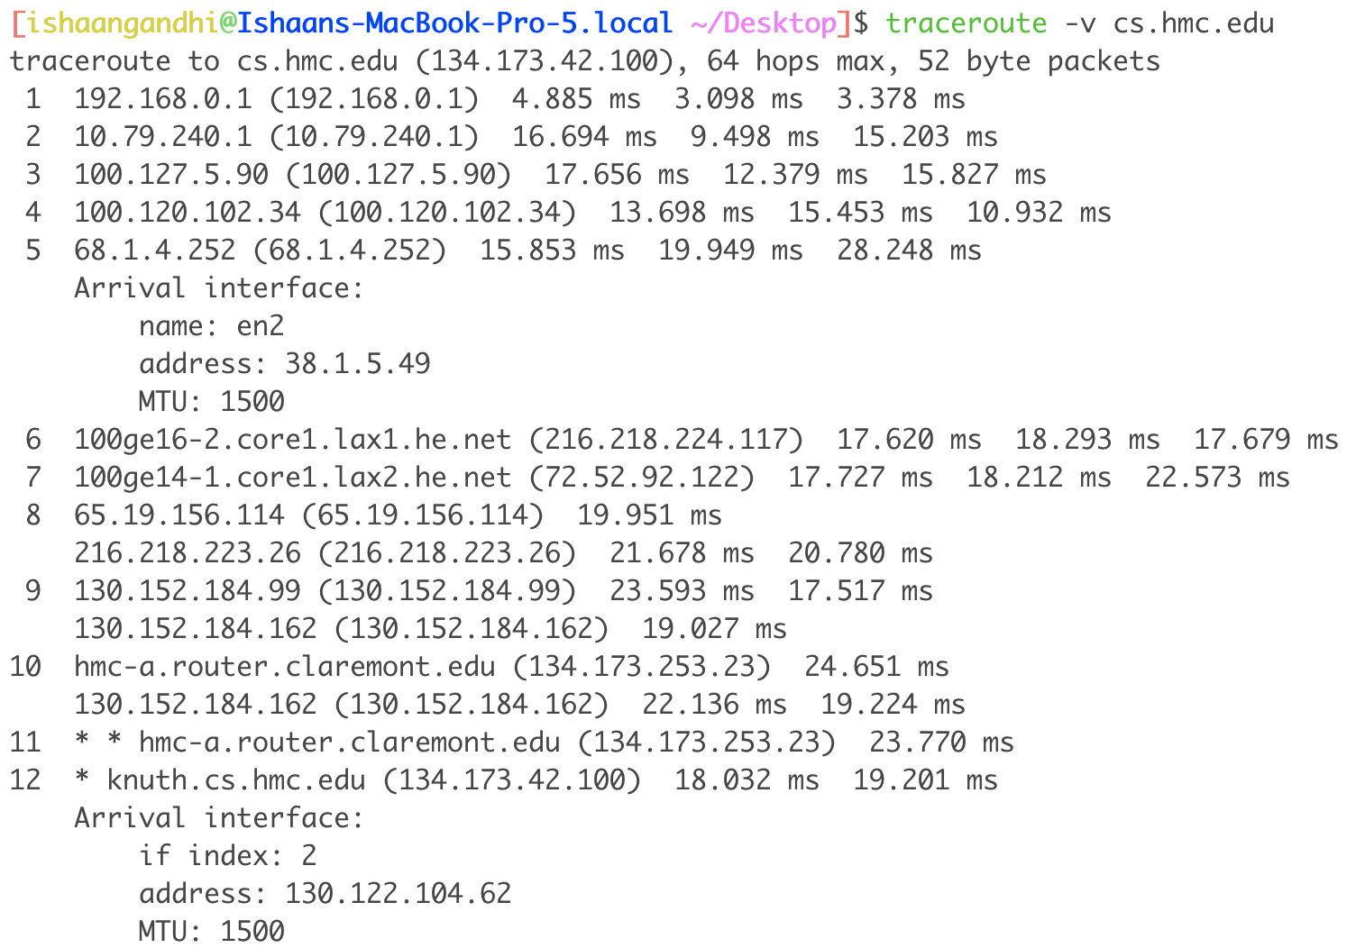
Example Usage

Slide 21
SECURITY CONSIDERATIONS
Not enabled by default
Accessible from specified source addresses only

Slide 22
IMPLEMENTATIONS
JUNOS (in progress)
LINUX Kernel (in progress)
LINUX IP Utils Traceroute (in progress)
Wireshark (3.5)

Slide 23
Ron Bonica, Ishaan Gandhi, Spencer Lang, Nick Ludwig, Andreas Roeseler

